Slide 1
From CLARIN Component Metadata
to Linked Open Data
Matej Durco
Institute for Corpus Linguistics and Text Technology
matej.durco@oeaw.ac.at
Menzo Windhouwer
The Language Archive - DANS
menzo.windhouwer@dans.knaw.nl
LDL@LREC 2014
Reykjavik, Iceland

Slide 3
Outline
CLARIN Component Metadata
  Component Metadata Infrastructure (CMDI)
CMD 2 RDF
  Model
  Profiles and components
  Instances
Some first experiments
Conclusions and future work

Slide 4
CLARIN
CLARIN = Common Language Resources and Technology Infrastructure = an european ESFRI infrastructure project
Aims at providing easy and sustainable access for scholars in the humanities and social sciences to digital language data (in written, spoken, video or multimodal form) and advanced tools to discover, explore, exploit, annotate, analyze or combine them, independent of where they are located.
  Building a networked federation of European data repositories, service centers and centers of expertise.
One pillar of this infrastructure is a joint metadata domain
http://www.clarin.eu/

Slide 5
Component Metadata Infrastructure
Rationale for CMDI
  Limitations of existing metadata schemas (OLAC/DCMI, IMDI, TEI header)
    Inflexible: too many (IMDI) or too few (OLAC) metadata elements
    Limited interoperability (both semantic and syntactic)
    Problematic (unfamiliar) terminology for some sub-communities.
    Limited support for LT tool & services descriptions
  CMDI addresses this by:
    Explicit defined schema & semantics
    User/project/community defined components
    http://www.clarin.eu/cmdi/

Slide 6

CMDI - example
Metadata Profile
Project
Name
Lets describe a
speech recording
Contact
Location
Continent
Country
Address
Actor
Name
Age
Sex (male, female)
Language
Language
Name
Id (aaa … zzj)
Technical
Metadata
Sample frequency
Format
Size

Slide 7
CMDI - example
Metadata Profile
Project
Lets describe a
speech recording
Location
Actor
Metadata schema
(W3C XML Schema)
Language
Technical
Metadata
Metadata description
(XML document)

Slide 8

CMDI - workflow
ISOcat
metadata
catalogue
component
registry &
editor
metadata
modeler
metadata
user
Relation
Registry
search &
semantic mapping
metadata
editor
metadata
creator
Joint metadata
repository
Local
metadata
repository
metadata
curator
metadata
curator
OAI-PMH
Service provider
OAI-PMH
Data provider
DATA

Slide 9
CMDI in CLARIN
 | 2011-01 | 2012-06 | 2013-01 | 2013-06 | 2014-03
Profiles | 40 | 53 | 87 | 124 | 153
Components | 164 | 298 | 542 | 828 | 1110
Elements | 511 | 893 | 1505 | 2399 | 3101
Distinct Data Categories (DCs) | 203 | 266 | 436 | 499 | 737
Metadata DCs | 277 | 712 | 774 | 791 | 1103
% Elements w/o DCs | 24.7% | 17.6% | 21.5% | 26.5% | 24,2%
CMD profiles for existing metadata schemas like OLAC/DCMI, TEI Header and META-SHARE have been created
Profiles differ a lot in structure:
  Small and flat profiles with 5 – 10 elements
  Large and complex profiles of up to 10 component levels with hundreds of elements
More than 670.000 CMD records are harvested from around 60 providers
http://catalog.clarin.eu/vlo/

Slide 10
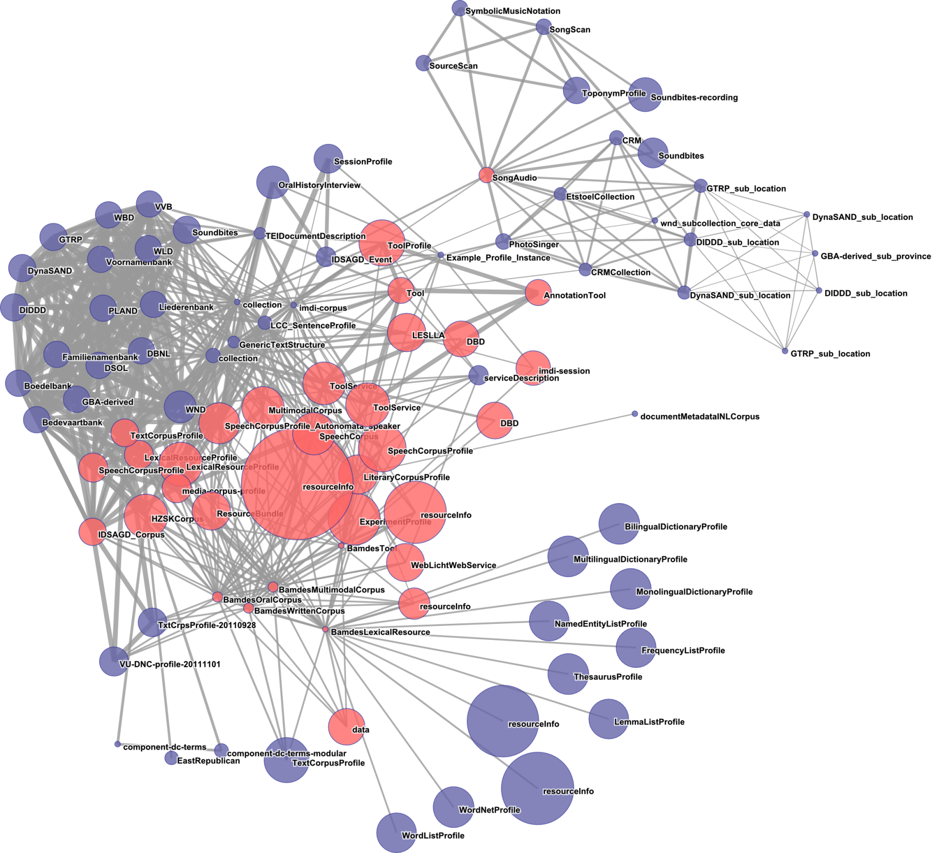
CMD Cloud
By reusing data categories and components a semantic network is created: a CMD cloud with clusters of related resources
  CMD cloud poster + demo, Wednesday, P10, 156
The CMD facetted browser (aka VLO) uses this semantic layer to find facet mappings and deal with the diversity of CMD records
  CLARIN booth, HLT Village
CMDI is based on XML
  Well established core technology in the metadata domain
  Still with the focus on semantics, lets see how it could look in RDF

Slide 11
CMD 2 RDF
To map a CMD record to RDF we need
  A mapping for the basic component model
    Basic classes and properties to represent profiles, components, elements, attributes and their relationships and values
  A mapping for a specific profile or component
    A specific subclass or subproperty of the basic component model
  A mapping for specific metadata records
    Instances of profile or component
    Embedding in common LOD vocabularies

Slide 12
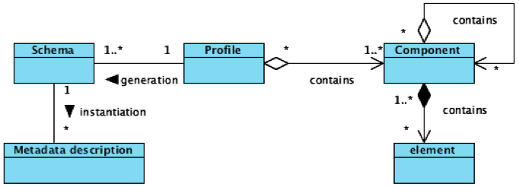
Component Metadata Model
Basic CMD model is described by ISO/DIS 24622-1
  1st part of ISO TC 37 SC 4 3 CMD standards family
Natural mapping to RDF:
  Profiles/components to RDF Classes
  Elements to RDF Properties
Complication
  CLARIN’s CMDI allows attributes on both Components and Elements
    Elements have to be RDF Classes

Slide 13
CMDM 2 RDF
cmdm:contains
cmdm:contains
cmdm:Component
cmdm:Element
rdfs:subClassOf
cmdm:hasElementEntity
cmdm:hasElementValue
cmdm:Profile
cmdm:Entity
cmdm:Value
cmdm:hasAttributeEntity
cmdm:hasAttributeValue
cmdm:Attribute
cmdm:containsAttribute
cmdm:containsAttribute

Slide 14
CR 2 RDF
To foster reuse profiles and components are stored in the Component Registry
  And its REST API provides them with an URI
    http://catalog.clarin.eu/ds/ComponentRegistry/rest/registry/components/clarin.eu:cr1:c_1299509410079
  We reuse this URI+’/rdf’ to identify profiles and components
    Future work: ComponentRegistry will really return the RDF representation

Slide 15
CR 2 RDF (cnt.)
A profile or component can have inner components
  Parameter
    Name
    Description
    Values
      ParameterValue
        Value
        Description
To indicate a specific inner component or element add the dot-path to the profile/root component URI
  http://catalog.clarin.eu/ds/ComponentRegistry/rest/registry/components/clarin.eu:cr1:c_1299509410079/rdf#Parameter.Description
  http://catalog.clarin.eu/ds/ComponentRegistry/rest/registry/components/clarin.eu:cr1:c_1299509410079/rdf#Parameter.Values.ParameterValue.Description
Semantic equivalence of components/elements/attributes/values can be indicated by sharing a ConceptLink (to an ISOcat data category)
→ dcr:datcat

Slide 16
CR 2 RDF (cnt.)
cmdm:Component
isocat:DC-2520
rdfs:subClassOf
dcr:datcat
cmd-c:Parameter
cmdm:Element
rdfs:subClassOf
cmd-c:Parameter.Values
cmd-c:Parameter.Description
cmd-c:Parameter.Values.ParameterValue
cmd-c:Parameter.Values.ParameterValue.Description
cmd-c:Parameter.Values.ParameterValue.Value
cmd-c:hasParameter.Values.ParameterValue.hasValueElementValue
xsd:string

Slide 17
CR 2 RDF (cnt.)
If the value domain is an enumeration (like country code) there is an additional has...ElementEntity object property, which refers to the allowed values using their Component-based URI
  Entities can also have ConceptLinks which can later be used for more extensive mappings
Nesting of Components and Elements is just represented in the instance by the generic cmdm:contains property.
Missing profile specific subproperty? :
  cmd-c:Parameter.containsValues
  rdfs:subPropertyOf cmdm:contains;
  rdfs:domain cmd-c:Parameter;
  rdfs:range cmd-c:Parameter.Values.

Slide 18
CR 2 RDF (cnt.)
cmdm:Element
cmdm:hasElementEntity
cmdm:hasElementValue
cmdm:Entity
cmdm:Value
rdfs:subPropertyOf
rdfs:subPropertyOf
rdfs:subClassOf
cmd-c:ISO639.iso-639-1-code
cmd-c:ISO639.hasiso-639-1-code
ElementEntity
cmd-c:ISO639.hasiso-639-1-code
ElementValue
cmd-c:ISO639.iso-639-1-codeEntity
xsd:string
a
dcr:datcat
cmd-c:ISO639.iso-639-1-codeValue.aa
cdb:CDB-00130489-001

Slide 19
CMD Record
A CMD record consists of
  A header containing Dublin Core-like metadata
  A Resource section pointing to
    The resources being described
    Other CMD Records (modelling a collection)
    A landing page
    A search page
  The Component section governed by the CMD Profile

Slide 20
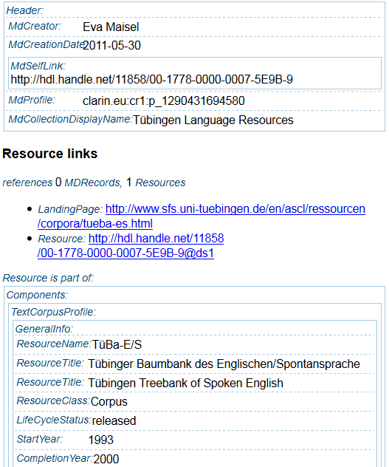
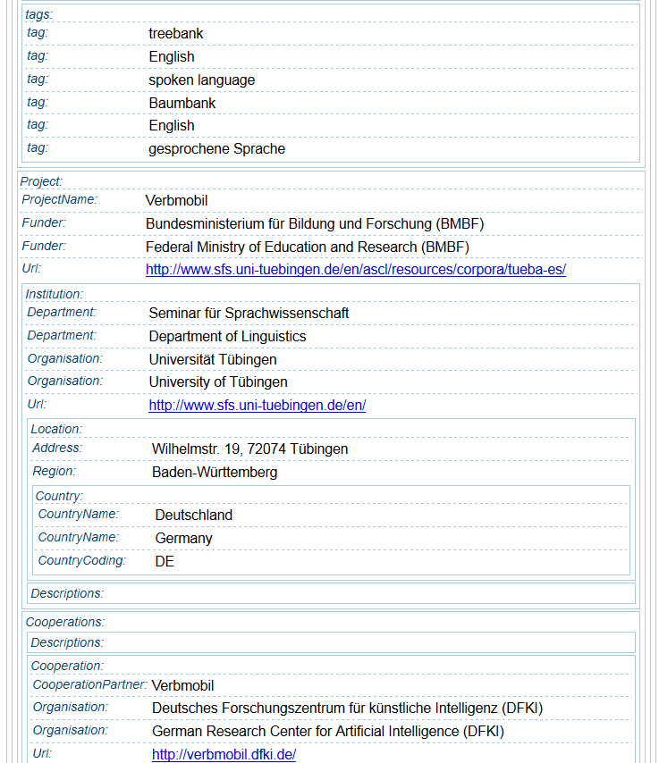
Sample CMD record

Slide 21
Record 2 RDF
Overall structure:
  Components follow the CR2RDF structure of their profile and are the body of an Open Annotation
  The Open Annotation describes the resources (oa:hasTarget)
Header elements become Dublin Core properties of the Component root
Landing and search pages are properties of the Open Annotation
When the CMD record represents a collection (i.e. references other CMD records), it is modelled as a
ORE ResourceMap for these other records
Every CMD records is wrapped into a separate graph
  e.g.:http://www.clarin.eu/cmd/BAS_Repository/
  oai_BAS_repo_Corpora_aGender_100103.rdf

Slide 22
First tests
A sample of ~14.000 CMD records from 18 different providers in 43 different profiles
Uploaded to Virtuoso together with
  the basic model (cmdm)
  CR2RDF (199 profiles and 877 components)
  data categories definitions and RR relation sets
S(i)ample SPARQL queries:
  basic facets: records / language, / profile
  inspect the recursive cmdm:contains predicate
  list existing organisation names (literals)
  usage of data categories
  search via data category (emulate VLO)
http://clarin.aac.ac.at/virtuoso/sparql

Slide 23
Future work
resolve literals to resource links (outbound links)
  i.e. has...ElementValue → has...ElementEntity
  step-by-step for selected predicates
  Organisations → CLAVAS, ?
  Persons → GND, VIAF, dbpedia
  Languages → WALS.info
  allows to ask for resource for languages with given phenomena (e.g. word-order)
  ...?
A CLARIN-NL project to flesh out CMD2RDF has just started ☺

Slide 24
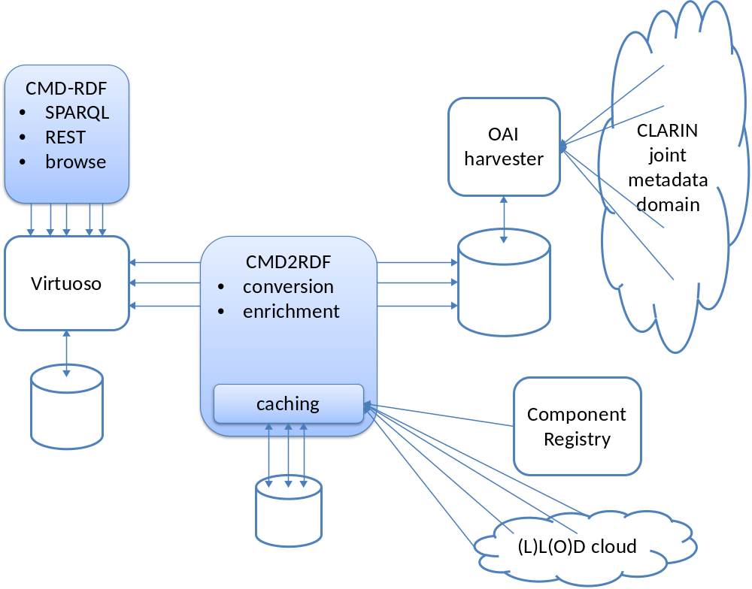
CMD2RDF system architecture

Slide 25
Thanks for your attention!
Questions?
Now or
matej.durco@oeaw.ac.at
menzo.windhouwer@dans.knaw.nl

Slide 26
Sample SPARQL queries
PREFIX cmdm: <http://www.clarin.eu/cmd/general.rdf#>
PREFIX dcterms: <http://purl.org/dc/terms/>
SELECT SAMPLE(?p) as ?profile SAMPLE(?pid) as ?pid COUNT(?i) as ?count
WHERE { ?p rdfs:subClassOf cmdm:Profile.
?p dcterms:identifier ?pid. ?i a ?p. }
GROUP by ?p ?pid ORDER BY DESC(?count)
PREFIX oa: <http://www.w3.org/ns/oa#>
PREFIX cmdm: <http://www.clarin.eu/cmd/general.rdf#>
SELECT ?elemtype ?value where {?rootcomponent a <http://catalog.clarin.eu/ds/ComponentRegistry/rest/registry/profiles/clarin.eu:cr1:p_1290431694579/rdf#LexicalResourceProfile>.
?rootcomponent cmdm:contains* ?comp.
?comp cmdm:contains ?elem.
?elem a ?elemtype.
?elem ?haselemvalue ?value.
?elemtype rdfs:subClassOf cmdm:Element.
FILTER( isLiteral(?value))
FILTER( regex(?value,'.'))
}

Slide 27
CMDM 2 RDF
@prefix cmdm: <http://www.clarin.eu/cmd/general.rdf#>.
# basic building blocks of CMD Model
cmdm:Component a rdfs:Class .
cmdm:Profile rdfs:subClassOf cmdm:Component .
cmdm:Element a rdfs:Class .
# basic CMD nesting
cmdm:contains a rdf:Property ;
rdfs:domain cmdm:Component ;
rdfs:range cmdm:Component , cmdm:Element .
# values
cmdm:Value a rdfs:Literal .
cmdm:hasElementValue a rdf:Property ;
rdfs:domain cmdm:Element ;
rdfs:range cmdm:Value .
# add a parallel separate class/property for the resolved entities
cmdm:Entity a rdfs:Class .
cmdm:hasElementEntity a rdf:Property ;
rdfs:domain cmdm:Element ;
rdfs:range cmdm:Entity .

Slide 28
CMDM 2 RDF (cnt.)
# Attributes
cmdm:Attribute a rdfs:Class .
cmdm:containsAttribute a rdf:Property ;
rdfs:domain cmdm:Component , cmdm:Element ;
rdfs:range cmdm:Attribute .
cmdm:hasAttributeValue a rdf:Property ;
rdfs:domain cmdm:Attribute ;
rdfs:range cmdm:Value .
cmdm:hasAttributeEntity a rdf:Property ;
rdfs:domain cmdm:Attribute ;
rdfs:range cmdm:Entity .

Slide 29
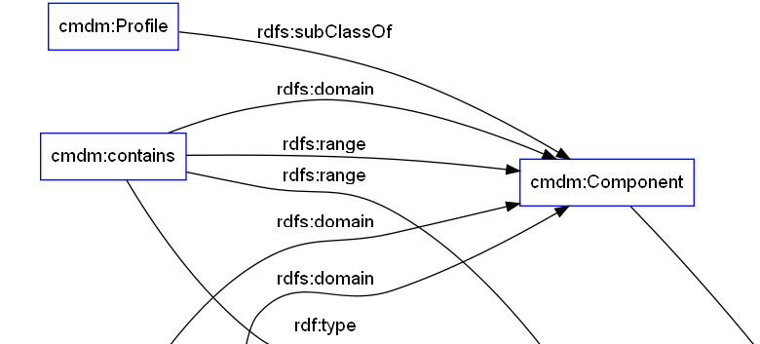
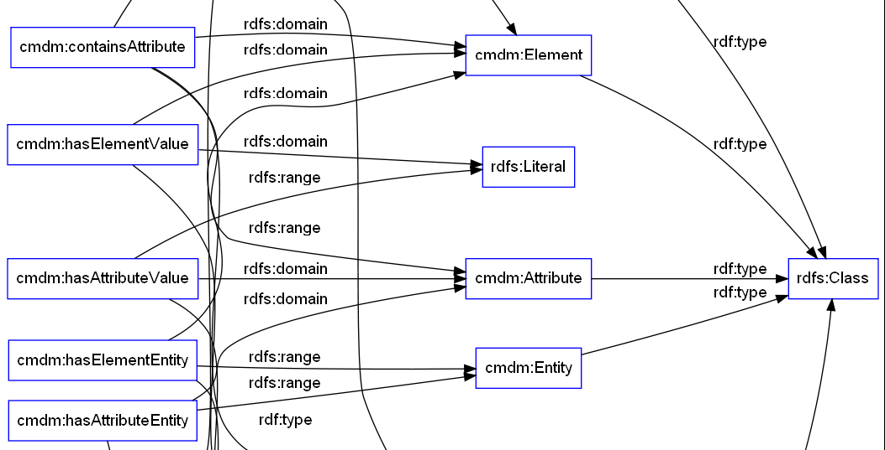
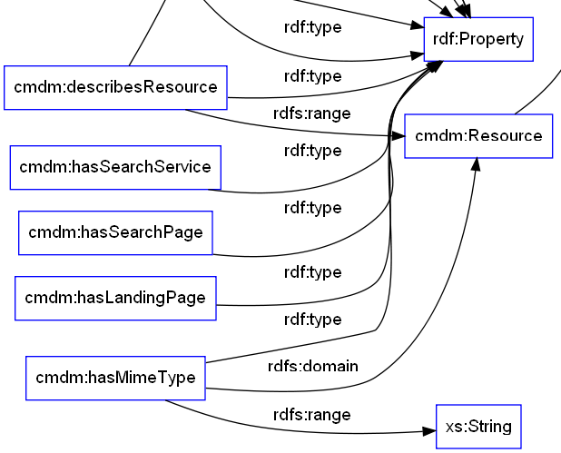
CMDM 2 RDF (cnt.)

Slide 30
CR 2 RDF (cnt.)
@prefix cmdm: <http://www.clarin.eu/cmd/general.rdf#>.
@prefix <http://www.isocat.org/datcat/>.
@prefix cmd-p: <http://catalog.clarin.eu/ds/ComponentRegistry/rest/registry/components/clarin.eu:cr1:c_1299509410079/rdf#>.
cmd-p:Parameter rfds:subClassOf cmdm:Component;
rdfs:label “Parameter”.
cmd-p:Parameter.Description rfds:subClassOf cmdm:Element;
rdfs:label “Description”;
dcr:datcat isocat:DC-2520.
cmd-p:Parameter.Values rfds:subClassOf cmdm:Component.
cmd-p:Parameter.Values.ParameterValue rfds:subClassOf cmdm:Component.
cmd-p:Parameter.Values.ParameterValue.Description rfds:subClassOf cmdm:Element;
rdfs:label “Description”;
dcr:datcat isocat:DC-2520.

Slide 31
CR 2 RDF (cnt.)
cmd-p:Parameter.Values.ParameterValue.Value
rfds:subClassOf cmdm:Element.
cmd-p:hasParameter.Values.ParameterValue.hasValueElementValue
rdfs:subClassOf cmdm:hasElementValue;
rdfs:domain cmd-p:Parameter.Values.ParameterValue.Value
rdfs:range xsd:string.
If the value domain is an enumeration there is an additional has...ElementEntity that has a range a Class from which each value (which gets a Component-based URI) is a subclass
  Entities can also have ConceptLinks which can later be used for more extensive mappings
Missing? Nesting of Components and Elements is just represented by the generic cmdm:contains property
  cmd-p:Parameter.containsValues rdfs:subClassOf cmdm:contains; rdfs:domain cmd-p:Parameter; rdfs:range cmd-p:Parameter.Values.

