Slide 1
Report on the ISOcat project
Marc Kemps-Snijders
Menzo Windhouwer
Peter Wittenburg
Sue Ellen Wright

Slide 2
Overview
DCR implementation
DCR organization
DCR output formats and applications
DCR neighbourhood planning

Slide 3
Overview
DCR implementation
  ISOcat introduction
  Demonstration & tutorial
  Planning
DCR organization
DCR output formats and applications
DCR neighbourhood planning

Slide 4
ISOcat introduction
ISOcat is
  the reference implementation of ISO 12620:2009
  the DCR implementation to be used by TC37
  the successor to SYNTAX
ISOcat provides
  a state-of-the-art web user interface
  a RESTful Application Programming Interface

Slide 5


ISOcat system architecture
client
client
tool
tool
web user interface
web interface
REST API
REST API
SOAP API
SOAP API
control access
control access
manage session
manage session
manage
manage
manage
manage
manage
manage
manage
manage
data category
user profile
comments
selection
workflow
balloting
access
access
administrator
access data
administrator
access data
manage system
manage system
core DCR services
core DCR services
mirror
mirror
DBMS
DBMS

Slide 6

ISOcat demonstration

Slide 7
What is missing?
Standardization workflow
Share DC(S)s
  DC(S) locking mechanism
Commenting DC(S)s
  embed existing forum service
Search private DCs
  generate list of all accessible DCs for a user
Advanced query interface
  also to be used to implement a user’s own checking rules
Storing user preferences
…
Focus was/is on functionality, not yet on performance

Slide 8
ISOcat Planning-1
Fix SYNTAX import process
Actual migration from SYNTAX to ISOcat
  Warn users and shut down SYNTAX
  Get fresh data dump from SYNTAX
  Actual data cleanup starts.
TDGs use ISOcat
  TDG’s must validate existing data categories
  Add missing functionality (e.g., sharing DC(S)s)
  Report and fix any bugs
Supporting TDGs and implementing the standardization workflow
  Finish ISO 12620:2009
Open up ISOcat to the general public

Slide 9
ISOcat Planning-2
Initiate TDG reappointment process via SC 3 secretariat
Reappoint TDG members
  Dependent on people signing up via the survey
Embedding ISOcat in its neighbourhood
  Mirror sites
  Open source environment
  Other registries

Slide 10
ISOcat tutorial
Caveats:
  Firefox 3 has been the most stable, however, is poorly interactive with larger profiles/DCSs
  In the past Internet Explorer 7 became instable after some time, however, I didn’t experience the problem for a while now
  Don’t edit one Data Category concurrently (by logging in twice), as this may lead to lost updates
  Concurrently generating large DCIF documents has been reported to be problematic (but we may try …)
Problems or ideas:
  Help facility will be setup in the form of a forum
  File a bug report/feature request at:
    http://sourceforge.net/tracker/?group_id=244572
Notes:
[SEW] We haven’t had any problems with IE, but then again we haven’t gotten in there and worked with huge files. But Dave has pushed some pretty big ones I think.
Concurrent editing: this is a perennial problem with entry-style database management (lexicography and terminology management). We usually have a freeze mechanism: if one person opens a DC specification to edit it, no one else can edit that item. But actually, we should prevent anyone but the TDG chairs or the DCRB chair from editing the master specs. People should have to pick the item, save it to their own DCS, and edit from there. Then the changes can be proposed through the standard worksflow process. Of course, this doesn’t prevent an individual from messing up and opening his/her own spec more than once.
Recommendation for nearly concurrent DCIF processing: if the system is busy with one DCIF, it will signal that it is busy. Wait a few minutes and try again. Be patient. I’ve not seen it crash.

Slide 11
ISOcat tutorial

Slide 12
Discussion
What functionality do you miss?

Slide 13
Overview
DCR implementation
DCR organization
  TDG organization
  Guidelines for DC specifications
  Procedures for reviewing existing DC specifications
  Procedures for adding new DC specifications
DCR output formats and applications
DCR neighbourhood planning
Notes:
[SEW] I’ve been thinking seriously about going to “DC specifications” in the document as well. What do you think? I get tired of “data category specification” over and over again.
[MAW] Sounds good to me ☺

Slide 14
TDGs and activities
TDG 1: Metadata
TDG 2: Morphosyntax
TDG 3: Semantic Content Representation
Activity 1: Discourse Relations
Activity 2: Dialogue Acts
Activity 3: Referential Structures and Links
Activity 4: Logico-semantic Relations
Activity 5: Temporal Entities and Relations
Activity 6: Semantic Roles and Argument Structures
TDG 4: Syntax
TDG 5: Machine Readable Dictionary
TDG 6: Language Resource Ontology
TDG 7: Lexicography
TDG 8: Language Codes
TDG 9: Terminology
Activity 1: General Principles
Activity 2: Concept Modeling
Activity 3: ISO Terminology Entries
Activity 4: Benchmarking Terminology
Activity 5: Terminology Management
Activity 6: TBX
Activity 7: TBX-Basic
Activity 8: Other TBX/TMLs
Activity 9: Geneter
Activity 10: TMS
TDG 11: Multilingual Information Management
TDG 12: Lexical Resources
TDG 13: Lexical Semantics
TDG 14: Source Identification

Slide 15
TDGs and activities in ISOcat
In ISOcat each TDG has been created
Each TDG owns a profile with the same name
For each Activity we can create
  An (ad-hoc) group of experts
  An (public) DCS (owned by the TDG)
  An profile related to the TDG

Slide 16
TDG Authorization
Current TDGs have been officially created by resolutions passed in their respective SC plenaries.
Theoretically, TDGs could also be created at the TC level, although 12620 does not explicitly provide for this.
Current TDGs shall be reconfirmed reconstituted after the Tilburg meetings.
Members will be officially reappointed.

Slide 17
Ramifications
TDG chairs SHALL (MUST, HAVE TO!) fill in a description for their TDGs in the TDG survey.
Individuals need to indicate their continued interest in working with their assigned TDG so that their SCs will reappoint them.

Slide 18
Guidelines for DC specifications
English “self name” and mnemonic identifier
  DCR Guidelines
  Set XML rules
  XML best practices for names
Definitions
  ISO 704 best practices for writing rigorous definitions
  ISO 12620 presentational style as compared to ISO 704 terminology style
  Defining data category concepts
  Avoiding tautologies within definitions and with respect to data element names
  Coordinating definitions for shallow concept systems (closed DCs + their value domains)
  Finding coordinate data categories in other TDGs and proposing harmonization strategies

Slide 19
Procedures for reviewing existing DCs
Select small DCSs grouping closely related DC specifications together (such as a closed DC + the simple DCs in its value domain).
Review the DC names to ensure that they following proper naming rules and guidelines. Enter the name in the English Language Section.
Provide the obligatory +note in the English Language Section.

Slide 20
Reviewing existing DCs-2
Check the definitions for:
  Proper definition form
  Consistency among simple DC definitions for simple DCs dependent on the same closed DC
  Absence of internal tautology or repetition of terms from the DC name
  Consistency with definitions for the same basic DC defined by other TDGs
  Possibilities for harmonization among similar DC specifications
Notes:
[MAW] “Consistency among simple DC …” may clash with sharing simple DCs in multiple value domains. DC specifications should be context insensitive, as they can be reused in very different contexts (application specific DCSs, in the case of simple DCs other value domains).

Slide 21
Switching from SYNTAX to ISOcat
Import issues
  Sometimes the type of the DC has to be guessed.
    Lack of explicit field code for DC type in SYNTAX data
    A DC typed as open may actually be a closed or a simple DC
  Some “bogus” DC specs need to be weeded out.
Cleanup process
  Check result:
    Most of the time the now mandatory English note is missing
    Demote some of these errors?
  Standardized DCs can’t be edited:
    Reassign them to an expert, and fast track them later through the standardization process using change requests?

Slide 22
Discussion
How do you envision the switch from SYNTAX to ISOcat?

Slide 23
Overview
DCR implementation
DCR organization
DCR output formats and applications
  Embedding DC persistent identifiers (PIDs) in schemata and other resources
  DCS-based templates for schemata/resources:
    XML Schema/Relax NG, RDF(S)/OWL, ...
    DCIF-based stylesheets: constructing ISOcat XSLT stylesheets plug-ins to generate other schema/resource templates, e.g. TBX-based templates
DCR neighbourhood planning

Slide 24
DC Persistent Identifiers
The DCR provides ‘cool URIs’ to the data category specifications
  http://www.isocat.org/datcat/DC-1708
  For more information on cool URIs, see http://www.w3.org/Addressing/
The Registration Authority of ISO 12620.2009 guarantees the persistence of these URIs.
The non-mnemonic syntax of the URIs was chosen to meet the requirements of PID frameworks, and to prevent ‘semantic rot’.
The ‘DC-’ prefix is used for private DCs, while the ‘ISO-DC-’ prefix is used for standardized DCs.

Slide 25
Data Category PIDs
To be able to leverage the power of the DCR, linguistic resources should now be annotated with these DC PIDs.
  In general the PIDs will be embedded in the schema of the resource.
  The desired result is to ensure server-side resolution of the PID and delivery of the actual content of the referenced DC specification.

Slide 26
Embedding DC PIDs – built in
Some schema languages have built-in facilities to embed the PIDs
  ODD
    <elementSpec ident="pos">
    <equiv name="partOfSpeech"
    uri="http://www.isocat.org/dc/ISO-DC-1345"/>
    <!-- additional specifications here -->
    </elementSpec>
  XCS (only complex DCs)
    <datCatSet>
    <termNoteSpec name="animacy
    datcatId="http://www.isocat.org/dc/ISO-DC-78">
    <contents datatype="picklist" forTermComp="yes">
    animate inanimate otherAnimacy
    </contents>
    </termNoteSpec>
    </datCatSet>

Slide 27
Embedding DC PIDs – DC Reference
The DC Reference XML vocabulary can be used to annotate schemas or resources without built in facilities:
  Relax NG:
    <element name="identifier" dcr:datcat="http://www.isocat.org/datcat/DC-8">
    <data type="string"/>
    </element>
  XML Schema:
    <xs:element name=“identifier">
    <xs:annotation>
    <xs:appinfo>
    <dcr:datcat pid="http://www.isocat.org/datcat/DC-8"/>
    </xs:appinfo>
    </xs:annotation>
    </xs:element>
  …

Slide 28
Embedding DC PIDs - RDF
RDF has its own DC Reference statement:
  <rdf:Property rdf:about=“http://www.isocat.org/ns/dcr.rdf#datcat">
  <rdfs:subPropertyOf
  rdf:resource="http://www.w3.org/2002/07/owl#sameAs"/>
  </rdf:Property>
To be used to annotate a RDF resource:
  <rdf:Description rdf:about="http://example.com/app/myId">
  <dcr:datcat rdf:resource="http://www.isocat.org/datcat/DC-8"/>
  <rdfs:label xml:lang="en">Identifier</rdfs:label>
  </rdf:Description>
  Note: no choice has been made yet for the resource to be a RDF class or property

Slide 29
DCS-based templates
To encourage the embedding of DC PIDs the DCR supports various export templates which can be instantiated for a specific DCS:
  DCIF (implemented)
  Basic RDF (implemented)
  Relax NG (planned)
  XML Schema (planned)
  OWL (planned)
  XCS (planned)
  ODD (planned)
  …
Notice: in most cases this will result in a template which the user can download and has to complete further by putting the data categories in their application specific context
Later ISOcat may support uploading an annotated schema and check its validity against the DCR (as long as the used patterns are recognizable)

Slide 30
Alternative RDF/OWL patterns
:headword
dcr:datcat <http://www.isocat.org/datcat/DC-258> ;
rdfs:label "head word"@en ;
rdfs:comment "A lemma heading a dictionary entry."@en ;
rdfs:label "lemma"@nl ;
rdfs:comment "Het eerste woord van een artikel in een woordenboek."@nl .
:partOfSpeech
dcr:datcat <http://www.isocat.org/datcat/DC-396> ;
rdfs:label "part of speech"@en ;
rdfs:comment "A category assigned to a word based on its grammatical and semantic properties."@en .
DCs become either a class or property:
:headword a rdfs:Class .
:partOfSpeech a rdf:Property ;
rdfs:domain :headword .
DCs become classes:
:headword a rdfs:Class .
:partOfSpeech a rdf:Class.
:hasPartOfSpeech a rdf:Property ;
rdfs:domain :headword
rdfs:range :partOfSpeech .
:noun a partOfSpeech .
Notes:
[MAW] The parts in blue indicate connections between the DCs related classes/properties that the user will have to recreate. The DCR doesn’t contain information about these relationships. And to support the construction of these relationships would make the plug-in model too complex. Notice however, the retention of the relationship between the partOfSpeech class and the noun class, which is a conceptual domain relationship stored in the DCR.

Slide 31
DCIF-based plug-ins
The DCS export formats are based on the DCIF export of a DCS
Some export formats may require the user to make some choices between various possible patterns:
  OWL: will the DC be a property or a class?
  OWL: how will the value domain of a complex DC be mapped?
  XCS: on which level should the DC appear?
  XSD/RNG: which name in which language to use for a value (simple DC)
  …
A plug-in system is under development to support this, which will allow to store these choices together with a DCS
  global and local (DC specific) properties
  XSLT 1 or 2 stylesheets stored in ISOcat or accessed remotely
  remote procedure call
  …

Slide 32
Requirements for DCR plug-ins
Generated templates should faithfully represent the relationships in the DCR:
  between complex and simple DCs (value domains)
  (optionally?) between simple DCs (is-a relationships)
When possible also constraints should be supported
  embed constraints in a fitting rule language
    OWL plug-in: SWRL
    RNG: schematron
    …

Slide 33
Discussion
What export formats do you miss?

Slide 34
Overview
DCR implementation
DCR organization
DCR output formats and applications
DCR neighbourhood planning
  Mirrors of the TC37 DCR
  Separate DCR instances (e.g., TBX meta-data categories)
  Other types of registries (e.g., relation registries)

Slide 35
Mirrors of the TC37 DCR
Several instances of ISOcat TC37 instance will be (virtually) sharing the same database
Mirrors intend to be created at
  MPI - The Netherlands
  KAIST - Korea
  MITRE – US (?)
  BRANDEIS – US (?)
The idea is that databases will be coupled using a PostgreSQL replication mechanism, e.g., Slony-I

Slide 36
Separate DCR instances
ISOcat is open source and will be available on sourceforge
  see http://sourceforge.net/projects/isocat/
Using the software other DCR instances can thus be created
  for other domains
  for ‘meta data categories’
  …
Notes:
Will those DCR instances still be ISO 12620.2 complaint?
[SEW] Not necessarily if sourceforge folks tweak the software – but that’s the strength and risk of SF
[MAW] Well we’re the owners of the project, so not everyone can edit ISOcat. However, someone may download and make a incompliant fork. However, my questions was more related to the items I added above, which an other instance may skip or even can’t officially have …

Slide 37
‘meta data categories’
Definition of a data category:
  result of the specification of a given data field
In a data model you’ve ‘containers’ which contain ‘data fields’
  UML: classes contain attributes
  Relational databases: tables contain fields
  Data-centric XML documents: inner nodes and leaf nodes
  TBX: …
Can you create data categories for the ‘containers’?
  Are those complex data categories?
  Are they open/closed/constrained?
  If so what would be their data type?
  Or do we need a separate data category type?
  May some data categories function in some applications as ‘containers’ in others as ‘data fields’?
Will people expect data categories for the ‘containers’?
Do we keep the TC37 DCR ‘pure’?
  And store the ‘container’ concepts in the Relation Registry …

Slide 38
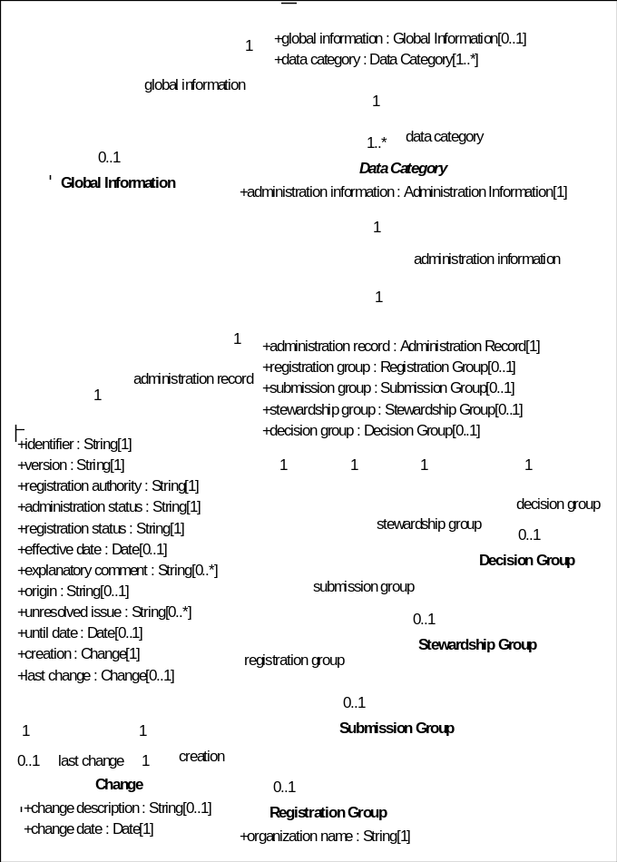
UML diagram

Slide 39
Other registry types
Relation registries
MPI RR
Typological Database System
RR
Data category registries
MPI
DCR
ISO
DCR
Linguistic resources
MPI
archive
resource
TDS
database
Notes:
[SEW] What is the TDS RR? Be sure to tell people.
[MAW] It’s meant to represent a different Relation Registry, i.e., one that contains the meta date from Typological Database System … but yes this will have to be explained while showing the slide …

Slide 40
Relation registry
A relation registry contains relationships between two or more data categories
These relationships can be stored in various ways:
  (fuzzy) equivalence
  resource schemas
  taxonomies
  ontologies
  …
The registry can be populated manually, but also through some (machine learning) algorithm
Registries may have different levels of trust
The more semantic context the relationship encodes, the more effectively it can be utilized to determine semantic overlap

Slide 41
Utilizing the registry network
If there is a set of common APIs an agent can traverse the network to identify semantic overlap, or help an user to understand a resource
  A researcher finds an interesting resource in the MPI archive, and asks the agent to find similar resources. The agent crawls the network:
    The set of MPI DCR DCs related to the MPI resource
    A RR provides equivalence of some of these DCs with DCs from the TC37 DCR
    A cluster of the TC37 DCs appear in a common semantic context specified in the TDS RR
    Resources within this context in the TDS thus have a high chance of being of interest to the researcher

Slide 42
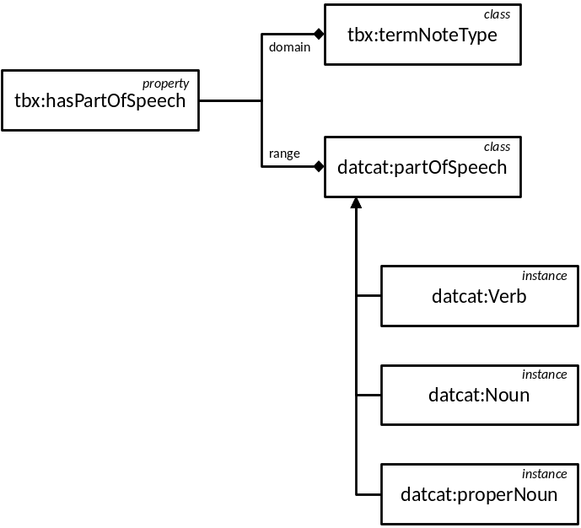



Registry network
Relation registries
Data Category registries
resource registries

Slide 43
Discussion
How do you envision the (interaction in the) neighbourhood in which the DCR will operate?

