Slide 1


Adventures with the Owl and the ISOcat
Expressing DATCAT Relations in and around the dcr
Sample experiments
Sue Ellen Wright
MPI Relation Registry Workshop
January 8, 2009

Slide 2

The Owl and the Pussycat
The Owl and the Pussy-Cat went to sea
In a beautiful pea-green boat:
They took some honey,
and plenty of money
Wrapped up in a five-pound note.
http://the-office.com/bedtime-story/owlpussycat.htm

Slide 3
Relations Issues
Relations limited inside the DCR
Modeling needs reflected in multiple ontological views (No one ideal model)
Class / property / instance / restriction, etc., assignments
OWL DL or OWL Full
Resolving Q-names to DCR PIDs (real URIs) (owl:sameAs; other options)
Containers – in DCR or no?
Resolving references to successor DC specs for updated standard DC specs*
PID links with the CDB, particularly for language codes & language tags*
  *Not treated in detail
Notes:
The TC 37 Metadata Registry, which is referred to as the Data Category Registry

Slide 4
Limited Expression of Relations
Intentionally limited relations capability inside DCR
Expression of closed DC / Value Domain values declared in Conceptual Domain section of DC specification
Expression of shallow “isA” relations between simple DCs in an enumeration
E.g, /abbreviation/, /acronym/, /initialism/ → /abbreviated form/
Appears as declaration in simple DC specification; tree display in the “Context of this data category” view
Notes:
ISOcat purposefully excludes the expression of multiple relations between complex data categories or the expression of merely “related data categories” of any type. The only relations that can be expressed inside the DCR are:
Parent / child relations between closed data categories and their enumerated value domains
Limited “isA” relations between subsets of simple DCs and their broader (less granular) pseudo-siblings within a long flat list of simple DCs (for /abbreviation/, /acronym/, and /initialism/ are all more granular instances of /abbreviated form/, although they are listed in a flat list for pragmatic reasons when modeled in terminological databases.

Slide 5
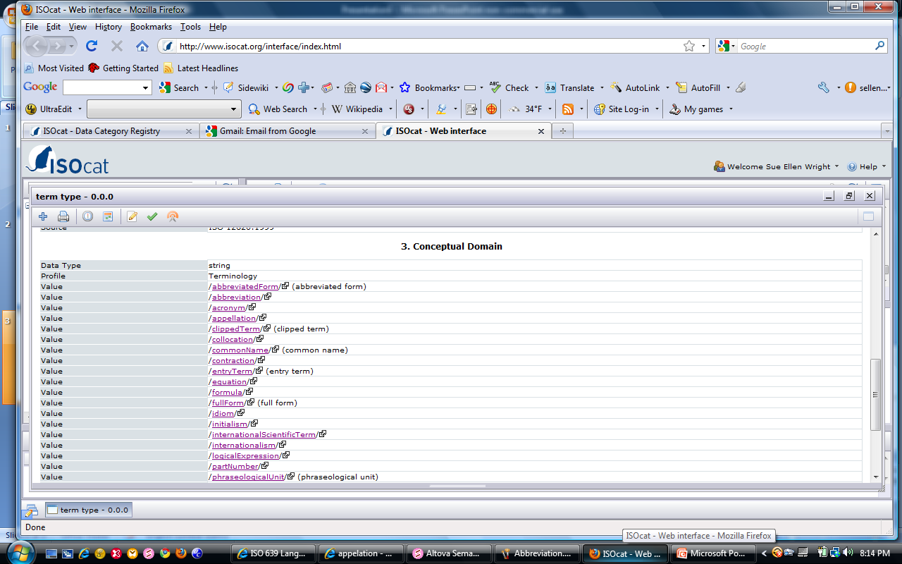
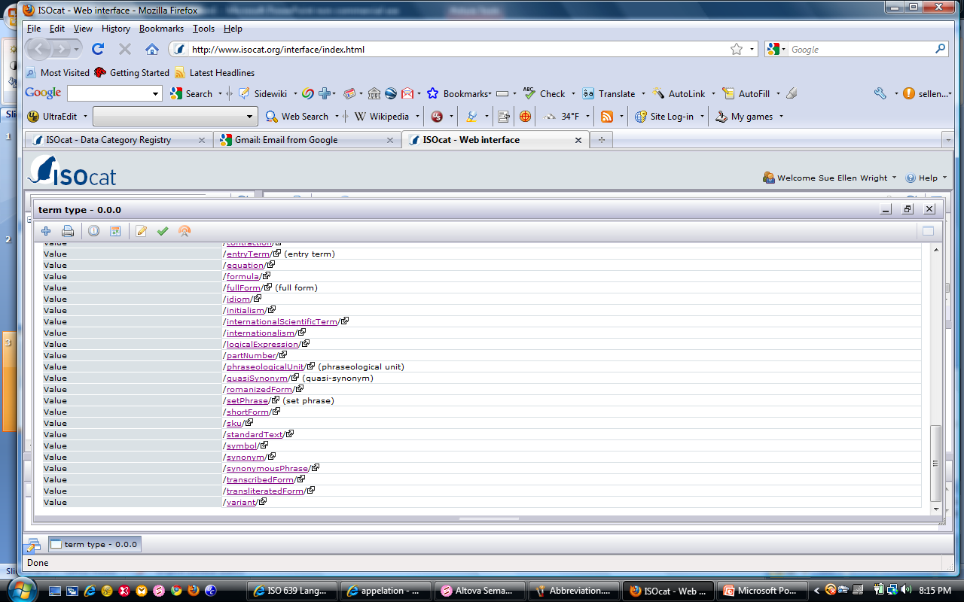
Value Domain for /term type/
Value Domain display in Conceptual Domain segment of DC specification for Closed DC /term type/

Slide 6
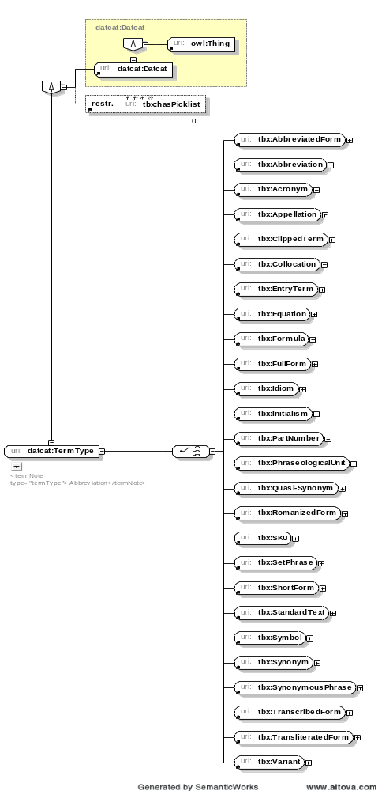
datcat:TermType modeled as per TBX flat representation
Values appear here as (OWL) tbx:(Instances)
rdfs:subclassOf
owl:OneOf
OWL Assertion: DC Term Type has instances tbx:AbbreviatedForm … tbx:Variant.
Notes:
TBX enumerates a set of values for /Term Type/, which could well be differentiated into several different groups of values. They are all reported in TBX as values of one overarching data category for pragmatic reasons: working terminologists do not want more than a small handful of items fill in in their data models. At times there is a need to indicate more than one of these values, which is accommodated by making the DC iterative at the interface level.
Here I have modeled /term type/ inside an ontology I started last year for representing data categories strictly within the data model structure of TBX, as opposed to the way they might be modeled when viewed from a standard linguistic representation.
For practicality’s sake, the simple datcats here are all modeled as tbx:instance, which leaves us free to use datcat:SimpleDatCat names as parallel class names. If we stay in OWL full, we could equate them with owl:sameAs declarations, although I’d like to come up with a way to get back to DL.

Slide 7
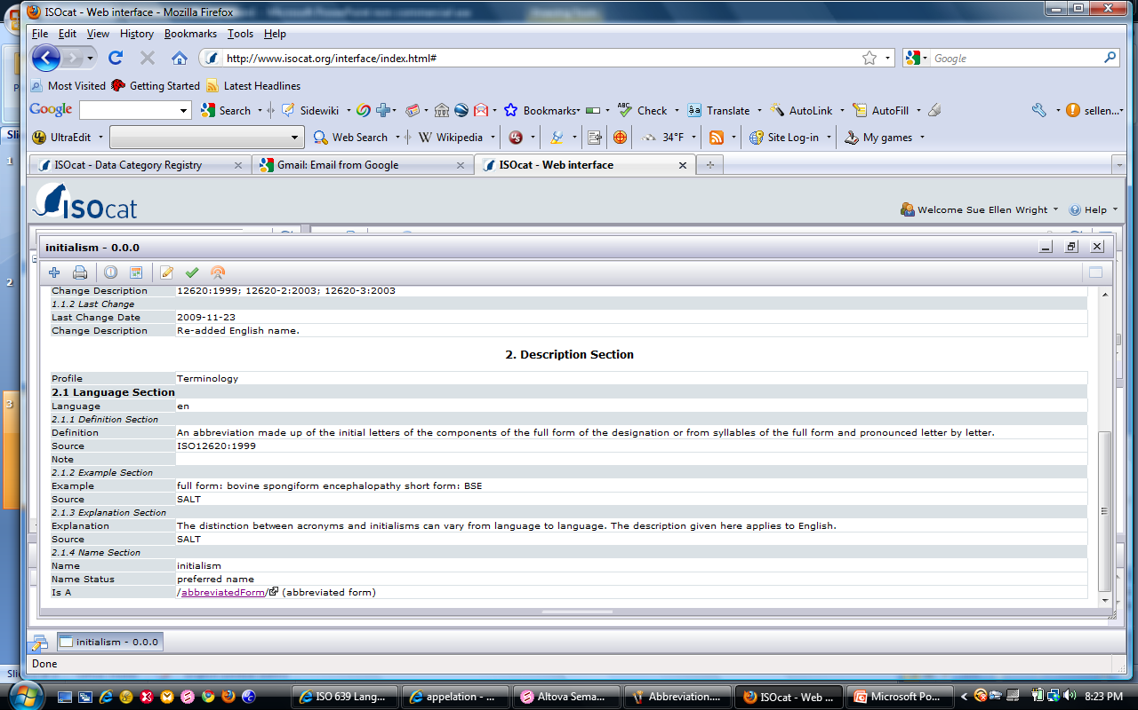
“IsA” Relations
Limited sub-categorization of simple DCs
/initialism/ “is A” /abbreviated form/
/abbreviated form/ is a subset of /term type/
Notes:
One can declare that /initialism/ “is a” /abbreviated form/, but the only place this appears in the DCR is in Description Section for the child DC. One cannot display the full tree with all the various subsets and their members nor see this declaration in any other way looking down from the “parent” simple DC.

Slide 8
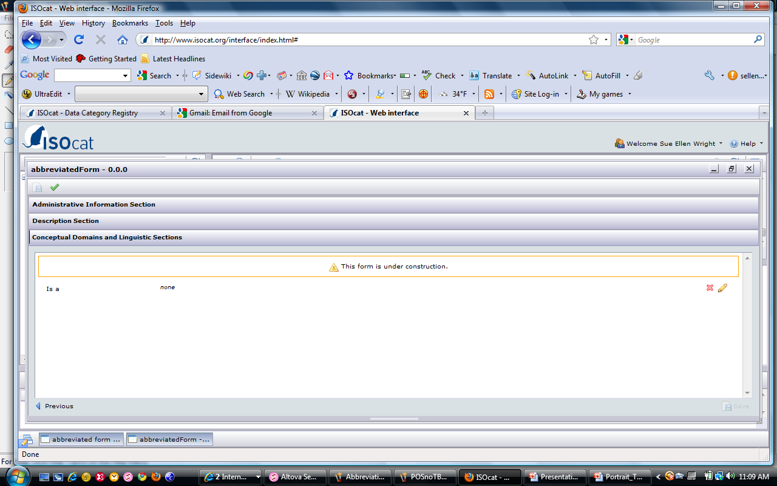
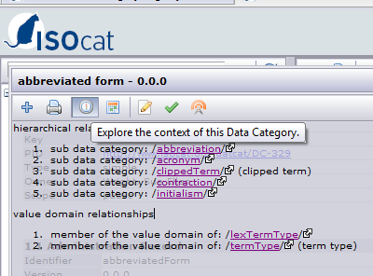
From parent to child
Child DCs do not appear in the edit window or standard display, but are viewable in the context view pop-up.
Not shown in edit display
Click on (!) icon (Explore context …) to display relations.
Notes:
Menzo: something I’ve been wanting to know – why do “clipped term” and “term type” appear the way they do in parentheses? I only see this for some DCs, but obviously not for all. I haven’t been able to figure out where it comes from.
Another question: is there any way to track the DCSs that have been created that contain a given DC?

Slide 9
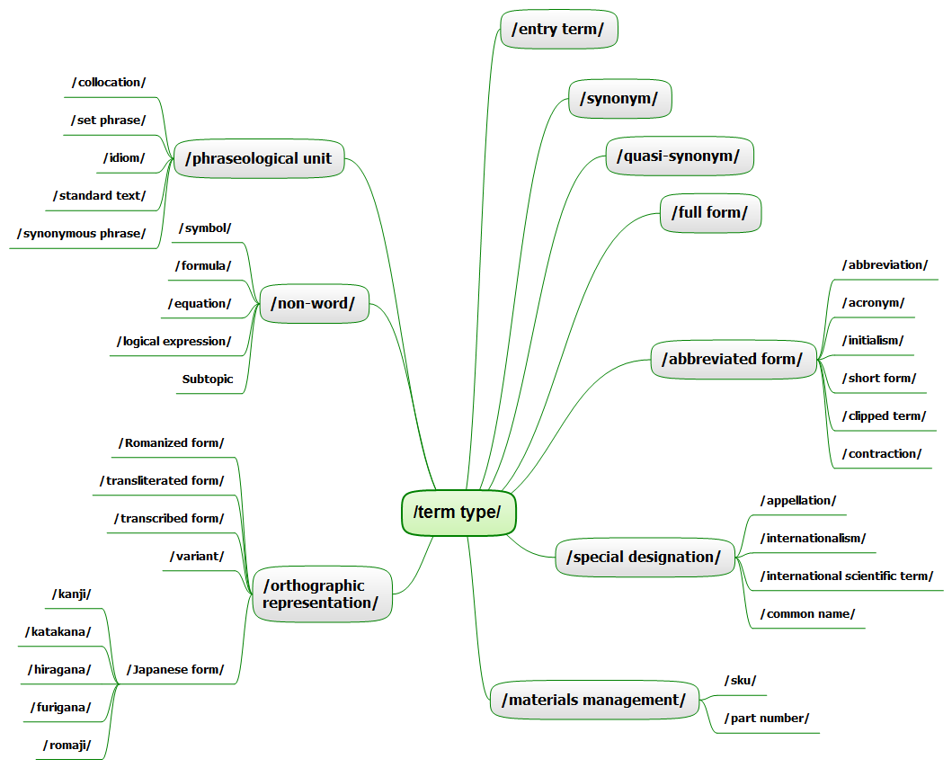
Multiple Levels Not Displayed
◆

❖
⬥
/term type/ DCs subsetted according to subordinate categories, resulting in four levels of abstraction
Notes:
It is not, however, possible to display the full tree for all instances of datcat:TermType. Note here that we can express each individual level in that terminals can be declared as “isA” objects associated with the next higher level, but we can’t put the whole picture together inside the DCR, nor can we express similar relationships between complex DCs or between DCs and containers. For this we need to move outside the DCR to some other environment, probably OWL.

Slide 10
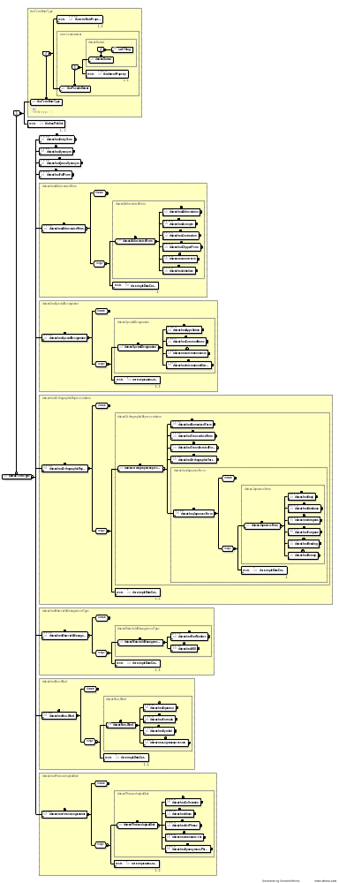
OWL Assertion: datcat:TermType has instances tbx:abbreviated form … variant, which can be structured to reflect sub-categories of simple DCs.
The DCR does not display the full tree
datcat:TermType modeled to reflect sub-categories
Values are modeled as DatCat classes
Values as properties of datcat:TermType
Notes:
But I can model the relations that exist (as I see them for my purposes) if I use some sort of external modeling tool. Here I’ve developed an OWL ontology, originally starting in OWL DL, which I prefer. Currently the DCR rdf output pushes out to OWL Full.

Slide 11
rdfs:subclassOf
Values expressed as properties
datcat:AbbreviatedForm/ broken out into more granular DCs
Sub-categories of datcat:AbbreviatedForm

Slide 12
Term-Type sub-categories of datcat:SpecialDesignation and datcat:OrthographicForm
Notes:
In order to further articulate the sub-sets within the flat list of simple data categories, I added intermediate levels for:
/special designations/ (/appellation/, /common name/, /internationalism/, /international scientific term/)
/orthographic representation/ (Romanized form/, /transcribed form/, /transliterated form/, /orthographic form/, /Japanese form/
/Japanese form/ broken down into: /kanji/, /katakana/, /hiragana/, /furigana/, /romaji/
(Note: DC names from the DCR are not capitalized generally, but OWL classes are. Consequently some notations look inconsistent.)

Slide 13
Sub-categories of datcat:MaterialsManagement, datcat:Non-word, and datcat:PhraseologicalUnit
Notes:
In order to further articulate the sub-sets within the flat list of simple data categories, I added intermediate levels for:
/materials management/ (/part number/, /sku/)
/non-word/ (equation/, /symbol/, /formula/, /logical expression/)
/phraseological unit/ (/collocation/, /set phrase/, /idiom/, /standard text/, /synonymous phrase/)

Slide 14
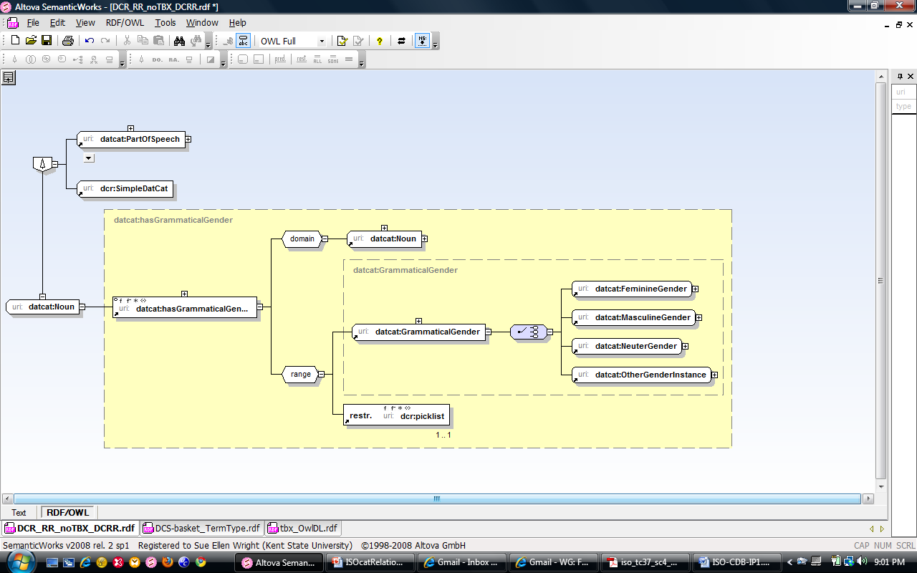
“Noun” Modeled for Grammar
Data modeling variance: /noun/ modeled for TBX is different than /noun/ modeled for conventional grammar

Slide 15
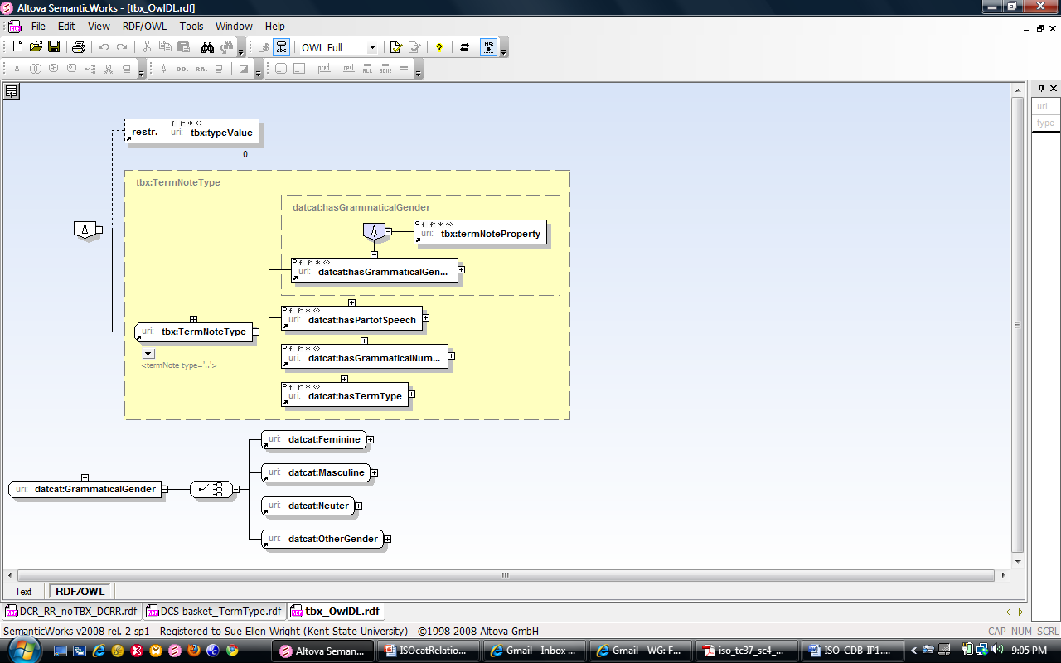
TBX Modeling Variant
TBX: /grammaticalGender/ is a property of the /term/, and /noun/ is a value of /partOfSpeech/, but the two aren’t modeled together.

Slide 16
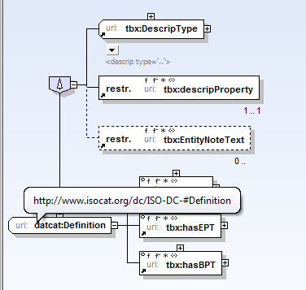
Modeling TBX & DCs
Need for meaningful Q-names
Declaration of meaningful class name instead of PID
Modeling choice pre-dates current PID structure
Notes:
The current Q-names are not real resolvable URIs

Slide 17
Real Persistent Identifiers
Output as RDF from ISOcat for any declared DCS (OWL full)
Output as OWL instances, showing the true non-mnemonic URIs / ISOcat PIDs
Challenge: link to meaningful Q-names & design a way to resolve the link for interoperable access to ISOcat entries from OWL resources
Sample:
<?xml version="1.0"?>
<rdf:RDF … [resource declartions] … >
<rdf:Description rdf:about="http://www.isocat.org/datcat/DC-329">
<dcr:datcat rdf:resource="http://www.isocat.org/datcat/DC-329"/>
<rdfs:label xml:lang="en">abbreviated form</rdfs:label>
<rdfs:comment xml:lang="en">A term or lexeme resulting from the omission of any part of the full term or lexeme while designating the same concept.</rdfs:comment>
</rdf:Description> …
</rdf:RDF>

Slide 18
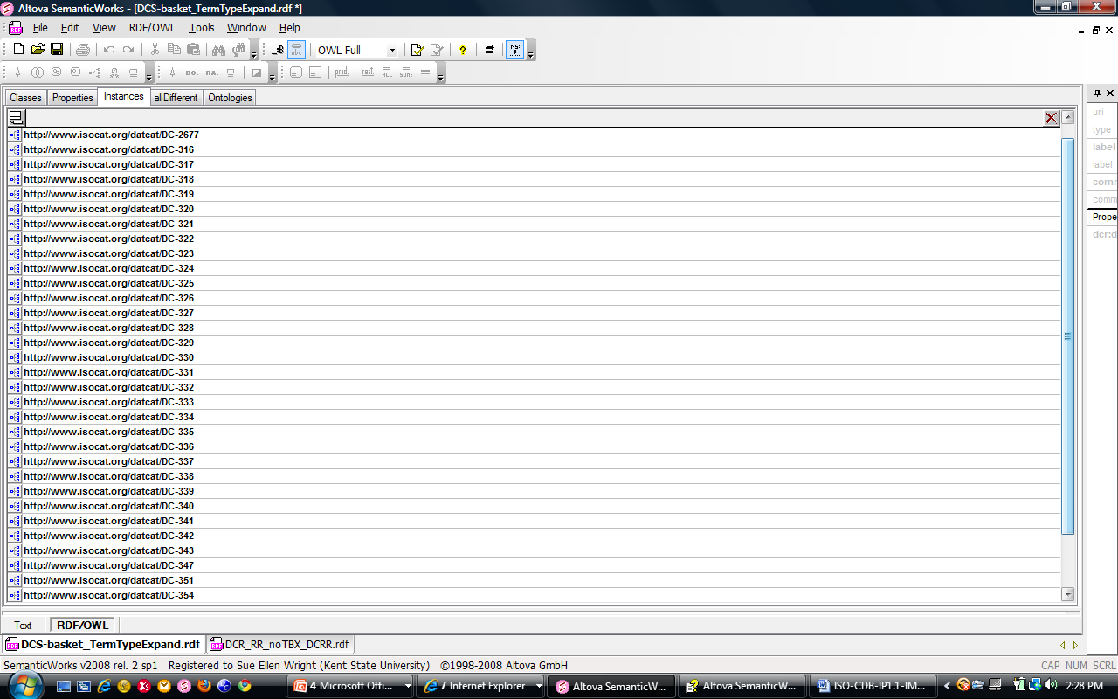
/term type/ PIDs
PIDs for the /term type/ and its value domain
Current representation is OWL Full compliant, breaks OWL DL.
Notes:
Issues: The PIDs that are output in the RDF output from ISOcat are resolvable to the individual DC specifications in ISOcat, but they are not user-friendly for anyone modeling concepts in an OWL resource. As shown here, they are output as OWL Instances.

Slide 19
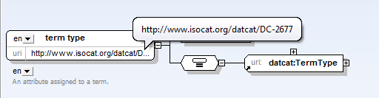
Individual Instances
Graph mode for OWL instance /term type/
PID in theory resolvable back to ISOcat
owl:sameAs assertion points to the OWL class object “TermType”
We could treat the URLs as owl:properties , in which case we might be able to stay in DL, but we might not be able to pack in all the info that’s there now.
owl:sameAs
Notes:
Although Menzo says these can also be properties, Altova interprets them as instances. But we could explore how to quickly convert them to properties. This is something to think about in the future when we have a little more time.

Slide 20
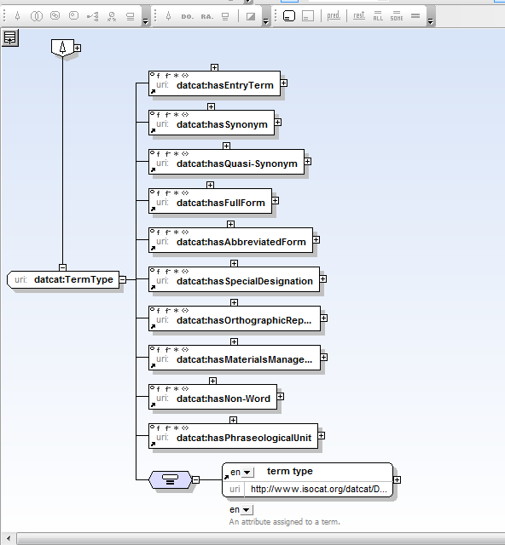
owl:sameAs
owl:sameAs links the instance URL to the OWL entry for the class datcat:TermType
Issue: Requires OWL Full to do this
(Option)
owl:sameAs
Notes:
Simple solution: Declare as identical using owl:sameAs
Problem: Only possible in OWL full

Slide 21
Resolution?
How do we instantiate the link in order to have a resolvable relation?
RESTful web interface?

Slide 22
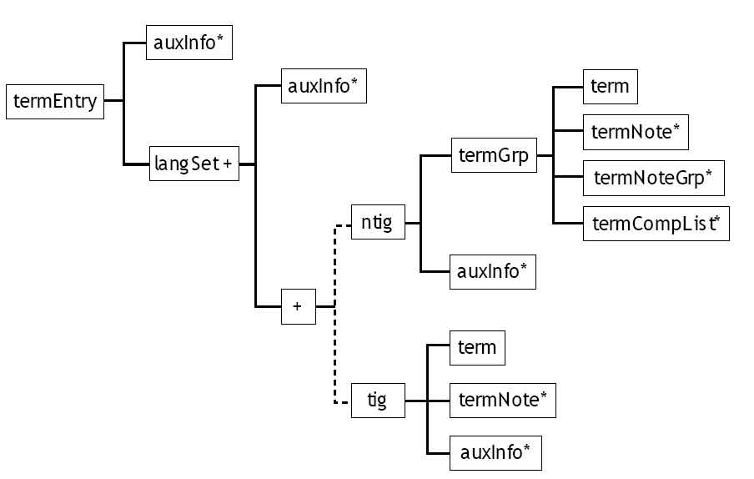
TBX Containers
“Pseudo-datcats” = super-classes created to represent logical lacunae in the current system
TBX meta data categories, containers
= datcat:TermInfoSlot
datcat:AuxInfo (collector)
datcat:SubAuxInfo (subset of AuxInfo)
+
Notes:
“Box with a plus sign in it” = TermInfoSlot
AuxInfo = TBX entity; not a real container in the actual markup
SubAuxInfo = AuxInfo – (descrip + descripGrp)

Slide 23
Containers Not in ISOcat
Initial decision to keep ISOcat “pure”
Suggestion that groups model container DCs (e.g., TBX /termEntry/, /auxInfo/, /adminGrp/, etc.) in external DCRs
Recent requests for containers from Annotation Framework work groups
TEI legacy?
Solution sought …

Slide 24
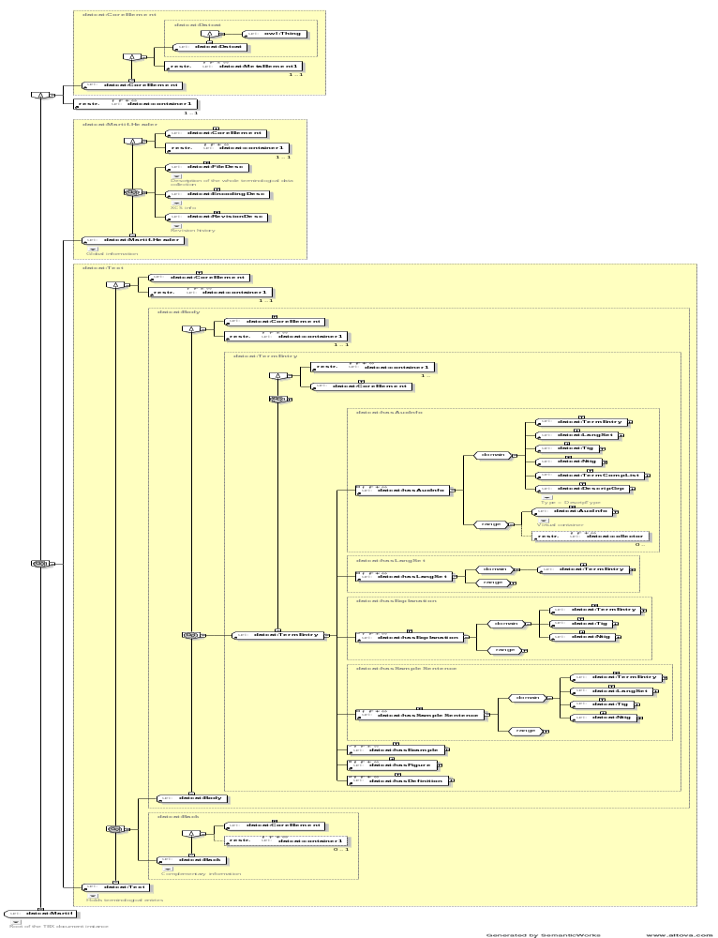

Containers inside of containers – many of which are not in ISOcat
Notes:
I’m sorry about the resolution here. It looks ok in Word, but is illegible in ppt. Maybe you can get copies made of the Word paper to hand out. I go on to show detailed elements below.

Slide 25
AuxInfo
AuxInfo is a TBX CoreElement
Has property restriction MetaElement
Has property restriction collector
Has cardinality 0.. [in any given position = UML 0 … *]
Is Pseudo-Datcat (a container)
IsUnionOf:
  Descrip, DescripGrp
  Admin, AdminGrp
  TransacGrp
  Note, Ref, Xref

Slide 26
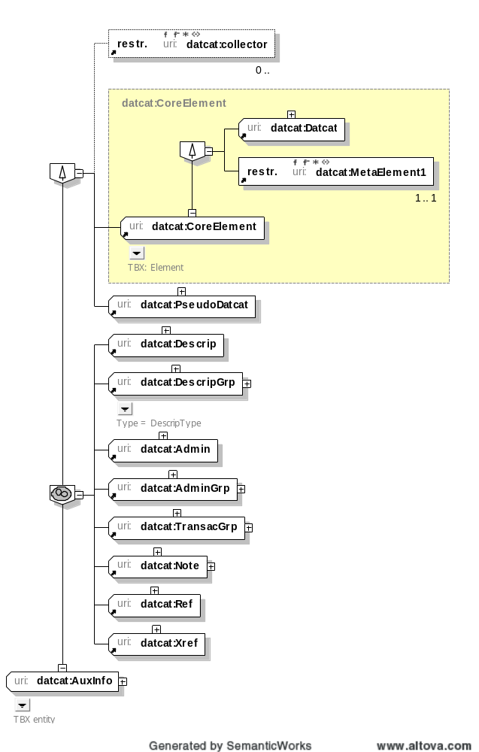
All containers, which ultimately hold DCs.
Do we want to include them in ISOcat, and if so how?
Does this impact RRs in any way?
Or are they external, in which case we need RRs and pointers.
AuxInfo

Slide 27
Using Owl Elements
In OWL we can model
  Classes
  Properties
  Instances
I’ve used all three and interlinked them in order to capture various OWL functionalities

Slide 28
Using Owl Elements
I’ve modeled all datcats as classes.
I’ve provided a property “hasX” for each class so that we can also use property functionalities
I’ve modeled permissible instances (which are terminals), called simple data categories in TBX) as OWL instances
PIDs are also coming in as OWL instances, although they would be closer to class names in my system

Slide 29
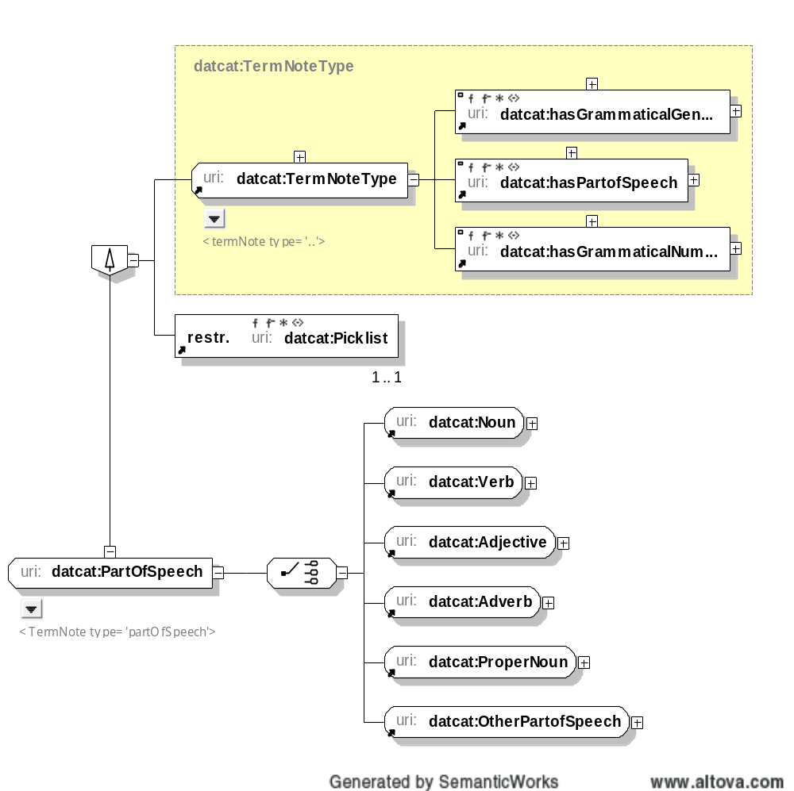
Part of Speech as an OWL Class

Slide 30
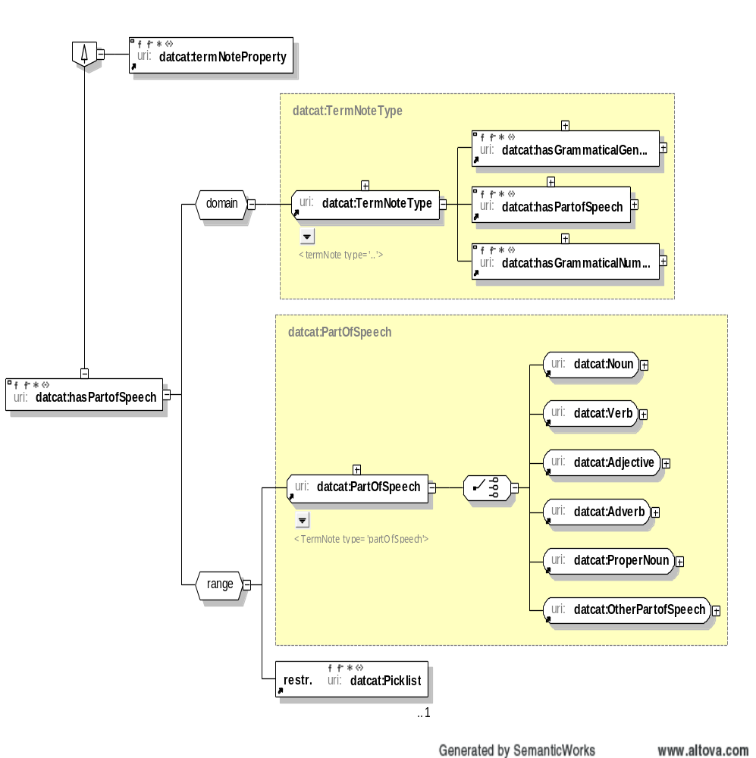
Part of Speech as an OWL Property

Slide 31
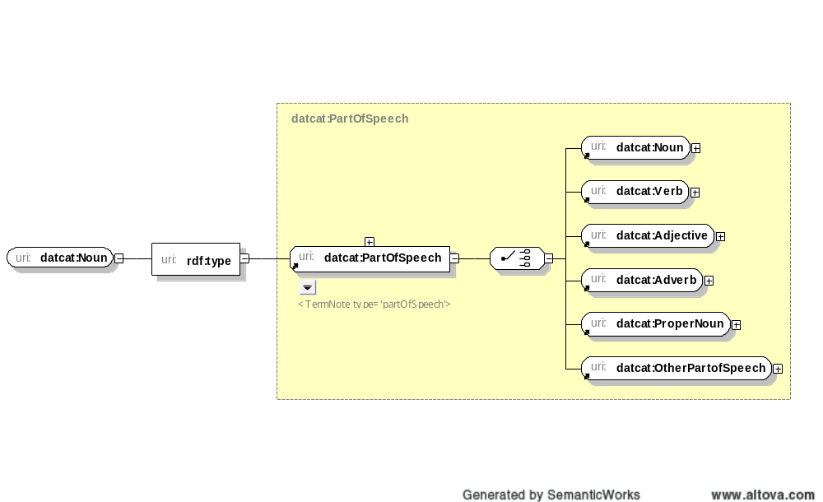
Instances
“Noun” is a simple datcat in the DCR, so I’ve modeled it as an instance of rdf type PartOfSpeech, which replicates then the whole POS tree.
This creates an object I can capture then in the “isOneOf” stack in the Class view for PartOfSpech.
BUT I can say that “Term” (a class) “hasAGrammaticalGender”
But not that “Noun” does, since noun is now a terminal
So this solution works for the TBX model, but not for all models.
So DCR rdf output must be flexible.

