Slide 1

Relation Registry
Workshop
Friday, January 8, 2010
Max Planck Institute for Psycholinguistics
Nijmegen, The Netherlands

Slide 2
Workshop agenda
10 – 12 presentations by
  Sue Ellen Wright (Kent State University)
  Alastair Burt (DFKI)
12 – 13 lunch
13 – 15 presentations by
  Thierry Declerck (DFKI)
  Laurent Romary (INRIA)
  Jan Odijk (Utrecht University)
  Menzo Windhouwer (MPI)
15 – 17 further discussion

Slide 3
RR vision
Relation registries
MPI RR
Typological Database System
RR
Data category registries
MPI
DCR
ISO
DCR
Linguistic resources
MPI
archive
resource
TDS
database

Slide 4
RR ≈ a triple store
Register various types of relationships between concepts (e.g., data categories) stored externally in other registries (e.g., ISOcat)
  Concepts are identified by PIDs, and all PIDs are URIs
  (<uri>,<relation>,<uri>)
Keep track of which graph the relationship belongs to
  Named graphs: (<graph>,<uri>,<relation>,<uri>)

Slide 5
RR concepts
Linguistic resource (schema)
Linguistic knowledge base
Data categories
Containers
Concepts
Relation
Data Category Registry
Concept Registry
Relation Registry

Slide 6
Data categories ≈ concepts
“result of the specification of a given data field ” (ISO 12620:2009)
data element concept (ISO 11179)
  “concept for which the definition, identification and conceptual domain are specified independently of any particular representation”
complex data categories are data element concepts

Slide 7
RR relationship types
Relations may come from various sources, e.g., OWL, possibly CMD
Precise semantics of these relationships are only known for specific tools, e.g., an OWL reasoner
How to make it also possible for more generic tools to traverse the relationships?
Proposal: a taxonomy of relationships

Slide 8
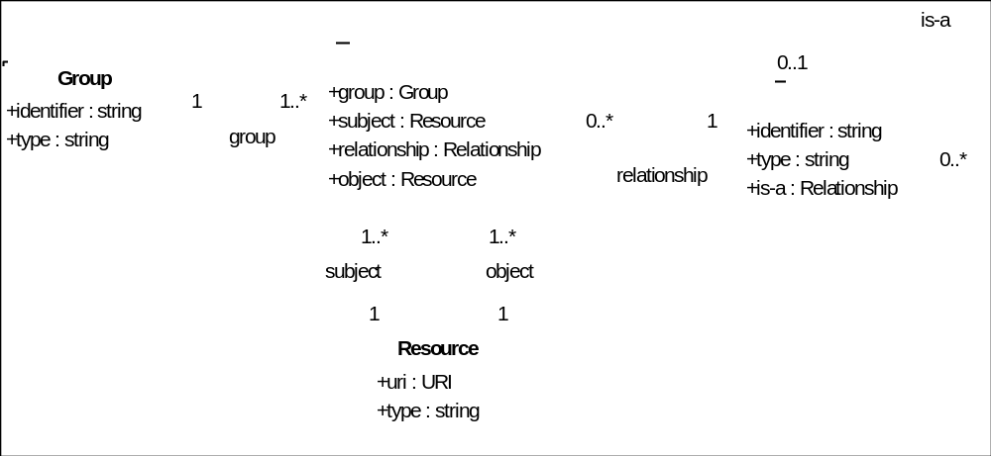
RR UML diagram

Slide 9
TDS global ontology

Slide 10
TDS global ontology in the RR - I
Groups
identifier | type
TDS global ontology | OWL 1.0
Resources
uri | type
Core Constituent Word | OWL class
Basic Word Order | OWL class
SOV | OWL class
SVO | OWL class
VSO | OWL class
Predicate-based Word Order | OWL class
Predicate Initial | OWL class
Predicate Medial | OWL class
Predicate Final | OWL class
In the case of the TDS ontology we expect all concepts to be loaded in ISOcat.
This example uses the concept name as replacement for the URI

Slide 11
TDS global ontology in the RR - II
Relations
group | subject | relationship | object
TDS global ontology | Basic Word Order | rdfs:subClassOf | Core Constituent Word Order
TDS global ontology | SOV | rdfs:subClassOf | Basic Word Order
TDS global ontology | SVO | rdfs:subClassOf | Basic Word Order
TDS global ontology | VSO | rdfs:subClassOf | Basic Word Order
TDS global ontology | Predicate-Based Word Order | rdfs:subClassOf | Core Constituent Word Order
TDS global ontology | Predicate Initial | rdfs:subClassOf | Predicate-Based Word Order
TDS global ontology | Predicate Medial | rdfs:subClassOf | Predicate-Based Word Order
TDS global ontology | Predicate Final | rdfs:subClassOf | Predicate-Based Word Order
TDS global ontology | Basic Word Order | tds:equatesWith | Predicate-Based Word Order
TDS global ontology | SOV | tds:equatesWith | Predicate Final
TDS global ontology | SVO | tds:equatesWith | Predicate Medial
TDS global ontology | VSO | tds:equatesWith | Predicate Initial

Slide 12
TDS global ontology in the RR - III
Relationships
identifier | type | is-a
is-a | generic
related-to | generic
rdfs:subClassOf | OWL 1.0 – builtin | is-a
tds:equatesWith | OWL 1.0 – object property | related-to

