Slide 1
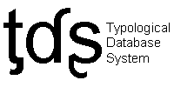
Typological Database System
Menzo Windhouwer

Slide 2
What is the TDS?
The Typological Database System (TDS) provides integrated access to multiple, independently created typological databases.
Users can query the aggregated databases through the system’s web server:
http://languagelink.let.uu.nl/tds/
The TDS was an NWO-supported LOT project, with participants from UvA, UiL-OTS, Leiden University and Nijmegen University

Slide 3
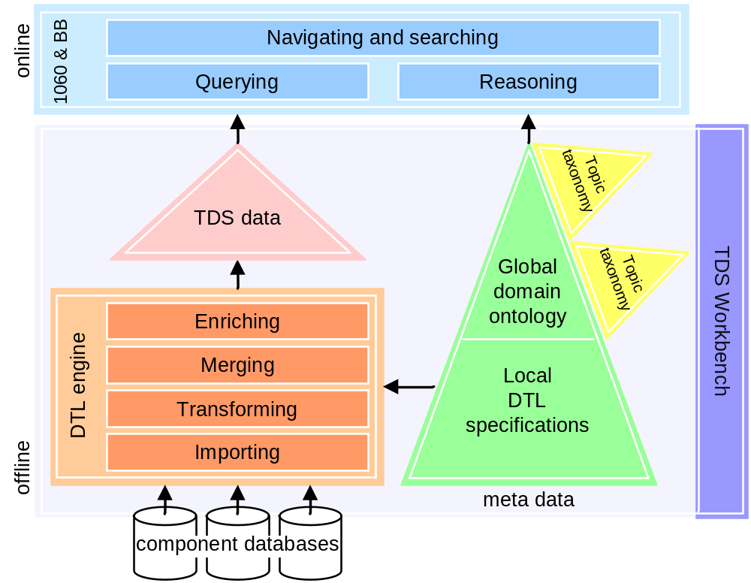
System architecture

Slide 4
(Meta)data architecture
Database schemata
(any DDL)‏
Local database ontologies
(DTL)‏
Global linguistic ontology
(OWL)‏
Topic taxonomies
(SKOS)‏
Database developer
TDS Knowledge engineer
Domain expert
Can the TDS knowledge base be represented in the combination of the DCR and the RR?

Slide 5
Local (database) ontologies (DTL)
TOP NOTION tdn:locationalPredicates
LABEL "Locational predicates"
DESCRIPTION "Information concerning locational predicates, including form of,
and conditions on, construction, and form of the negation."
LINK TO CONCEPT locationalPredicate
GROUPS {
NOTION tdn:ZeroEncoding
LABEL "Locational predicate is zero“
LINK TO CONCEPT conditionsOnEncoding
GROUPS {
NOTION tdn:v168_Zero_plus_locative_prepositional_phrase
LABEL "Locational predicate is zero + locative prepositional phrase"
DESCRIPTION "The locational predicate is expressed without the use of
an overt verb, but has a locative prepositional phrase."
IS FIELD v168
GROUPS WHEN "yes" {
NOTION tdn:v169_Zero_for_present_only IS FIELD v169;
NOTION tdn:v170_Zero_in_positive_sentences_only IS FIELD v170;
}
}
}
Concept notion
Container data category
Container data category
Grouping notion
Complex data category
Field notion
The DTL also allows descriptions of values, i.e., specifies simple data categories.
The DTL also specifies structural and semantic relationships.

Slide 6
Global (domain) ontology (OWL)
predicate
predicate
Local ontology notion
is-a
Data categories
non-verbal predicate
tdn:locationalPredicates
non-verbal predicate
LINK TO
CONCEPT
is-a
adjectival
adjectival
ascriptive
ascriptive
existential
existential
identity
identity
nominal
nominal
possessive
possessive
locational
locational
disjoint-with
alias
spatial adverb
Ontological relationships between concepts.
adpositional predicate
Are these concepts also specified in the DCR, e.g., as concept data categories,
or in the Relation Registry or …

Slide 7
Relationship types
DTL
  Structural relationships, i.e., nesting
  Semantic relationships, i.e., equivalence, subset, superset, overlap with a concept
OWL
  Subsumption
  Loose synonomy
  Related phenomena
  Meronomy
  Determination
  Form-function

Slide 8
Are concepts included in the DCR/RR network?
Linguistic resource (schema)
Linguistic knowledge base
Data categories
Containers
Concepts
Relation
Data Category Registry
Concept Registry
Relation Registry

