Slide 1


Group work and standardization features in ISOcat
Menzo Windhouwer

Slide 2
Outline
Groups in ISOcat
Cooperating on a Data Category (Selection)
Managing a Thematic Domain Group
Standardizing Data Categories
Future work

Slide 3
Groups in ISOcat
Groups
  More or less adhoc groups of users that cooperate on Data Categories and Selections
    can be created by any user
Thematic Domain Group
  Maintaining (standardized) data categories for a specific thematic domain
    constituted at the TC 37 plenary
DCR Board
  Maintaining the coherence of the registry
    designated by the (P) members of TC 37
Subsets of these form various groups in the standardization process

Slide 4
Cooperating on a Data Category (Selection)
Demo:
  Create a group
  Create and share a DCS
  Create and share a DC
  Make the DC(S) public
Notes:
  Groups can request a public and/or private forum
Caveats:
  Groups will get an invitation/introduction model
  DCSs are shared but not yet locked, DCs are

Slide 5
Thematic Domain Group
TDG 1: Metadata
TDG 2: Morphosyntax
TDG 3: Semantic Content Representation
TDG 4: Syntax
TDG 5: Machine Readable Dictionary
TDG 6: Language Resource Ontology
TDG 7: Lexicography
TDG 8: Language Codes
TDG 9: Terminology
TDG 11: Multilingual Information Management
TDG 12: Lexical Resources
TDG 13: Lexical Semantics
TDG 14: Source Identification
TDGs are the owner and guardians of a coherent subset of the DCR
TDGs own one or more profiles
Each TDG has a chair
A number of judges (assigned by SC P members)
A number of expert members (up to 50%)
TDGs are constituted at the TC37/SC plenary
New TDGs need to be proposed by a SC
  Translation
  Sign language
  Audio

Slide 6
Manage a TDG
Demo:
  The chair manages the TDG:
    Add/remove judge/member
      should be registered in ISOcat
    Change the description of a TDG
  Notes:
    Status/activity are currently managed by the ISOcat system administration
  Caveats:
    Chairs can request a public and/or private forum
    Description changes are not yet propagated to the ISOcat homepage

Slide 7
Standardization workflow - summary
Decision Group
Submission
group
Thematic Domain
Group
Data Category Registry
Board
Stewardship
group
Evaluation
Validation
rejected
rejected
Publication

Slide 8
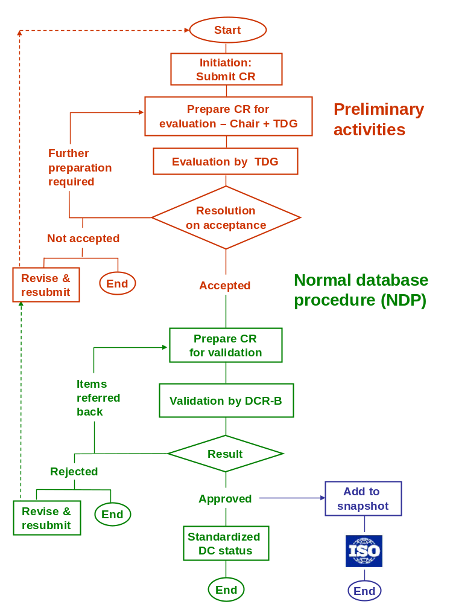
Standardization workflow – part 1

Slide 9
Standardization workflow – part 2

Slide 10
Standardizing DCs
Demo
  Walkthrough of the current implementation of the standardization process (tweaks coming up)
Notes:
  Standardize DCs in (small) selections
Caveats:
  Not yet available at isocat.org, expected in September
  Should also be able to handle change requests for already standardized DCs
  A change request can currently only move forward
  Procedure to handle harmonization needs to worked out

Slide 11
Tweaks
Distinction between TDG members and judges will disappear
The decision group chairs will have read/write rights to the DCs during the whole process, other member will have only read rights
More detailed info on the vote: who accepted/rejected a DC to foster discussion
The DCRB decision group should not vote on the DCs rejected by the TDG
All decision group members can enter (‘public’) log messages
Add post-evaluation and post-validation CR status to allow proper handover by the chairs
Decision group can also involve all TDG and/or DCRB members, in that case the chair should decide when the ballot finished and the decision is based on the collected votes

Slide 12
Future work
Invitation/introduction model
Finer access rights management for groups
  read-only rights
Roll out standardization workflow
Change requests to already standardized DCs
  currently only private DCs can be submitted
In the Thematic Views part of the workspace standardized DCs will become more prominent
  but first we need standardized DCs
  and by default hide superseded/deprecated DCs
Version management for private DCs?
Support for version management of DC PID references
  redirect to the latest version?

Slide 13
Thank you for your attention!
Visit
www.isocat.org
Questions?
www.isocat.org/forum/
isocat@mpi.nl

