Slide 1

The ISOcat
Data Category Registry Standardization Process
Standardizing Data Categories
&
Data Category Specifications
Sue Ellen Wright
Metadata TDG WeBinar
2011-05-16

Slide 2
Standardization in the DCR
The DCR comprises a global collection of data category specifications used in a wide range of language resources.
Individual data categories (DCs) are assigned to one or more Thematic Domain Groups (TDGs).
The task of the Metadata TDG is to standardize the Individual DCs in the Metadata Data Category Selection.

Slide 3
Two-Step Standardization Process
Standardization in the DCR follows a two-step process.
  Evaluation phase conducted by subject-area experts making up the Thematic Domain Group under the management of the TDG Chair (Peter Wittenburg for the Metadata TDG)
  Validation phase conducted by the TC37-wide DCR Board, made up of experts nominated by the P-member bodies of ISO TC 37
  Steps mirror standard ISO practice (Committee Draft [CD] followed by a Draft International Standard [DIS])

Slide 4
Standardizing DCs
Individual data categories are discussed and standardized.
Important standardization elements include:
  Identifier
  Data category name
  Data category type (container, complex, simple)
  Data category definition
  Conceptual domain
    Can vary for same DC used in different TDGs

Slide 5
Standardizing DCs
Excluded from standardization
  Optional translations in other Language Sections
  Changes may take place during the standardization process, (e.g., in the data category name or in definitions, examples, explanations, notes), which will mean that language sections will have to be updated once the standardization process is complete.
  Additional translations can be added at any time.

Slide 6
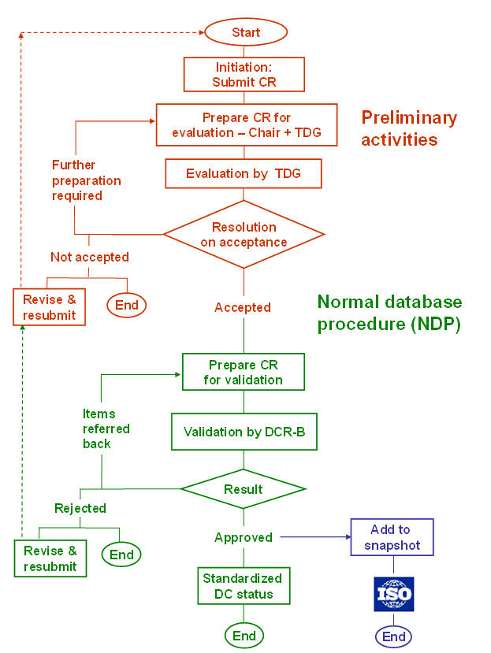
TDG Evaluation Phase

Slide 7
DCRB Validation Phase

Slide 8
Standardized DCs
Frozen after standardization
Changes require submission of Change Request

Slide 9
Standardizing DCSs
Unresolved issue: Once all DCs in a DCS have been standardized it may or may not be desirable to standardize the whole set.
If a DCS is used as a functional unit in the framework of an given annotation scheme (like TBX or LMF), it may be desirable to standardize the DCS in order to ensure interoperability.
If the set is more open-ended and it is possible to pick and choose options depending on pragmatic needs, it may be desirable to leave the set open and not standardize at the DCS level.

Slide 10
Standardization in the DCR
The DCR comprises a global collection of data category specifications used in a wide range of language resources.
Individual data categories (DCs) are assigned to one or more Thematic Domain Groups (TDGs).
ISO 12620:2009 provides for the standardization of:
  Individual DCs that can be reused in an unlimited number of ad hoc or functional DCSs
  Specific sets of DCs that function as aggregated standards in the framework of specific annotation frameworks, such as the ISO 30042 TBX (Termbase eXchange) standard

