Slide 1

The Well-Formed
Data Category Specification
Criteria for
Standardizing Data Categories
Sue Ellen Wright
Metadata TDG WeBinar
2011-05-16

Slide 2
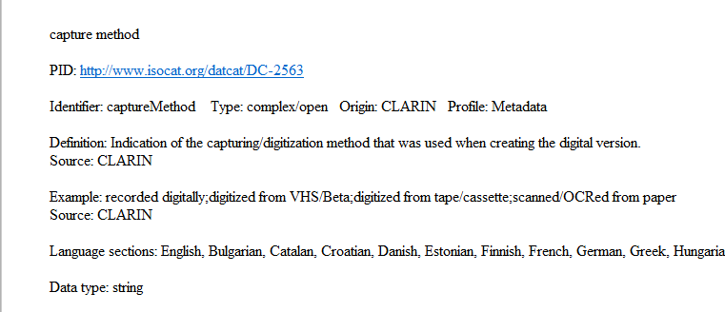
Data Category Names
Lowercase (have been harmonized here)
Status: preferred name (triggers the <strong> mode in the html “print” output)

Slide 3
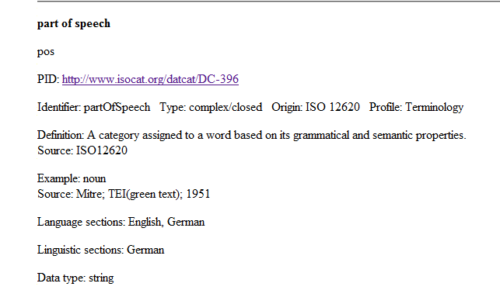
Preferred and Admitted Names
Admitted DC Name
Use admitted term for alternate “synonym” DCs

Slide 4
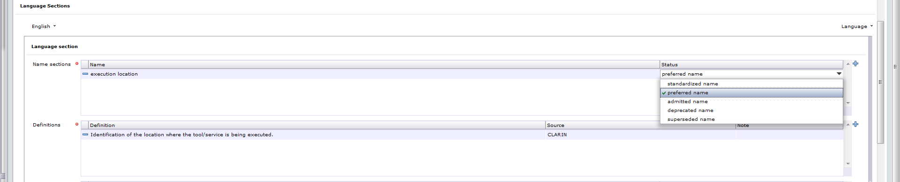
Convert Value to Preferred Name
TDG member notes need for change in the Submission Forum.
Chair edits the DC Spec.
In the Description Section, change the status of the English Name to preferred name.
This definition is good.

Slide 5
Definition Form
Superordinate concept + defining characteristics
  Indication of the capturing/digitization method that was used when creating the digital version.
Indication = superordinate element
What kind of indication?
  of the location where the tool/service is being executed.
Capital letter & ends in a period
Single sentence fragment
  No extra sentences
  No complete sentences
  Avoid tautologies

Slide 6
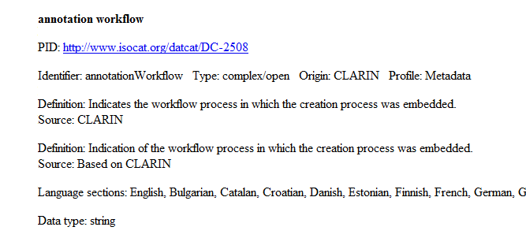
Flawed Definitions
Don’t start a noun definition with a verb; use a comparable noun: Indicates → Indication of ...

Slide 7
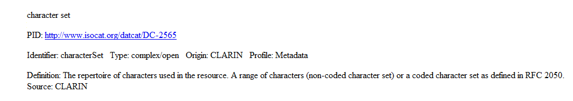
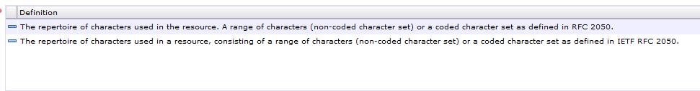
Flawed Definitions
Two sentence fragments; solution: combine to form a single definitive statement; identify RFC a little more clearly

Slide 8
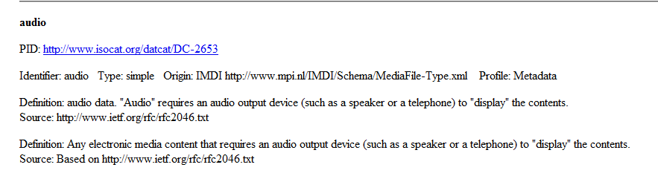
Flawed Definitions
1) Fragmentary definition
2) Definition harmonized to reflect a set of closely related definitions for values of the data category media type.

Slide 9
Harmonizing Definitions for Picklist Values
media type
Definition: Specification of the media type of the resource or the media types for which the tool or service is suitable.
  audio
  Definition: Any electronic media content that requires an audio output device (such as a speaker or a telephone) to "display" the contents.
  document
  Definition: Any electronic media content (other than computer programs or system files) that is intended to be used in either electronic form or as printed output.
  drawing
  Definition: Any electronic media content representing a picture, likeness, diagram or representation produced by marking lines as with a pencil, pen, crayon, or computerized drafting application.
  image
  Definition: Any electronic media content that requires a display device (such as a graphical display, a graphics printer, or a FAX machine) to view the information.
  text
  Definition: Any electronic media content consisting of a non-binary human-readable sequence of characters and the words they form that can be encoded into computer-readable formats such as ASCII or UNICODE.
  video
  Definition: Any electronic media content that requires the capability to display moving images, typically involving specialized hardware and software.

Slide 10
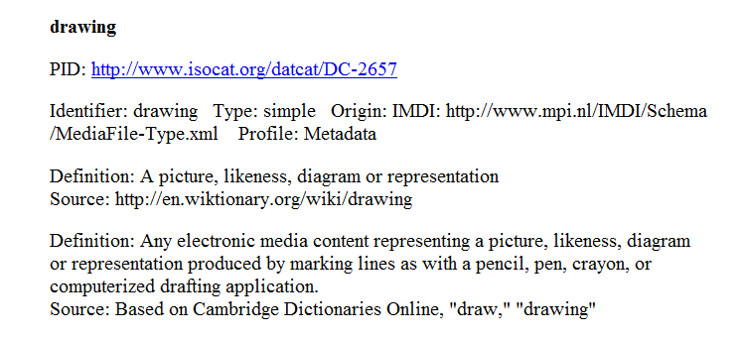
Faulty Definitions
Misleading definition: some pictures are photographs and others are paintings; not all are drawings. Also: harmonization to match other values.

Slide 11
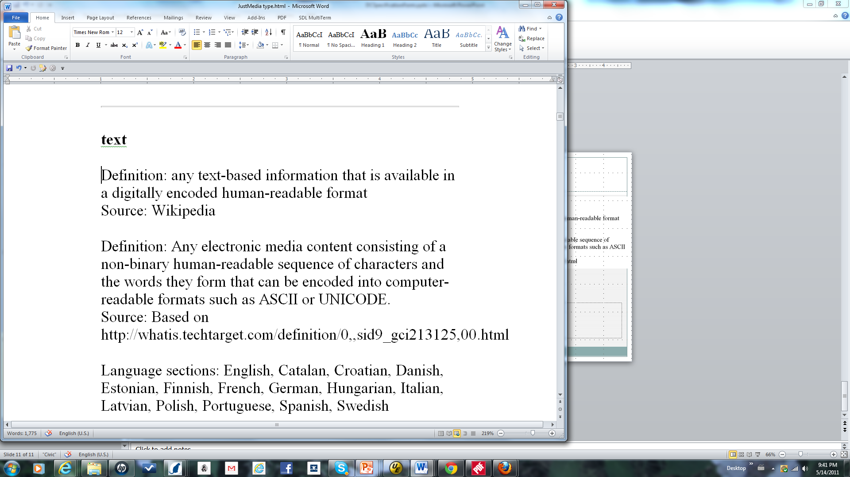
Near Tautology
A text is text-based information – see revised definition; text is difficult to define.

Slide 12
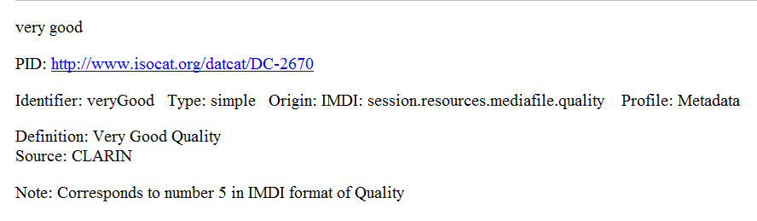
Adjective Definitions
Pertaining to very good quality.
Change to:
Definition: Pertaining to very good quality.
General rule: Adjectives defined using pertaining to, referring to, etc.

