Slide 1

How to do the TDG part of the standardization workflow in ISOcat?
Standardizing Data Categories
&
Data Category Specifications
Menzo Windhouwer
Metadata TDG WeBinar
2011-05-16

Slide 2
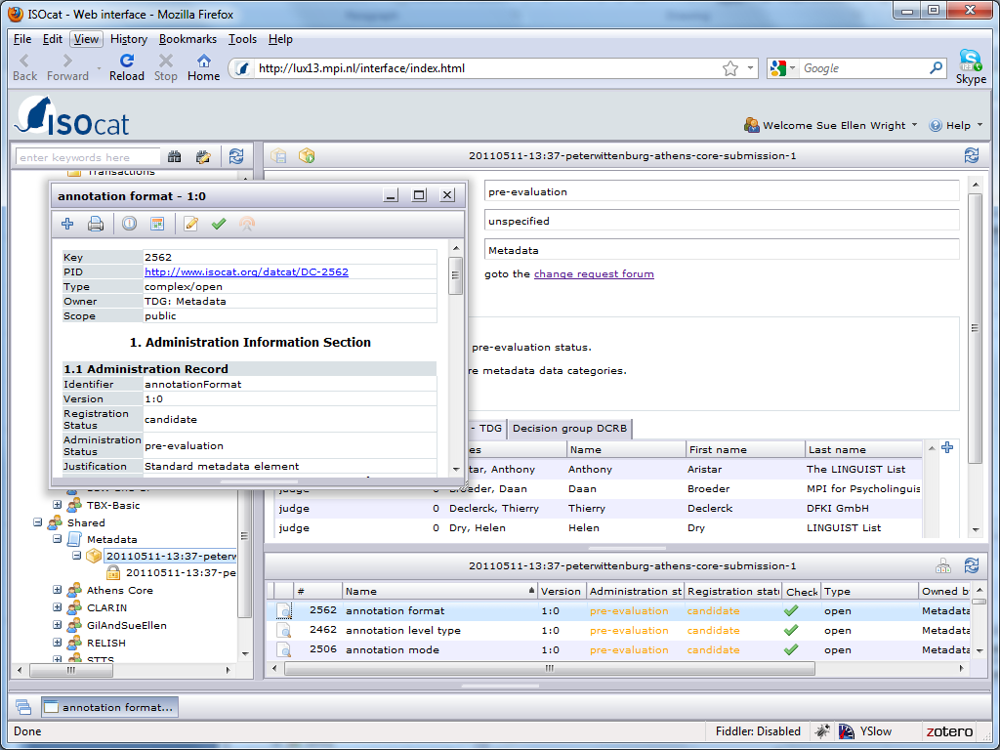
The Change Requests submitted to the Metadata TDG can be found in the Shared section of your workspace under the Metadata TDG node.

Slide 3
Once the Change Requests nodes is clicked in the workspace it is loaded in a specific viewer.

Slide 4
The Data Category Selection that forms the core of the Change Request is loaded at the bottom of the viewer.

Slide 5
Click on the view button to inspect a specific Data Category.

Slide 6
The selected Data Category is opened in a separate window.

Slide 7
The common DCS view is also available in the workspace as a node under the Change Request node.

Slide 8
Each Change Request has a forum to discuss the Data Categories.

Slide 9
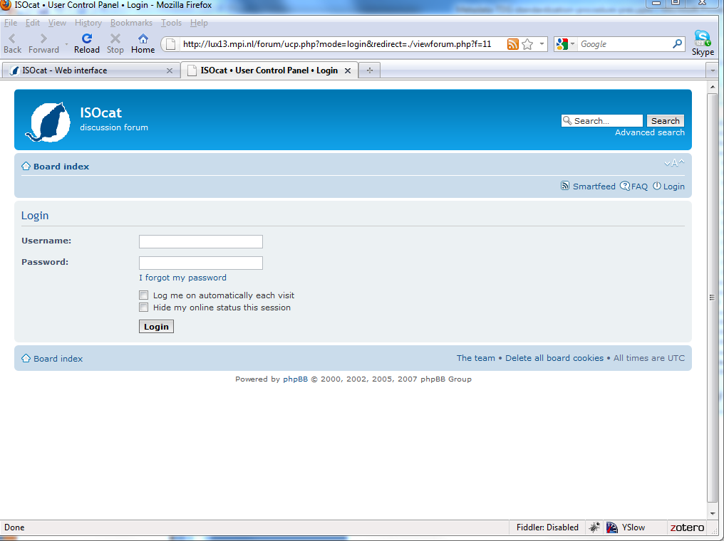
You can login to the forum using your ISOcat credentials.

Slide 10
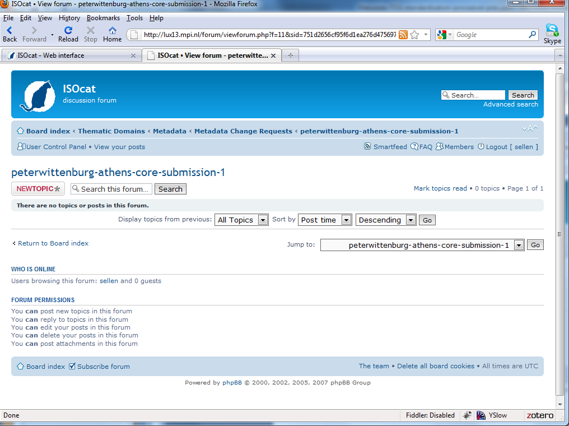
Start your own topic or reply to an existing topic (not shown).

Slide 11
The TDG Decision Group chair can edit the Data Category once there is consensus.

Slide 12
The TDG Decision Group chair can proceed the Change Request to the next phase: evaluation.

Slide 13
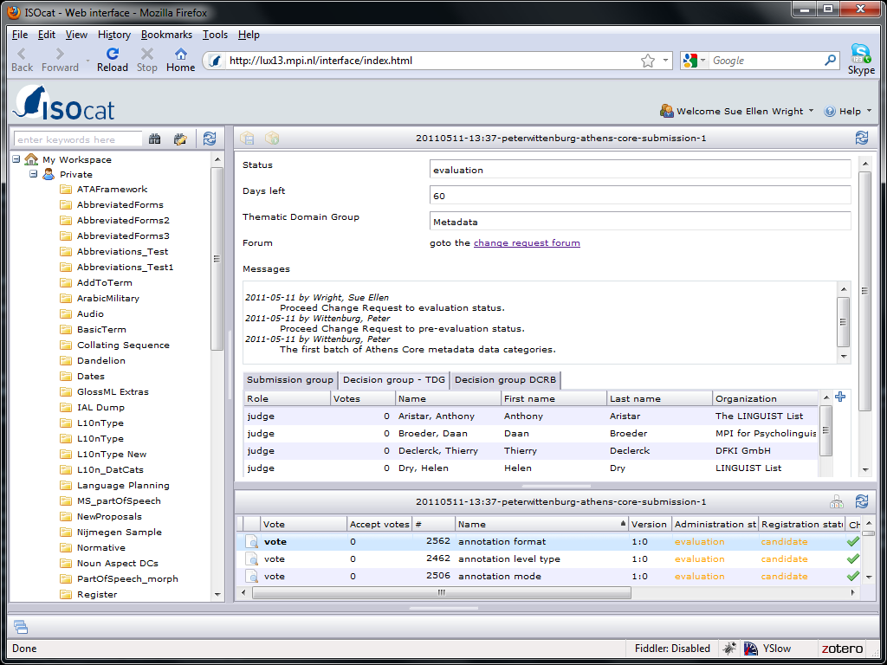
To accept/reject a data category click in the vote column.

Slide 14
To accept/reject a data category click in the vote column.
Counters indicate the progress of the ballot.

Slide 15
After 2 months the ballot is automatically ended.

Slide 16
Status
The Metadata TDG is the first TDG starting the standardization process
  This is the very first Change Request!
  And thus the very first use of this ISOcat functionality
  Feedback: isocat@mpi.nl
The Change Request currently inspected is on the ISOcat test server
  http://lux13.mpi.nl/
  Playground
  This CR will disappear later
Once the TDG chair gives the green light the Change Request will be recreated on the ISOcat production server
  http://www.isocat.org/
  The real standardization process will start then

