Slide 1
CLARIN Requirements for a
Semantic Registry
Daan Broeder
The Language Archive – MPI
daan.broeder@mpi.nl
Ineke Schuurman
CLARIN-NL/VL – KU Leuven & Utrecht University
ineke@ccl.kuleuven.be
Menzo Windhouwer
The Language Archive - DANS
menzo.windhouwer@dans.knaw.nl
ISOcat meeting
10 December 2013
Utrecht, The Netherlands

Slide 2
Outline
CLARIN’s use of ISOcat
CLARIN(-NL) experiences and requirements
  Data model
  Proces
  User interface

Slide 3
CLARIN’s use of ISOcat - 1
Component Metadata (CMD) uses ISOcat as a Concept Registry
  CMD profiles, components, elements, attributes and values can all link to ISOcat DCs in a @ConceptLink
  The ComponentRegistry editor allows to search in ISOcat and find relevant DCs
    It tries to steer the user to right DC type for a CMD context, but users can also copy a PID directly into the ConceptLink
      Types do frequently mismatch
    The link between ISOcat and CMDI is weak, i.e., when a DC is selected none of the specification information (data type, value domain) is taken over
      Representation information is seen as a hint
  The ConceptLinks are used by the VLO (a faceted search tool) for ‘automatic’ mappings from CMD records to facets
    This makes the flexibility in CMDI for the use of many different metadata structures and terminology managable for generic tools
    DCs on the component level become more and more important for disambiguation as they provide context

Slide 4

CMDI and ISOcat - 1
ISOcat
metadata
catalogue
component
registry &
editor
metadata
modeler
metadata
user
Relation
Registry
search &
semantic mapping
metadata
editor
metadata
creator
Joint metadata
repository
Local
metadata
repository
metadata
curator
metadata
curator
OAI-PMH
Service provider
OAI-PMH
Data provider
DATA

Slide 5
CMDI and ISOcat - 2
Desired mapping CMD types to DC types
  CMD profile ➔ container Data Category
  CMD component ➔ container Data Category
  CMD element ➔ complex Data Category
  CMD attribute ➔ complex Data Category
  CMD value ➔ simple Data Category
Due to the flexible nature of CMD this can potentially lead to many semantically equivalent DCs, but with different types

Slide 6
CLARIN use of ISOcat - 2
Content can also be semantically annotated with DCs
  CLARIN-NL call projects are required to do so
    Supported by yearly workshops
    The CLARIN-NL/VL group bundles this work
  Some CLARIN national initiatives have created DCs for tagsets
    Netherlands: CGN
    Poland: NKJP
    Germany: STTS
    Spain: not yet, but asked for info
  Some CLARIN related groups have used/created DCs for ISO TC 37 standards:
    Uby/Cornetto: LMF
    SHEBANQ: LAF/GrAF
These annotations could be exploited by (federated) search engines
  Currently level 0 (full text search) is working (no DCR involvement)
  Drafts for level 1 included ISOcat and RELcat interaction (at least for the metadata part)
  Needs an search indexing engine on the center side that understand DC annotated resources

Slide 7
CLARIN use of ISOcat - 3
In absence of standardized DCs the CLARIN ERIC suggested to appoint national ISOcat (and or CMDI) coordinators to streamline the process of ISOcat usage and DC creation
  They have been appointed, but they have not yet met
  The CLARIN-NL/VL experience is important input for this coordination effort

Slide 8
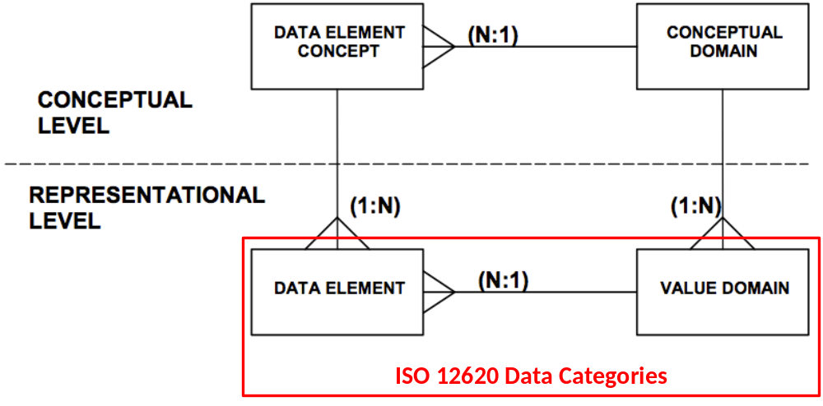
Data model - 1
ISO 11179
ISO 12620:2009

Slide 9
DC types - 1
complex:
open
closed
constrained
writtenForm
grammaticalGender
email
string
string
string
Constraint: .+@.+
neuter
feminine
masculine
simple:

Slide 10
DC types - 2
container:
lexicon
language
alphabet
entry
japanese
ipa
lemma
writtenForm

Slide 11
Data model - 2
Proliferation due to types:
  Different uses of a concept in a data model might lead to different representations
    in part-of-speech = “verb” /verb/ is a simple data category
    in verb = “to walk” /verb/ is an open data category
    in both cases the semantics might be the same
  The DCR data model doesn’t have provisions to share a semantic core (a concept)
  So users have to recreate data categories because they need another type
  This leads to proliferation and makes it hard for users to select the right DC or to keep semantics in sync across types
  Many users will just use the wrong type ☹

Slide 12
Data model - 3
Conflicts with actual use
  (metadata) resources point to DCs from a specific context
    CMD component should point to a container DC, but this happens not always and ISOcat has no way to enforce it
    An Relax NG <value> element should point to a simple DC, but this can’t be enforced by ISOcat
    …
  The ISOcat DCR has no way to enforce proper use of DC types within the resources
    It can steer in the form of XSD, RNG, FSD, … templates
    But in most (all CLARIN) cases a schema already exists
  In all cases the resource context provides the actual and thus correct representation information

Slide 13
Embed DCs in RNG
An XML attribute implies a complex DC
  <rng:attribute name=“alphabet” dcr:datcat=“http://www.isocat.org/datcat/…”>
  <rng:value dcr:datcat=“http://www.isocat.org/datcat/…”>
  ipa
  </…>
  …
  </…>
An value implies a simple DC

Slide 14
Embed DCs in a FSR (LMF/LAF/TEI)
A feature name implies a complex DC
<WordForm>
<feat
att="writtenForm"
dcr:datcat="http://www.isocat.org/datcat/DC-1836"
val="clergyman"/>
<feat
att="grammaticalNumber"
dcr:datcat="http://www.isocat.org/datcat/DC-1298"
val="singular"
dcr:valueDatcat="http://www.isocat.org/datcat/DC-1387"/>
</WordForm>
A feature value implies a simple DC

Slide 15
DC mismatches in CMDI
469 simple DCs:
  are linked to 165 CMD elements
  are linked to 72 CMD components
631 complex DCs
  are linked to 778 CMD components
59 container DCs
  are linked to 4 CMD elements

Slide 16
Data model - 4
A rare blend of expertise
  To create a good quality DC specification one needs to be able
    To provide a good definition, i.e., have domain expertise
    Pick the right DC type and data type, i.e., have technical insight
  This is a rare combination and often spread over multiple persons in a project with different roles and these might not come together to create a quality DC specification
    And even technical users are inclined to ignore DC types and select DCs based on matching semantics
      The CMDI metadata modelers are in most cases more technical oriented, still they use the wrong DC types
  Which leads to conflicts between the specified DC representation and its use in the actual resource context

Slide 17
Which DC type to use?
Which type is appropriate depends on the place of the data category in the structure of your resource:
  Can it have a value?
    Complex Data Category with an data type
      Any of the values of the data type?
        Open Data Category
      Can you enumerate the values?
        Closed Data Category
          Fill its value domain with simple Data Categories
      Is there a rule to constrain the values?
        Constrained Data Category
          Express the rule/constraint in one of the rule languages
  Is it a value?
    Simple Data Category
  Does it group other (container or complex) Data Categories?
    Container Data Categories
If a Data Category both has a value and groups Data Categories
  Complex Data Category
  (or two different Data Categories: one container and one complex)

Slide 18
Examples
S
<text>
…
<tag>N(soort,ev,basis,zijd,stan)</tag>
…
</text>
NP
VP
category
noun phrase
number
singular
Text=“John”
V
NP
agreement
person
third
Text=“hit”
Det
N
/category/ a closed DC
/noun phrase/ a simple DC
/agreement/ a container DC
/number/ a closed DC
/singular/ a simple DC
/person/ a closed DC
/third/ a simple DC
(Encoded as TEI P5 FSR the XML elements and attributes
are seen as syntactic sugar (or are
semantically annotated on a next
(meta) level)
Text=“the”
Text=“ball”
XSD
/text/ a container DC or an open DC
/tag/ a constrained DC (points to EBNF)
EBNF
/PoS/ is a closed DC
/N/ is a simple DC
/NTYPE/ is a closed DC
/soort/ is a simple DC
…
(Use EBNF to go into (P)CDATA that
contains additional structure/semantics)
/S/ a container DC
/NP/ an open DC
/VP/ a container DC
/V/ an open DC
/NP/ a container DC
/Det/ an open DC
/N/ an open DC
(Text is seen as syntactic
sugar)

Slide 19
Data model - 5
These experiences:
  Proliferation due to types
  Conflicts with actual use
  A rare blend of expertise is needed
And the insight that the actual representation can be, and has to be as the DCR can’t enforce conformance, derived from the resource context where the DC is used
Lead to the proposal to drop all types from the data model
Are these than still DCs, maybe not and CLARIN actually needs a (lightweight) Concept Registry (as ISOcat was already often marketed within CLARIN)
  the differences are too subtle for most users, so in many/most cases they will have entered ‘concept’ definitions
  but for consistency we’ll keep on using the term DCs in this presentation

Slide 20
Data model - 6
Other proposed changes:
  Remove the standardization information: leave the process to the implementation (recommendations)
  Remove Linguistic Sections: they are underused and currently hard to maintain (would require language specialist to have edit access)
  Replace DENs by Also Referred To As (ARTA) table: for mapping purposes we’re interested in more then names
  Replace identifier by a required ARTA entry: /identifier/ is confusing as it isn’t unique, the DC PID is unique
    So don’t remove it, just merge it with the DEN/ARTAs
  Consistent use of /source/: currently DENs use /source/ different then the Definition Section, maybe use in the DEN/ARTA entry /origin/
  Allow only one Definition Section: currently the official data model allows multiple Definition Sections for a Language Section if this happens a DC is ambiguous, so only one should be allowed (ISOcat already checks for that)
  Indicate successors of superseded names: currently names can get the status superseded, but its impossible to indicate by which name; this should become possible or names should just be deprecated

Slide 21
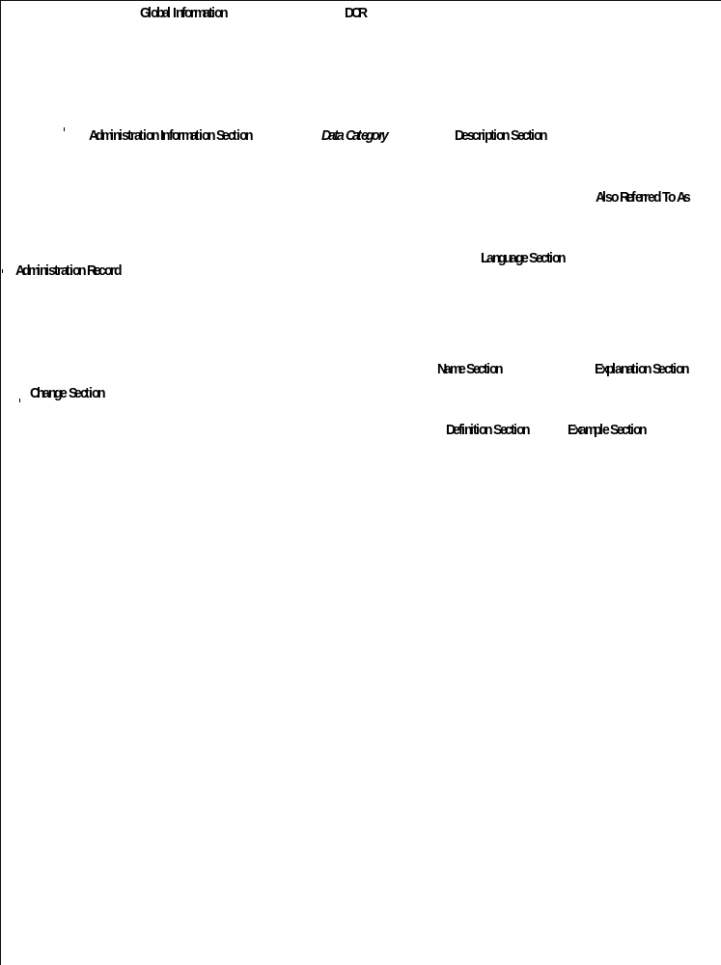
Data model - 7

Slide 22
Data model - 8
In this light weight model no relationships between DCs are stored anymore:
  In line with the previous insight that ontological relationships are too application/domain specific
  Representation-based information and relationships are actually as application/domain specific
Still relationships are interesting information
  Store them in application/domain specific relation sets in the Relation Registry
  Needed for disambiguation and full semantic description
    which DC (from which theoretical framework) does this concept in the definition refer to?
    which abstract concept (which would most likely never by a DC, and certainly has a hard to determine DC type) does this definition refer to?
    Link to the right DC/concept from the definition
      But leave typing to the a application/domain specific relation set in the Relation Registry

Slide 23
Data model - 9
Alternative data models (always a PID):
  SKOS
    By combination with the Relation Registry
  Name (1) -> {description, lang} (N), {keyname,value} (N)
    A term base?
    Experience shows that a bit more is needed for guiding the user, e.g., examples, guidelines
  …

Slide 24
Process - 1
Uptake of ISOcat is hampered by the strict ownership of data categories
  All changes have to go through owner, unless (s)he shared edit rights with you
What could be made easier?
  (Adding a value)
  Adding a DEN/ARTA entry
  Adding a translation
    Only the English Language Section is owned
  Adding a new profile membership
    Profiles could be replaced by tagging
  Publish DCs by a coordinator
    If the owner hands over a DC to a coordinator, (s)he implicitly indicates that (s)he finds the DC ready for publication and so the coordinator can do it on his/her behalf

Slide 25
Process - 2
One can take openness to an extreme with a wiki approach
  Stable semantics could be still be there due to giving every revision a PID
  But that might be a too fine granularity
A versioning policy managed by the user
  Semantic drift might be uncontrolled
    As the user finds updating his (new) resources to use a new PID too cumbersome
    Might be a task for a coordinator
  Transfer of ownership should be possible
    Triggered by a coordinator if an owner becomes unresponsive

Slide 26
User interface - 1
ISOcat uses the General Interface RIA framework, which gets old and is not actively developed anymore
  Time for a more modern approach, e.g., Bootstrap/Angular
  Wiki-like approach, i.e., more text oriented instead of the form oriented approach
However, an existing Semantic Registry framework will most likely come with its own framework
  Which might not (out-of-the-box) support functionality we do like in the ISOcat UI (if any ;-)

Slide 27
CLARIN requirements
CLARIN needs a Semantic Registry
  It more likely needs a Concept Registry than a Data Category Registry
    As actual representation information is provided by the resource context
Users do
  only occasionally use the Semantic Registry so it needs to be intuitive and not too complex (data model and UI)
  not have much technical expertise (in general), so providing correct representation information is a hard task for them
Some (perceived) proliferation is unavoidable
  due to different theoretical frameworks
  so disambiguation of concepts mentioned in definitions needs to be done, i.e., concepts specific to theories can’t be mixed and matched
  but should still be avoided where possible
    “be as generic as possible and as specific as needed”

Slide 28
Interesting ideas
ConceptWiki knowlets that group near same concepts
  conceptwiki.org only supports authorities, community involvement is currently disabled
  When to start a new knowlet, i.e., when has a concept drifted off too much?
RDA DFT StackExchange experiment
  Don’t provide a PID to the ‘knowlet’, but give each entry a PID and show them in the knowlet context (during search)
EUDAT semantic services
  API to search in authorities for a matching concept and an ‘overflow’ lightweight semantic store
    When no match is found add an entry to the lightweight store
    This lightweight store provides uncurated entries, which can be picked up by authorities (bottom up, grass roots)

Slide 29
Possible new setups
Lightweight ISOcat (ISO TC37 RA, TLA)
  DC types and relations move to RELcat
    /noun/ dcr:hasType /simple/
    /noun/ dcr:hasConceptBase http://www.isocat.org/…
    /PoS/ dcr:hasType /closed/
    /PoS/ dcr:hasConceptBase http://www.isocat.org/…
    /noun/ dcr:isPossibleValueOf /PoS/
    With he dcr:* properties are from a DCR specific RDF vocabulary
Full scale ISOcat (ISO TC37 RA)
  Contains the ISO TC37 standardized DCs
    Less open DCR then now, i.e., just ISO TC37 experts
    Carefully curated sets of DCs
  New lightweight semantic registry (CLARIN, EUDAT, TLA)
    Open for everyone to register ‘new’ semantics
    Uncurated concepts/terms/… (informal)
    Authorities can see what bubbles up from the communities

