Slide 1

Thinning Down a Bloated Cat
ISO TC 37/CLARIN Discussion
Utrecht, December 9/10 2013
Sue Ellen Wright
December 2013

Slide 2
Terminology Communities of Practice
Discourse-oriented terminology
  Text & discourse production
  Semantic modeling of concept relations
Object-oriented terminology
  Thesauri and controlled language, library community
  Retrieval of objects and information
Terminology for semantic reasoning – MPI
  Automated reasoning across heterogonous semantic networks
  Retrieval of information from aggregated and non-aggregated networks
Metadata-oriented terminology – TC 37/SC 3
  Definition of structured metadata
  Discovery and modeling of standards-compliant data sets
  Facilitation of highly efficient, highly precise interoperability

Slide 3
ISOcat History as a Metadata Registry
Long evolution within ISO TC 37, Terminology and other language and content resources
Metadata Registry (MDR) in the spirit of ISO/IEC 11179
Not intended as a concept database nor as a terminology database nor as a semantic registry
Notes:
ISOcat is the result of a long evolution within TC 37 to create a MetaData Registry (MDR) in the spirit of ISO/IEC 11179. It was not intended as a concept database nor as a terminological database. At the time that the first MDR was created in TC 37, ISO TC 37 terminology was housed in two standards, ISO 1087 parts 1 and 2, with 2 devoted to the standardization of terminology used primarily in the standards of TC 37, SC 3 (full name). ISO 1087 was not designed to reflect actual data element names and concepts (commonly referred to in TC37 as Data Categories) used in terminological resources or in terminology concept systems or other ontological resources.

Slide 4
ISOcat History as a Metadata Registry
Reasoning across a semantic resource would be interesting, but information retrieval is not our goal, although ontological resources would be something we would definitely be able to use.
We are interested in collecting structured DCSs for integration into data model design environments.
We are interested in tools and application integration via the intelligent extraction of structured DCSs.
Notes:
ISOcat is the result of a long evolution within TC 37 to create a MetaData Registry (MDR) in the spirit of ISO/IEC 11179. It was not intended as a concept database nor as a terminological database. At the time that the first MDR was created in TC 37, ISO TC 37 terminology was housed in two standards, ISO 1087 parts 1 and 2, with 2 devoted to the standardization of terminology used primarily in the standards of TC 37, SC 3 (full name). ISO 1087 was not designed to reflect actual data element names and concepts (commonly referred to in TC37 as Data Categories) used in terminological resources or in terminology concept systems or other ontological resources.

Slide 5
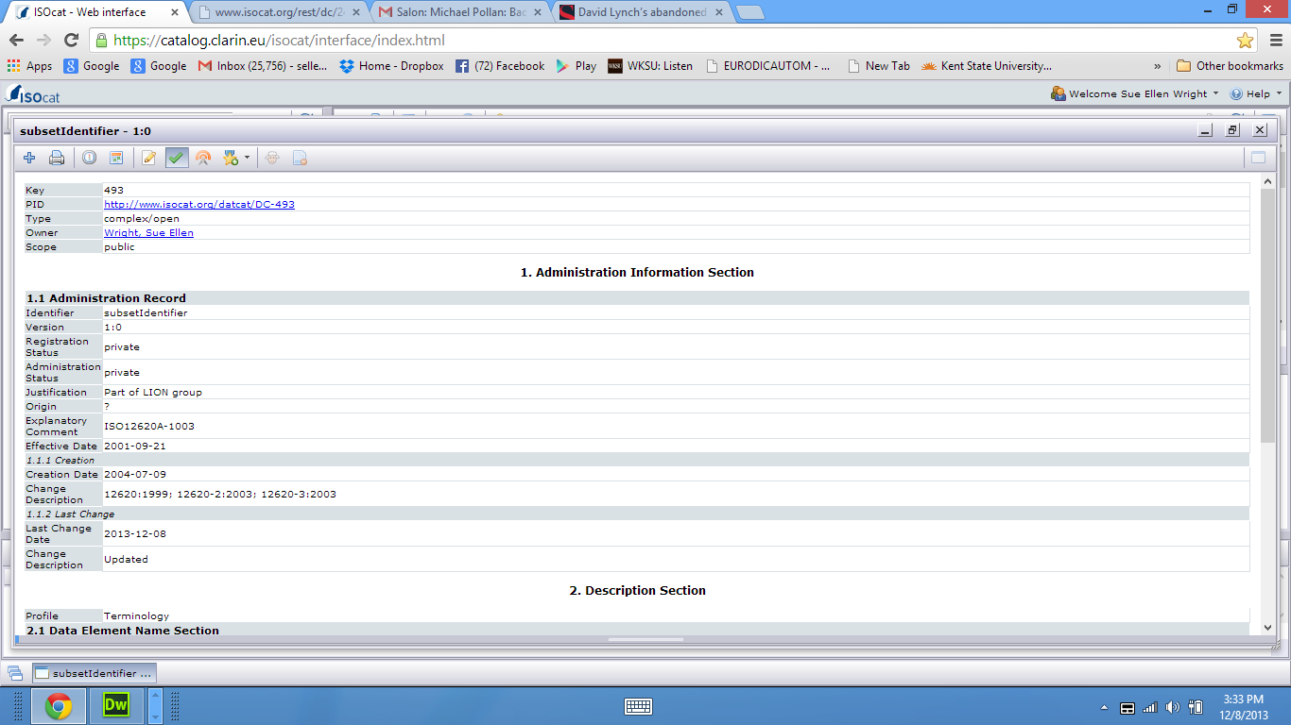
Header Area
We need identifier, but it doesn’t have to appear multiple times. It could be hidden, or included in a synonyms class as long as it’s identified.
We need PID, but the appearance of key is redundant.
We consider other options for hosting the DCR if we lose typing capability in some form.
We are not currently contemplating eliminating type because our whole raison d’être for the DCR (which predates ISOcat) centers here.

Slide 6
Administration Record
We can live with changes here
Justification and origin are potentially redundant, but we need some sort of origin info for variants on the DC name.

Slide 7
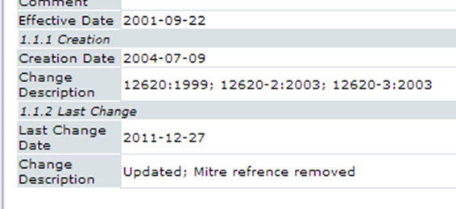
Dates
Dates are automated anyway, and can be easily hidden

Slide 8
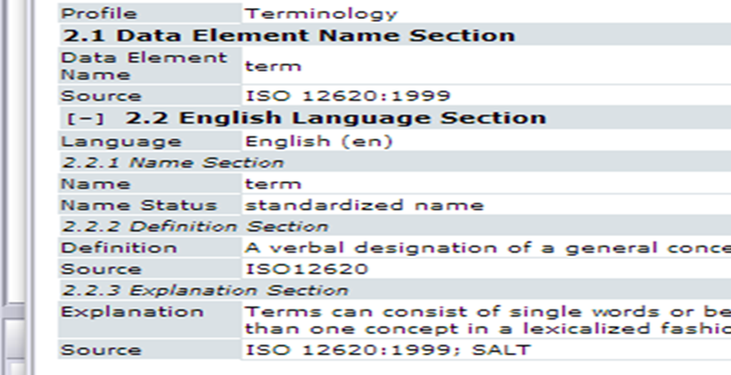
Data Element Description Section

Slide 9
Data Element Description Section
Data element name and English name could be conflated.
One and only one English definition based on community consensus is good.
We only need either explanation or note, but not both
Sources – problem for plagiarism reasons if omitted for good definitions sourced from other resources; could be optional

Slide 10
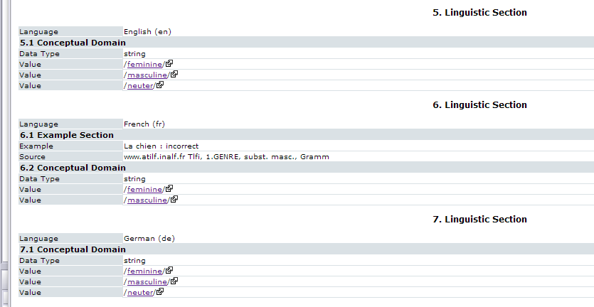
Linguistic Section
This we can live without, despite all our work on it.

Slide 11
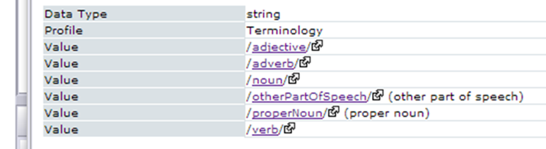
Conceptual Domain, Simple DC Type
Fundamental to our core
We contend that noun, for instance, defined as a complex DC, takes on new attributes that make it incompatible with its role as a simple DC, so it constitutes a different DC concept.
isA is not fundamental for us, but it might be used as the seed for a new way of integrating complex with simple DC concepts

Slide 12
Language Sections
We are concerned about the high proliferation of really bad translations and the potential for error that exists in the current language sections. We could live without this or maybe better, move it to standoff status.
At any rate, it should be carefully policed and subject to consensus. A wiki-like solution would be ideal.

Slide 13
Other Features
TDGs/Profile to be replaced with a more flexible, but potentially controllable new system (avoid proliferation of near clones)
Private/public collections, sharing groups – keep in some form
Eliminate standardization features but keep recommendations in the context of new profiles
Other features
TDGs
Private collections
Public collections
Shared collections & groups
Standardization features
Recommendation features

Slide 14
Other Features
Output formats – highly desirable, and they don’t complicate the model; it’s a hidden functionality unless used.
Display features – much could be hidden that is now visible
Multiple languages – come up with a way to clean this up – consensus driven wiki functionality would be great.
RRs, maybe use SKOS if its fully functional for us; good SKOS interfaces? If not, we are considering our own terminology management options.
Output features and formats
Display features
Multiple languages
External ontology resources

