Slide 1

ISOcat: Metadata Registry
ISO TC 37/CLARIN Semantic Data Registry Workshop
Utrecht, December 9 2013
Sue Ellen Wright
December 2013

Slide 2
Terminology Communities of Practice
Object-oriented terminology
  Thesauri and controlled language, library community
  Retrieval of objects and information
Discourse-oriented terminology
  Text & discourse production
  Semantic modeling of concept relations
Metadata-oriented terminology
  Definition of metadata
  Semantic registries for facilitation of ineroperability

Slide 3
ISOcat History as a Metadata Registry
Long evolution within ISO TC 37, Terminology and other language and content resources
Metadata Registry (MDR) in the spirit of ISO/IEC 11179
Not intended as a concept database nor as a terminology database
ISO 1087 not designed to reflect actual data element names and concepts (commonly referred to in TC37 as Data Categories) used in terminological resources or in terminology concept systems or other ontological resources.
Notes:
ISOcat is the result of a long evolution within TC 37 to create a MetaData Registry (MDR) in the spirit of ISO/IEC 11179. It was not intended as a concept database nor as a terminological database. At the time that the first MDR was created in TC 37, ISO TC 37 terminology was housed in two standards, ISO 1087 parts 1 and 2, with 2 devoted to the standardization of terminology used primarily in the standards of TC 37, SC 3 (full name). ISO 1087 was not designed to reflect actual data element names and concepts (commonly referred to in TC37 as Data Categories) used in terminological resources or in terminology concept systems or other ontological resources.

Slide 4
ISO TC 37 Terminology Standards
ISO TC 37 terminology originally was housed in two paper standards, ISO 1087 parts 1 and 2
Devoted to discourse oriented terminology used primarily in the standards of ISO TC 37, SC 3, Systems to manage terminology, knowledge and content
Terms currently housed in the iTerm resource
http://iso.i-term.dk/login.php TC37/TC37
Not compatible for linked data – no PIDs, not exportable in any formalism
ISO 1087 terms not necessarily designed to reflect actual data element names and concepts (commonly referred to in TC37 as Data Categories) used in modeling terminological or ontological data
Overlaps in usage between terminology and data modeling represent serendipitous convergence; common usage, but not necessary identical
Notes:
ISOcat is the result of a long evolution within TC 37 to create a MetatData Registry (MDR) in the spirit of ISO/IEC 11179. It was not intended as a concept database nor as a terminological database. At the time that the first MDR was created in TC 37, ISO TC 37 terminology was housed in two standards, ISO 1087 parts 1 and 2, with 2 devoted to the standardization of terminology used primarily in the standards of TC 37, SC 3 (full name). ISO 1087 was not designed to reflect actual data element names and concepts (commonly referred to in TC37 as Data Categories) used in terminological resources or in terminology concept systems or other ontological resources.

Slide 5
Early Development
Collaboration with ISO/IEC JTC 1/SC 32, Metadata
Standardization of the data categories used in terminology and other language resources
Growing and urgent industry demands for unambiguous, highly efficient interchange of terminological data in localization environments
Standards:
  ISO 16642, a high level metamodel for concept-oriented terminology databases
  ISO 12620, original paper list of data category specifications
  ISO 30042, TermBase eXchange format TBX for data collections that conform to the 16642 standard.
Notes:
Working in conjunction with ISO/IEC JTC 1/SC 32, TC 37 SC 3 and later SC 4 began work to standardize the data categories used in terminology resources based on a growing need for unambiguous, highly efficient interchange of terminological data in localization environments. This work paralleled the elaboration of ISO 16642, a high level metamodel for concept-oriented terminology databases, ISO 12620, which was originally a paper list of data category specifications, and ISO 30042, which specifies the TermBase eXchange format TBX for data collections that conform to the 16642 standard.

Slide 6
ISO/IEC 11179 Family of Standards
Data modeling combines a wide “concept” with an “object class” to form a more specific “data element concept”.
Example: “grammatical gender” is defined by the broad concept “grammatical category” combined with the limiting characteristic “grammatical relationships between words in sentences” to define the data element concept.
The specification of this DC includes its definition, its datatype, and, in the case of a DC for which there exists a constrained set of values, its conceptual domain in the form of a set of permissible instances.
In the DCR as realized object classes are treated as complex data categories and permissible instances are treated as simple data categories.
Not just semantics – closely application oriented

Slide 7
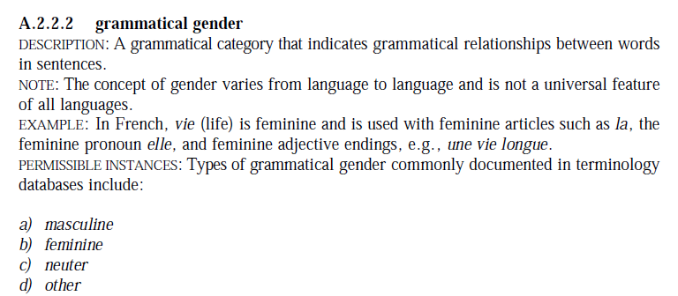
ISO 12620:1999 & Core 11179 Attributes
PID (old 12620 ID)
DC name / identifier (e.g., grammaticalGender)
DC Definition
Note
Example
List of permissible instances in the case of closed DCs
(Values themselves defined as simple DCs)
(Schemas use the camel case identifier form)

Slide 8
SYNTAX to ISOcat
The LIRICS-related SALT project produced SYNTAX, a precursor Meta Data Registry strictly for ISO 12620 data.
The CLARIN-based ISOcat project expanded to include a wider range of language resources:
  Influenced by a dictum from ISO Central Secretariat to enable the extraction of metadata definitions into a broadly conceived concept data base, then planned for implementation by the ISO Central Secretariat
  Supported by (since proven to be unworkable) two-stage balloting procedure that mirrored the procedures used in customary ISO balloting for paper standards
  Centered on the ISO 11179 approach to the creation of a Metadata Registry
Notes:
Initial work on creating an electronic representation of the data categories began in the so-called SALTproject, which produced a representation that was later manifested as a system called SYNTAX. (a weird misnomer considering that it is much more a semantic resource than a syntactical one). Under the CLARIN project, the SYNTAX model segued into a more complex, indeed an unfortunately complex, Metadata Registry. At this point, the design was influenced not only by ISO 11179, but also by a dictum from ISO Central Secretariat to enable the extraction of metadata definitions into a broadly conceived concept data base, then planned for implementation by the ISO Central Secretariat. This process involved the introduction into the ISOcat environment of a complex (and since proven to be unworkable) two-stage balloting procedure that mirrored the procedures used in customary ISO balloting for paper standards. in the meantime since the revised standard appeared in 2009 the notion of a central ISO concept database has been essentially abandoned and ISO shows no interest in the proceures followed in TC 37 to standardize or simply to recommend data categories.

Slide 9
Core 11179 Functionalities in ISOcat
Rigorous definition of core classes (identified in our literature as complex data categories)
Specification of itemized value domains where relevant (complex closed DCs)
Data element name agnostic (i.e., specification of synonyms and multilingual equivalent names)
The ability to group, regroup and subset critical data category selections
Ability to output data specifications in readily readable (HTML) and processable form (rdf, rng, wsd, etc.
Notes:
Hence the core functionalities of the DCR (disregarding aspects that we wish to dispense with) include:
1) Rigorous definition of core classes (identified in our literature as complex data categories)
2) Specification of itemized value domains where relevant
3) The ability to group, regroup and subset critical data category selections
4) The ability to output this information in readily processable form, as evdenced by
1) HTML representations that lend themselves to publication for human reading and analysis
2) rdf, rng, and other serializations that lend themselves to integration into various data management environments, specifically designed to support data interchange and integration in a variety of environments, but with regard to TC 37, for the purpose of supporting the design and maintenance of terminology resources

Slide 10
The DCR Entry
Data Category Specifications

Slide 11
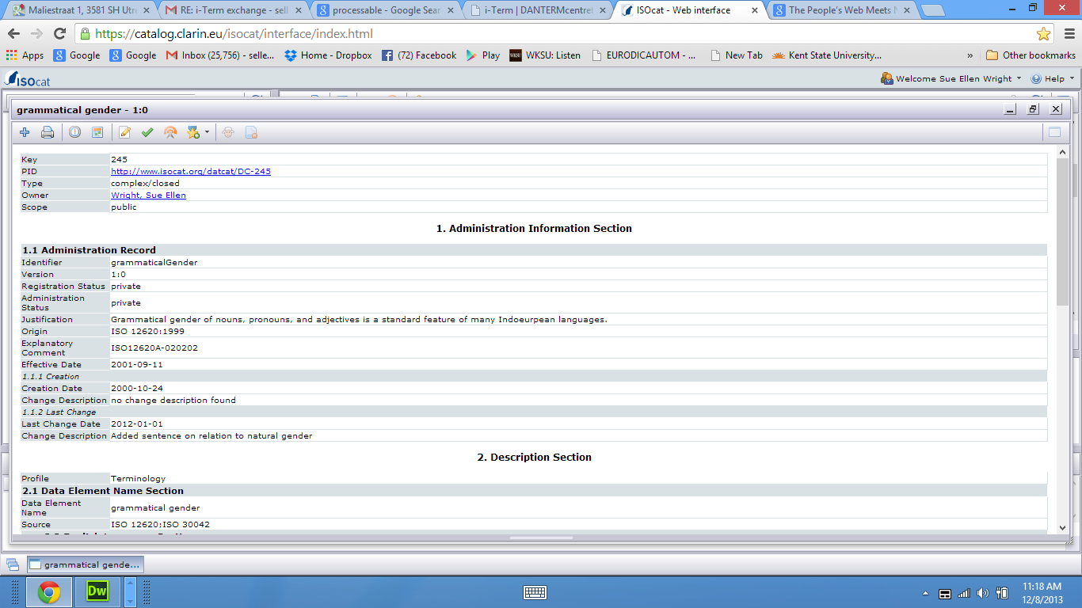
ISOcat DC Specification – Header
Header info: Key & PID; Type; Owner; Scope
Critical feature: PID universally resolvable through RESTful interface

Slide 12
PID Resolution
http://www.isocat.org/datcat/DC-245
Yields:
Designed to serve as reference from other resources on the web
Capable of supporting external relation registries or other ontological resources that might in future replace DCR-related functionalities

Slide 13
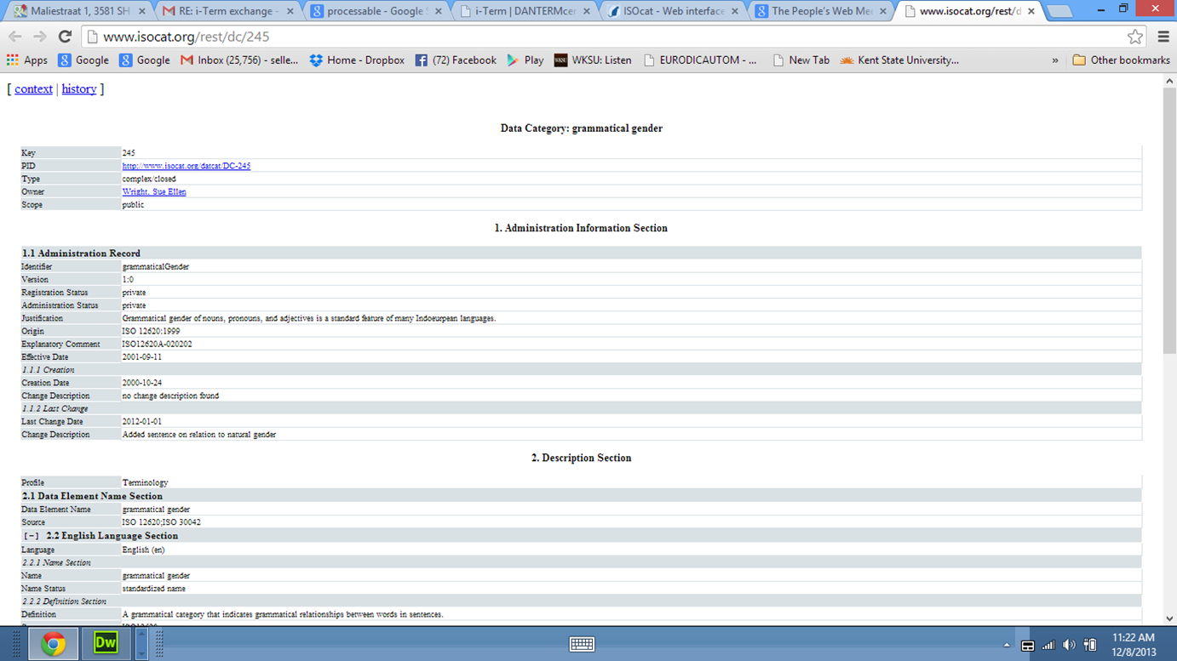
PID Resolution

Slide 14
ISOcat DC Administrative Information
Administrative section
Contains quite a bit of redundant or unnecessary information
Could be reduced or parts hidden

Slide 15
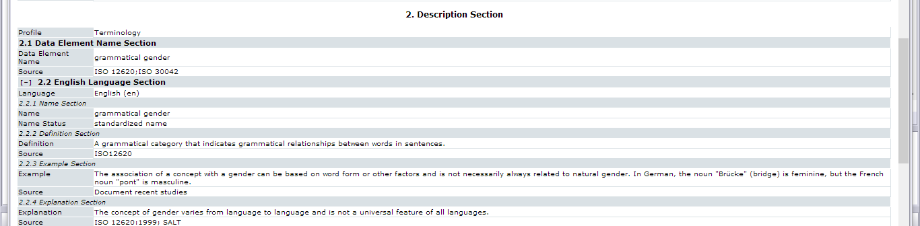
ISOcat DC Description Section
Data element name /English language name
Data element definition (one and only one)
Examples, explanations, notes, sources
Repeatable by language
Note: can become much more complex than shown here

Slide 16
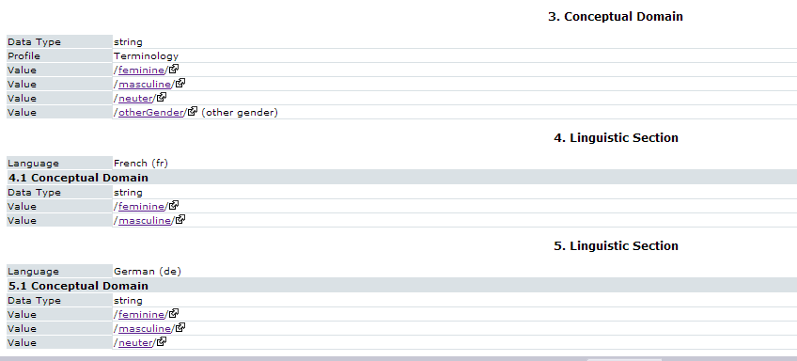
Conceptual domain, Linguistic Section
Conceptual Domain (Links to permissible instances)
Language-specific constraints

Slide 17
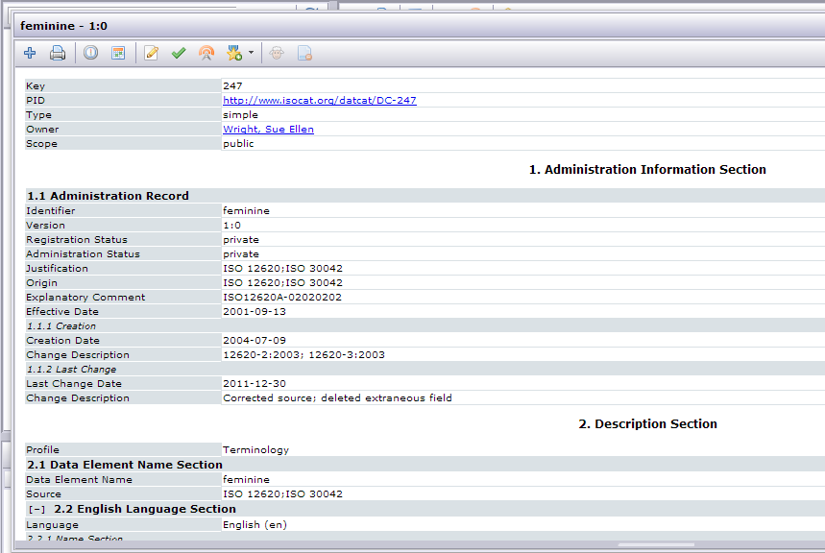
Link to a Simple DC in the Conceptual Domain
Click individual item to display its DC spec
Note: linked items are simple DCs

Slide 18
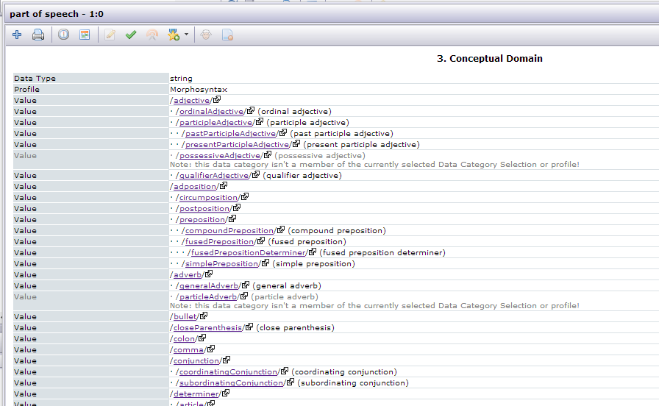
Multiple Conceptual Domains
Part of speech – Morphosyntax
To be continued …

Slide 19
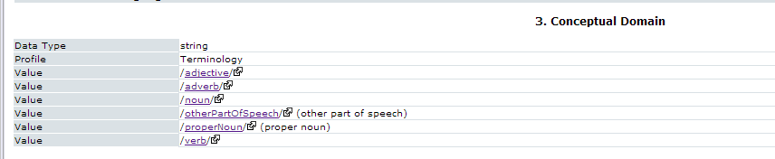
Multiple Conceptual Domains
Part of speech – Terminology

Slide 20
Data Category Selections
Declaring domain & application-specific subsets

Slide 21
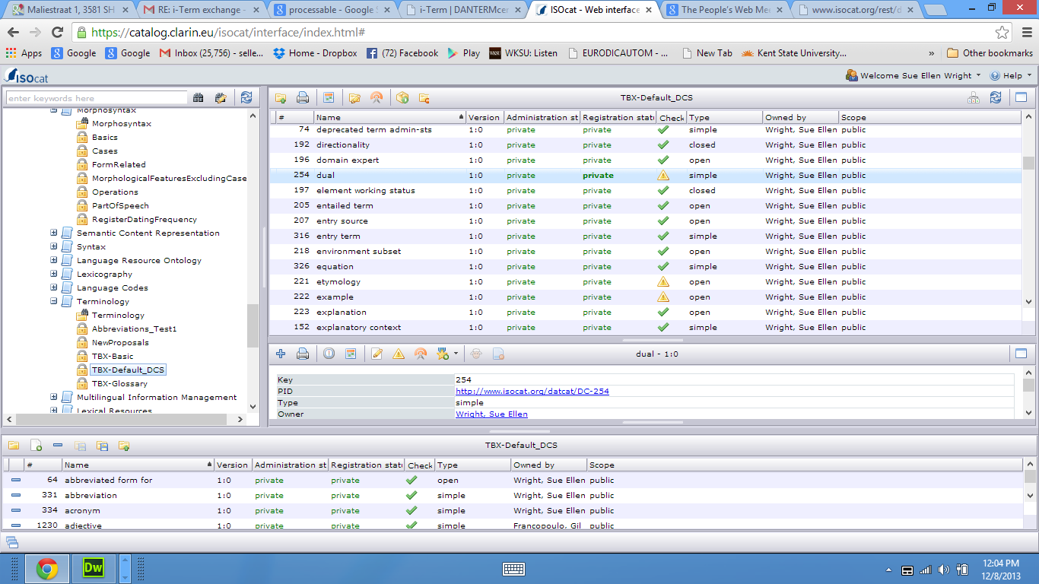
User Access & Data Category Selections
DC Selections
Selected DCS
Selected DC
User’s “Basket”
Potential New DCS

Slide 22
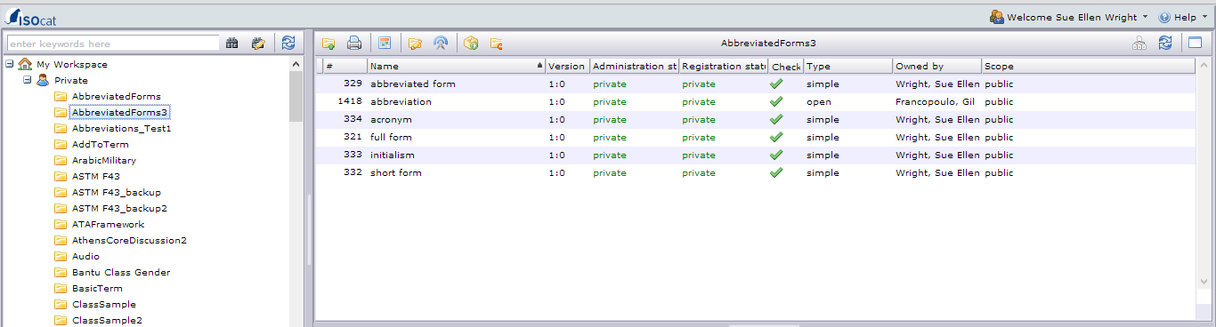
Private Workspace
Registered users can create their own DCSs either by creating new entries or collecting existing DCs into their own new DCSs. DCs are infinitely reusable and referenceable.

Slide 23
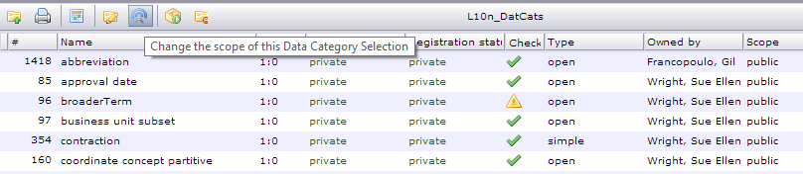
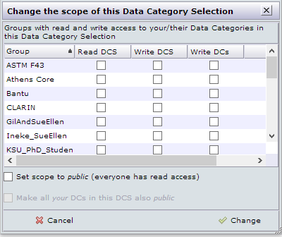
Going Public
Owners can declare a DCS (or a DC) public or share with a selected group

Slide 24
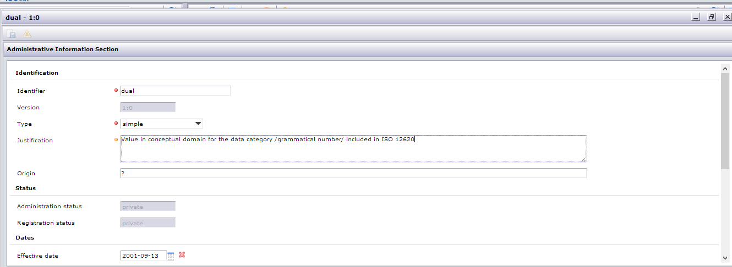
Create/Edit Modes
Owners or authorized registered members of a sharing group can edit existing entries or create new ones

Slide 25
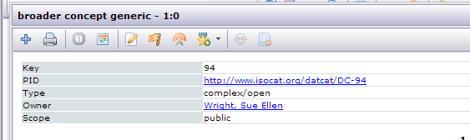
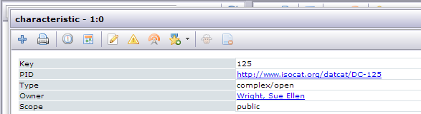
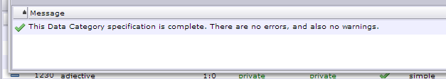
Quality Check
Specs that violate rules for proper form or incompleteness trigger QA warnings that can be resolved by correcting the entries.

Slide 26
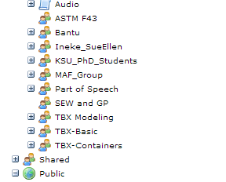
Sharing
Sharing groups show up in one’s private pane in the interface

Slide 27
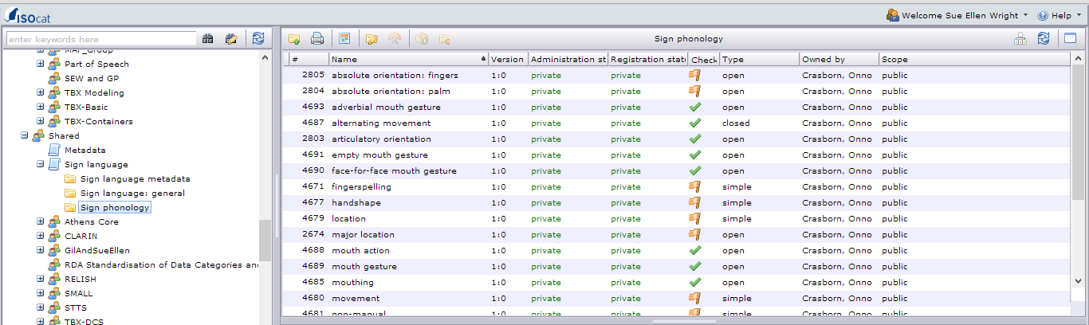
Sharing
Shared selection

Slide 28
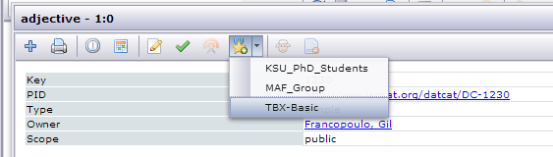
Recommended DCs
Moving away from the standardization concept, groups can less formally identify DCs as recommended for a certain context.
DCSs can then be standardized in relevant ISO standards.

Slide 29
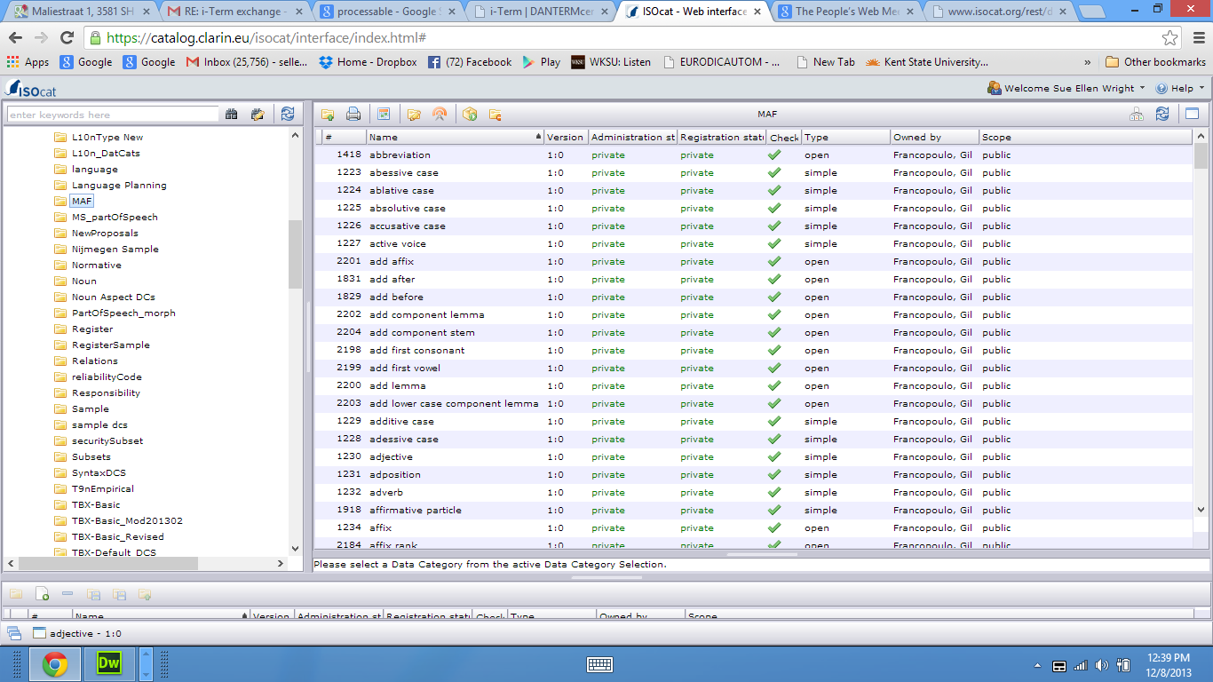
Standardized DCSs
Standardization is more readily realized by listing the DCS in the relevant ISO standard and instantiating the DCS list in the DCR.
ISO 24611:2012. Language resource management – Morpho-syntactic annotation framework (MAF)

Slide 30
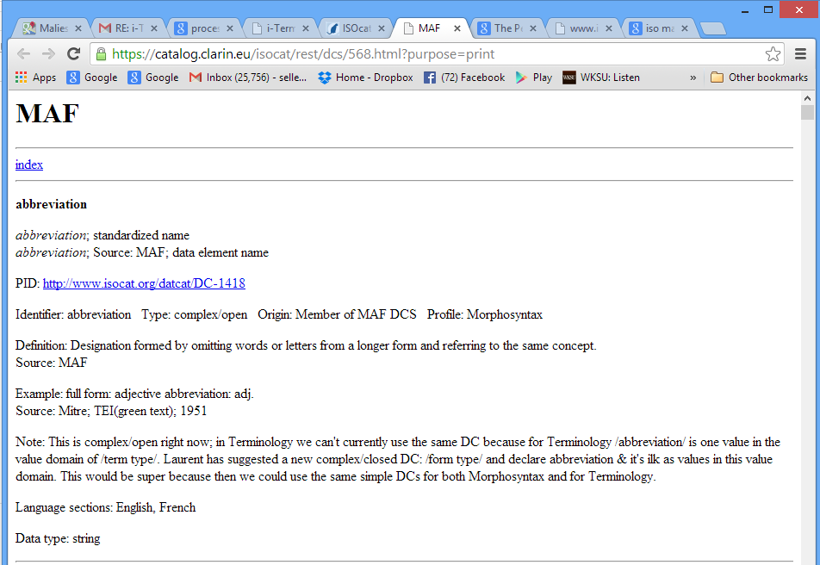
Data Outputs
Human-readable HTML representation

Slide 31
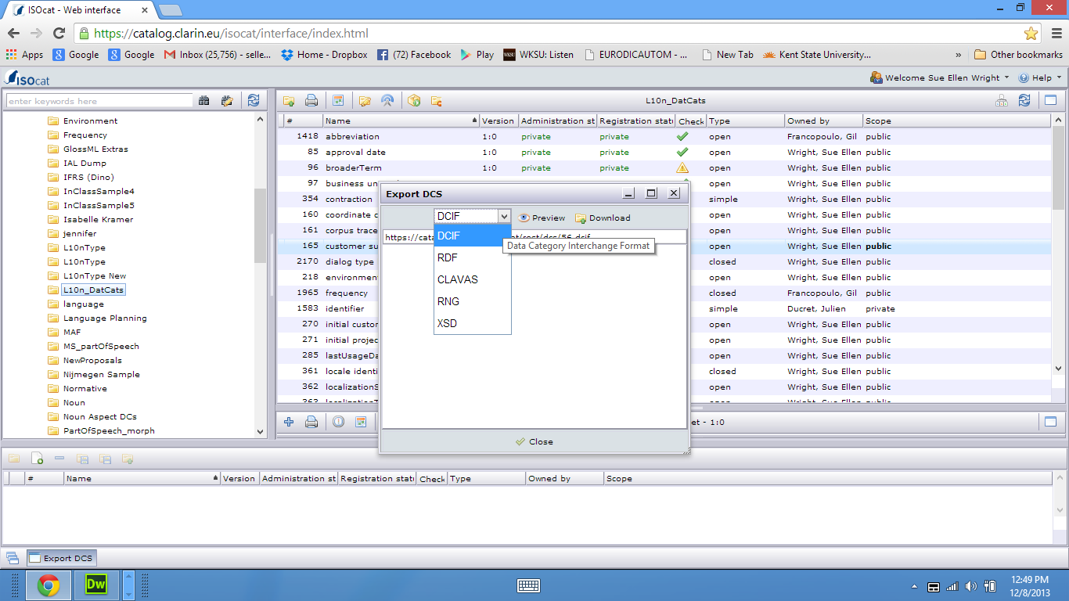
Data Outputs
Processable data outputs

