Slide 1
Semantic MediaWiki and Semantic Forms
Lloyd Rutledge
Semantic Registries Workshop, December 9th, 2013
http://www.slideshare.net/Lloyd.Rutledge/semantic-wikis-semantic-registries-workshop

Slide 2
Questions from the organizers
In your community, how is the support for a semantic registry?
How open is the registry, who can add or modify things, are the semantics stable?
Does the data model of the registry match your needs (information entry, relationships, granularity, possible inconsistency, …)
How is the sustainability of the registry: financially, organisational, … ?

Slide 3
In your community, how is the support for a semantic registry?
Semantic MediaWiki and Semantic Forms are themselves technologies for setting up semantic registries
They support their communities well
  Easy set up and maintenance
  Easily distributed maintenance, authoring and access
  Quick setup of Semantic Web endpoint
Wikipedia as semantic registry

Slide 4
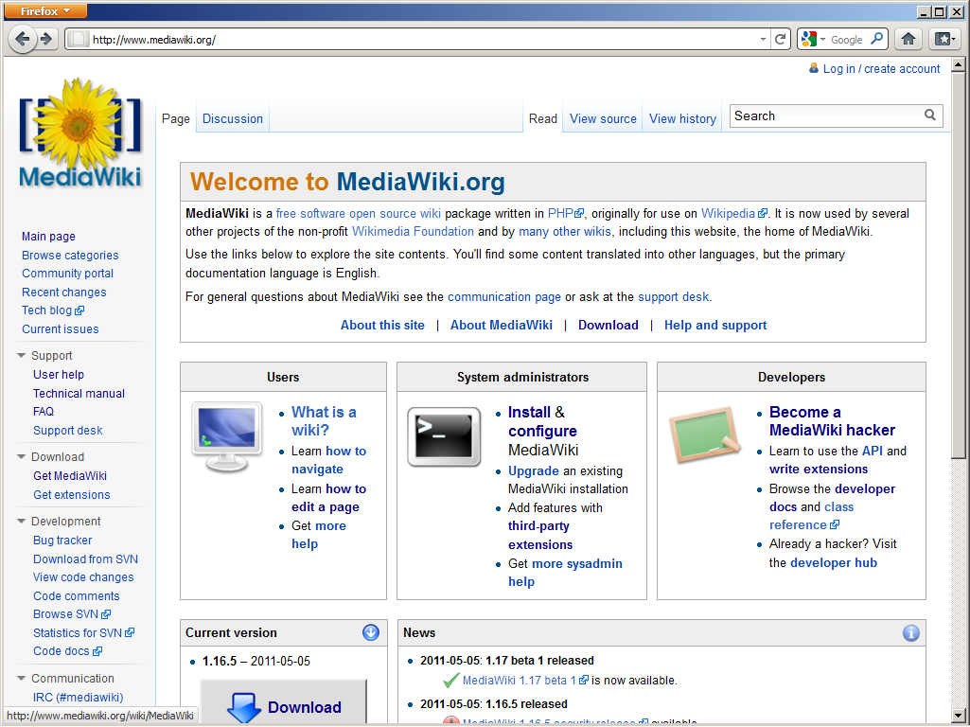

Slide 5
Online, sharable, universal
Specializes in distance collaboration
Well-supported, has extension framework

Slide 6
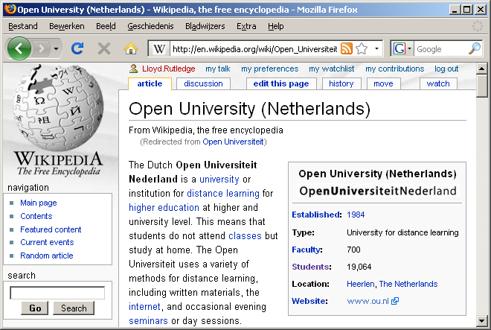
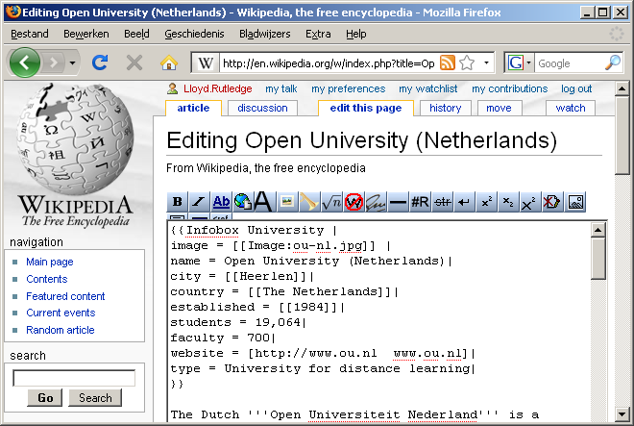
Wikipedia infobox: open data editing

Slide 7
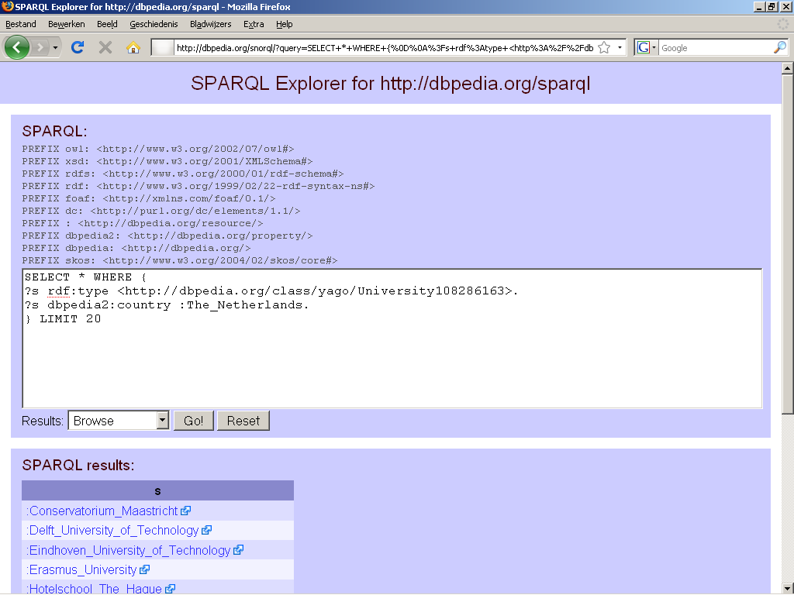

Slide 8
Online, sharable, universal
Specializes in data retrieval
XSLT can tailor data report presentation

Slide 9
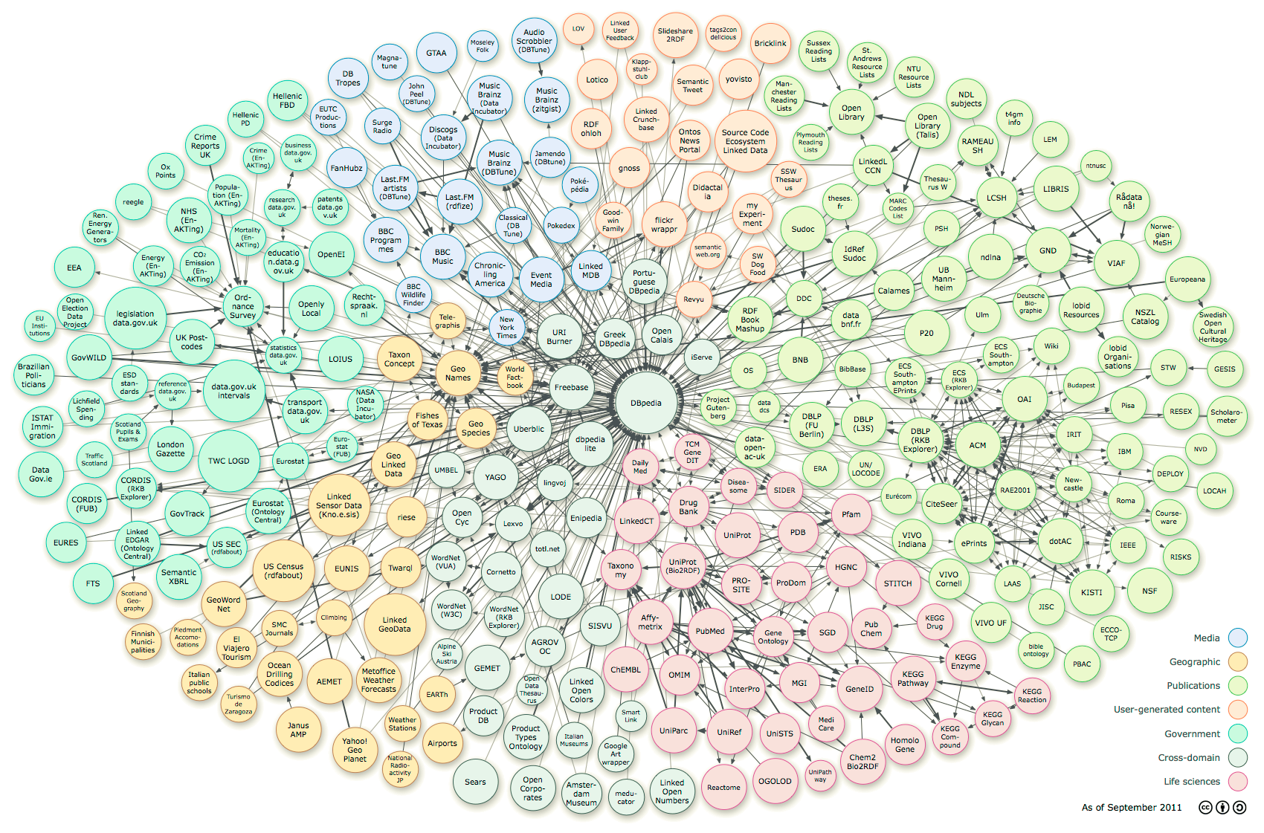
Your
wiki

Slide 10
How open is the registry, who can add or modify things, are the semantics stable?
By default open
Webmaster can modify read, create and edit permissions
  Based on user types
  For all pages (concepts, resources) equally
Data entry forms can restrict modification or entry of data
Stability
  Easy to change existing data (triples)
  Forms can help keep data conforming to ontologies

Slide 11
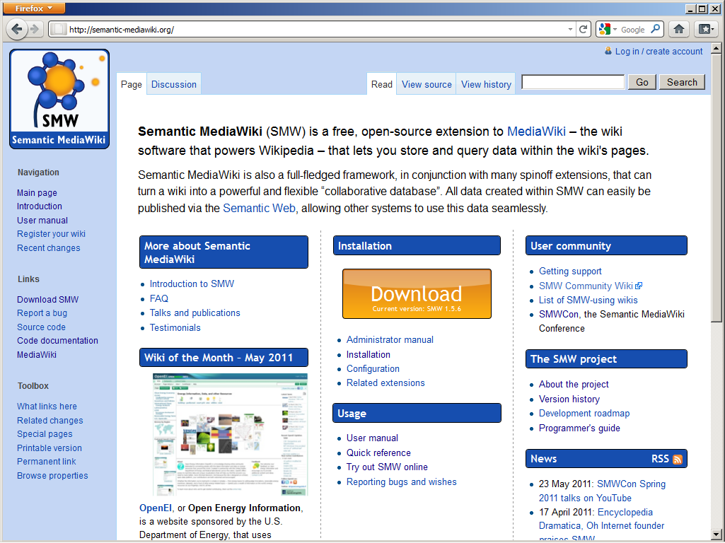

Slide 12
MediaWiki extension
Well-supported, active development
Semantic Web (-ish, -partial)
  Annotation syntax
  Data queries and formatted reports
  RDF export
  Direct connection to online endpoint

Slide 13
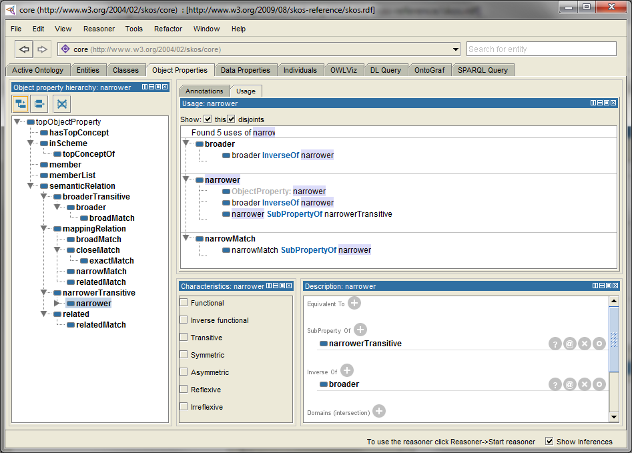

Slide 14
Protégé-OWL
Many conforming Semantic Web functions
Well-known oft-used tool
Specializes in editing ontologies

Slide 15
Does the data model of the registry match your needs?
Information entry?
  Forms makes entry easy. Wiki keeps pages maintainable
Relationships?
  Form field autocompletion
  Infobox-like displays
Granularity?
  Wiki imposes a page unit to data and concepts
Possible inconsistency?
  Not at purely semantic level
  Interface restrictions can help

Slide 16
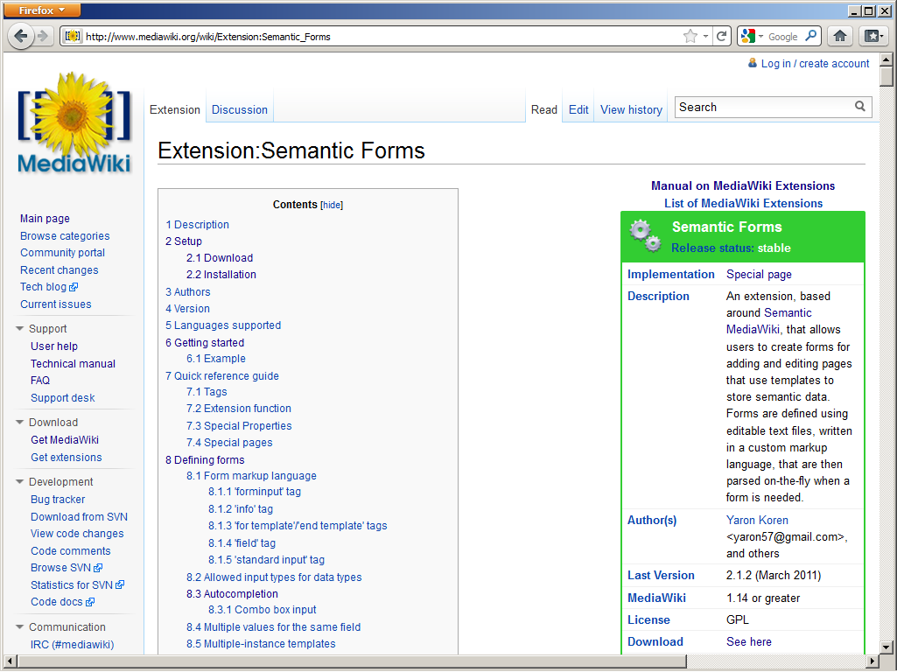

Slide 17
Semantic MediaWiki extension
Infobox-like templates for data browsing
Forms for data entry
Primitives for building ontology-based interface
Interface assistance and constraints help maintain ontological consistency
  Such as autocompletion

Slide 18
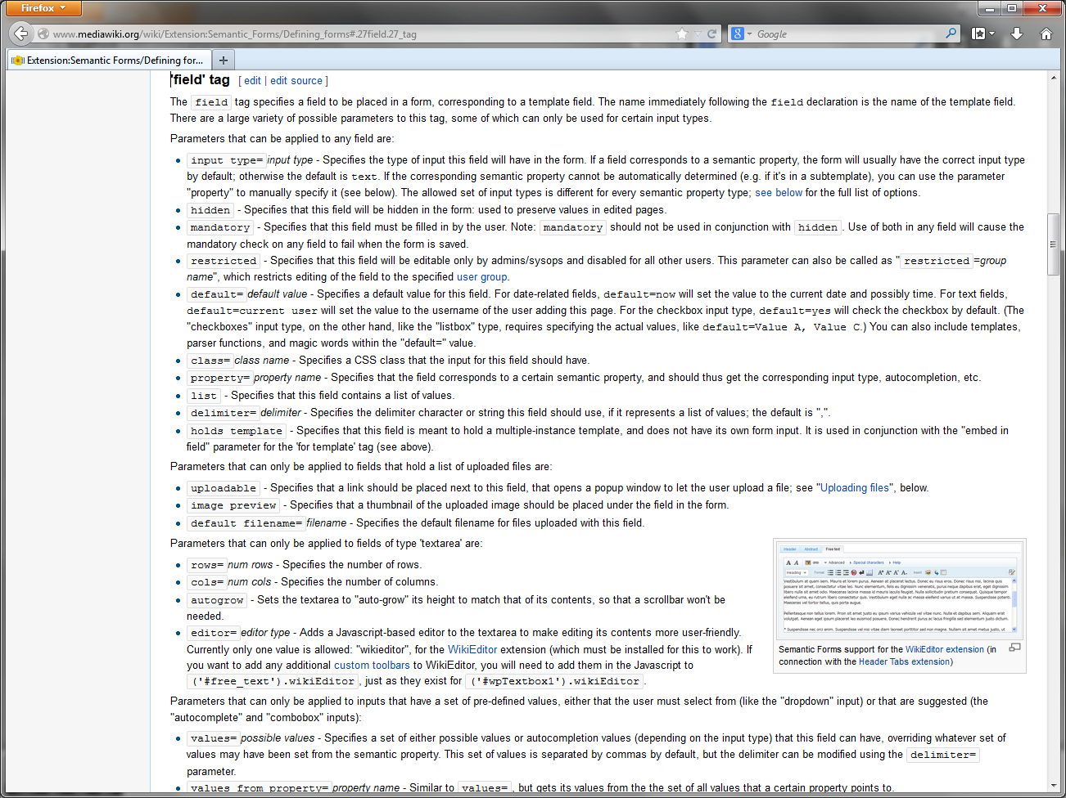

Slide 19
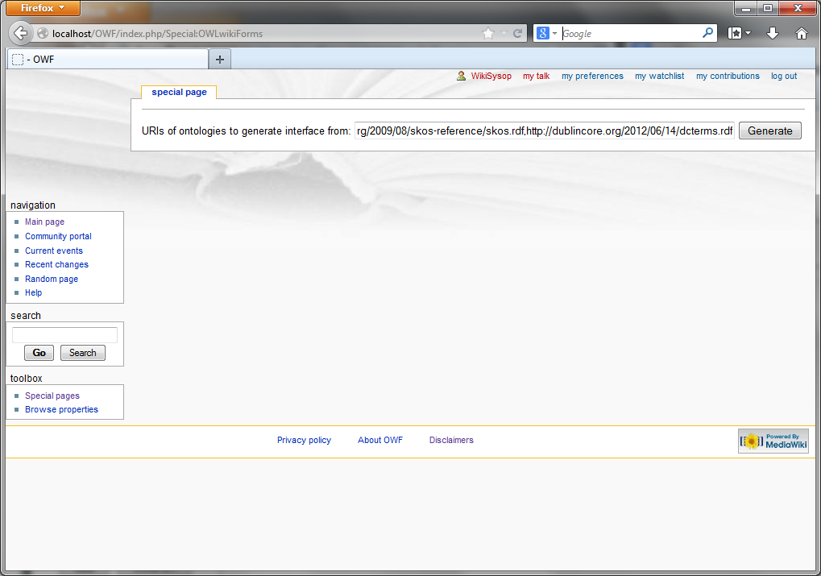

Slide 20
OWL Wiki Forms (OWF)
Input: Semantic Web ontology (data model)
Output: Semantic wiki with form-based input
Academic results
  Mapping of abstract data modeling to interface
Practical results
  Efficient quick setup of wiki interface for entering data for a given ontology

Slide 21
How is the sustainability of the registry?
(MediaWiki and Semantic MediaWiki)
Financially
  Open source
  Primarily academic project
  Much code offered as student projects
  Minority but substantial industrial involvement
Organisational
  Ditto
Is stable, mature and widely used with diverse community of user and developers

Slide 22
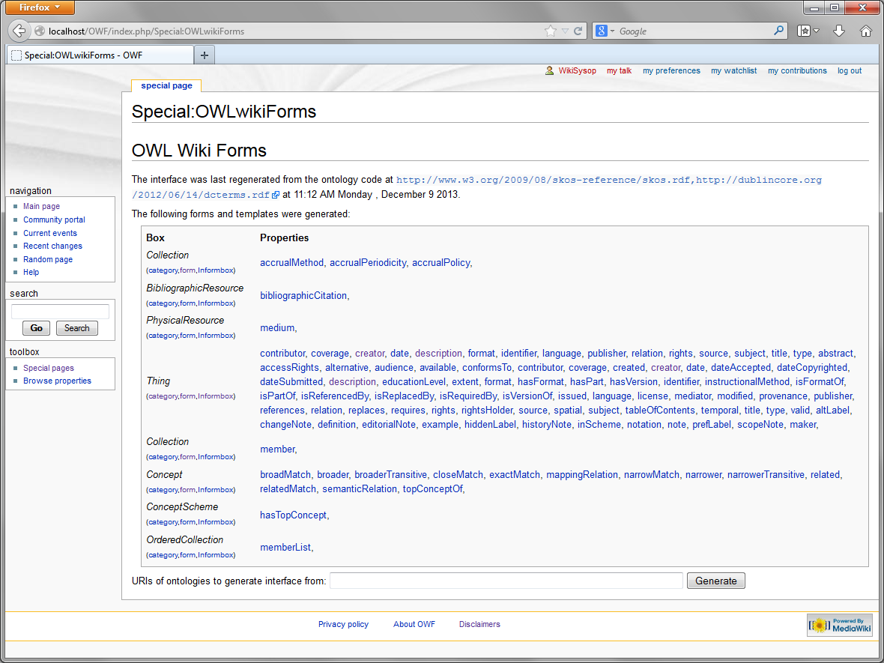

Slide 23
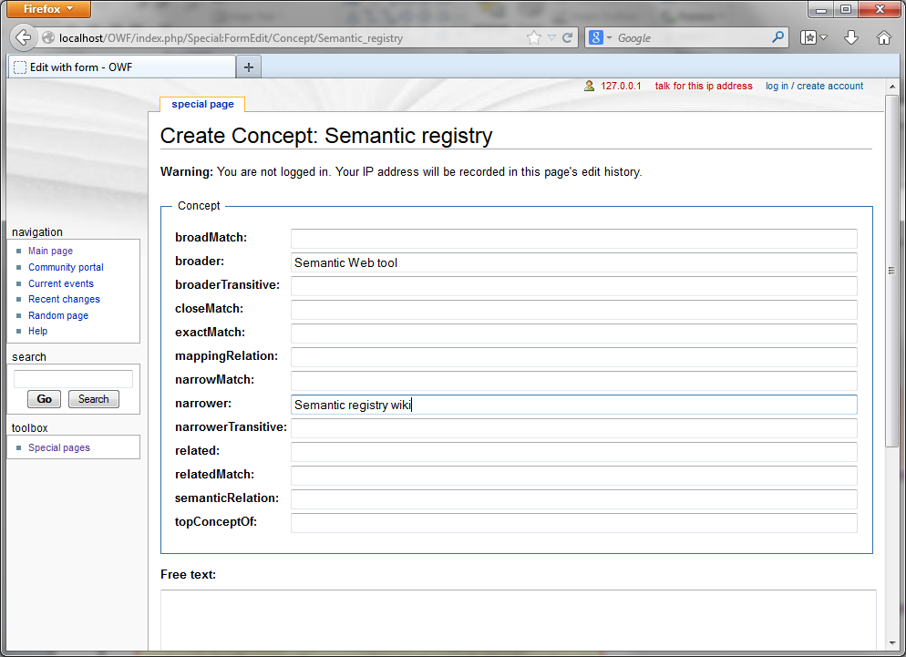

Slide 24
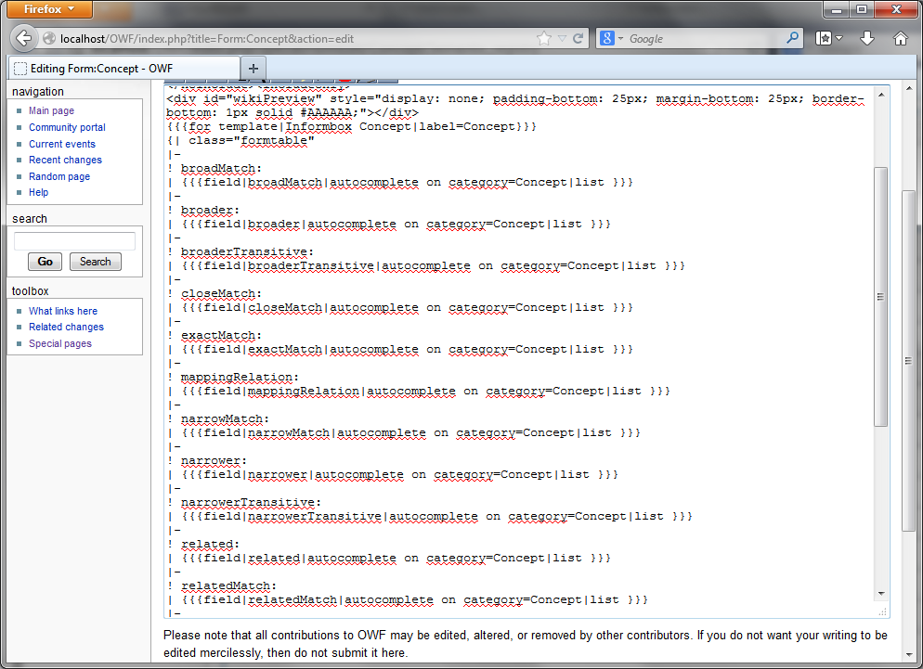

Slide 25
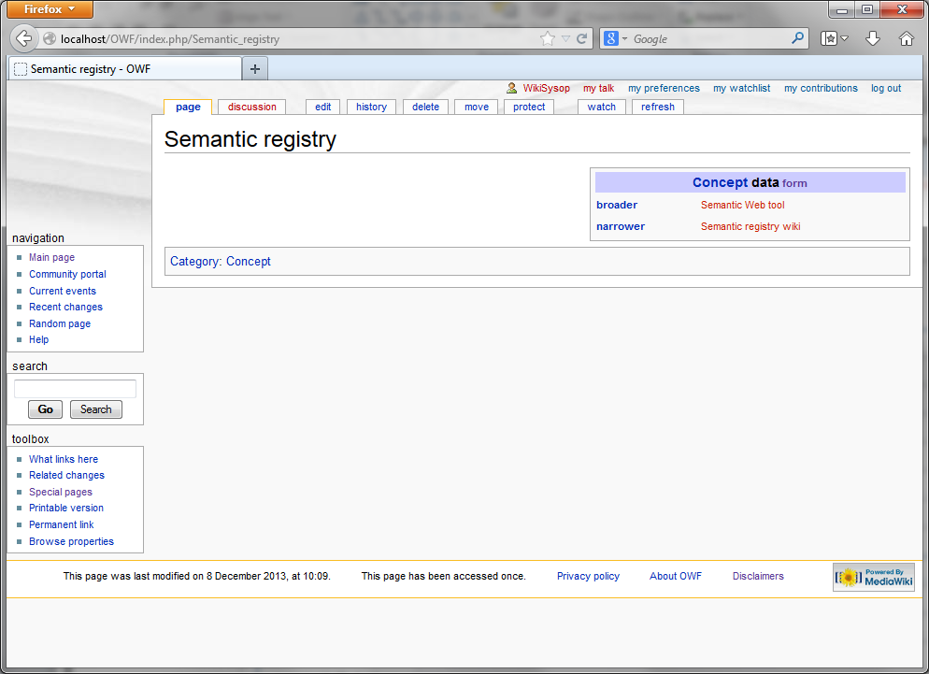

Slide 26
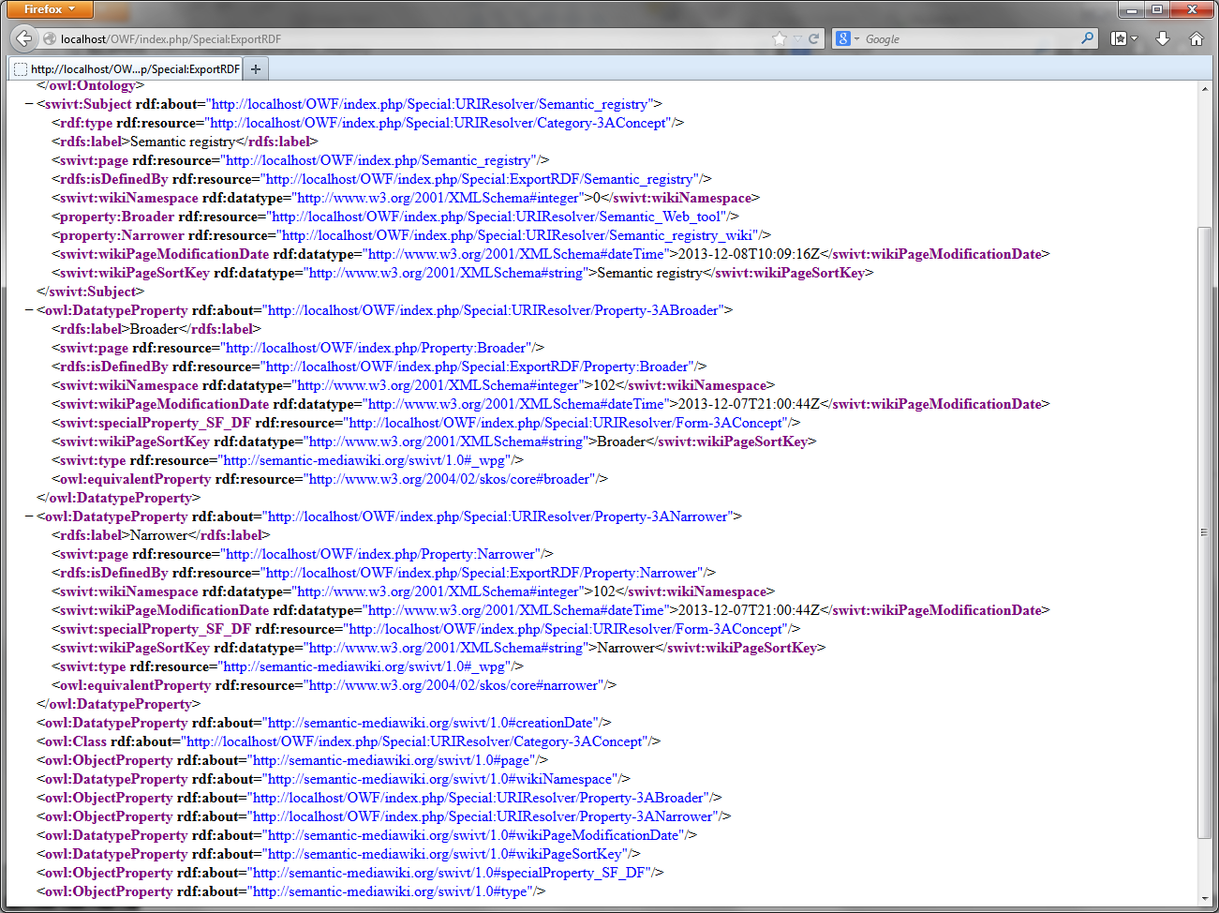

Slide 27
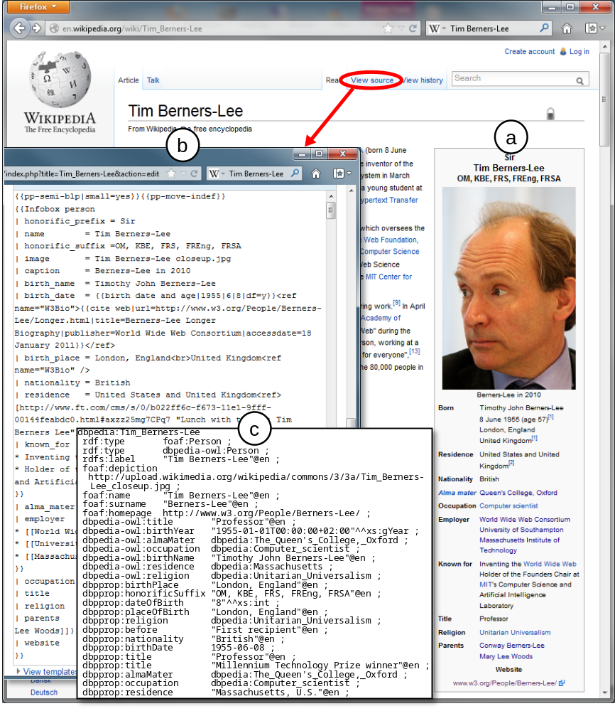

Slide 28
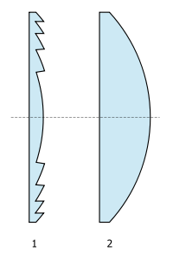
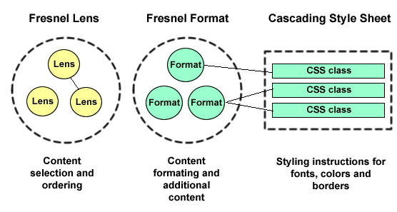
Fresnel: RDF interface in RDF
http://en.wikipedia.org/wiki/Fresnel_lens
Specifies how RDF is display
Separates style from content: like CSS for XML
Also in RDF
Supported by multiple semantic browsers such as Longwell
http://www.w3.org/2005/04/fresnel-info/manual/

Slide 29
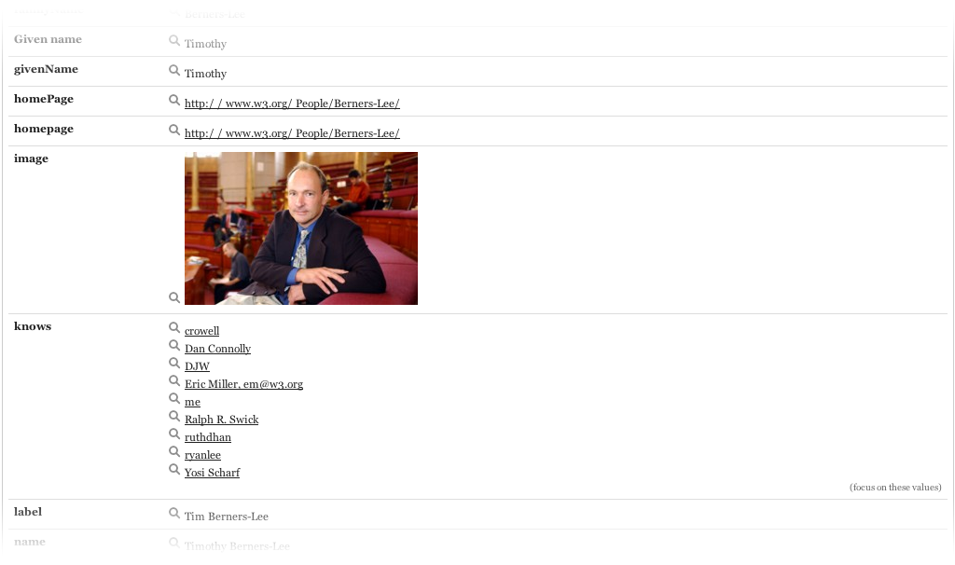
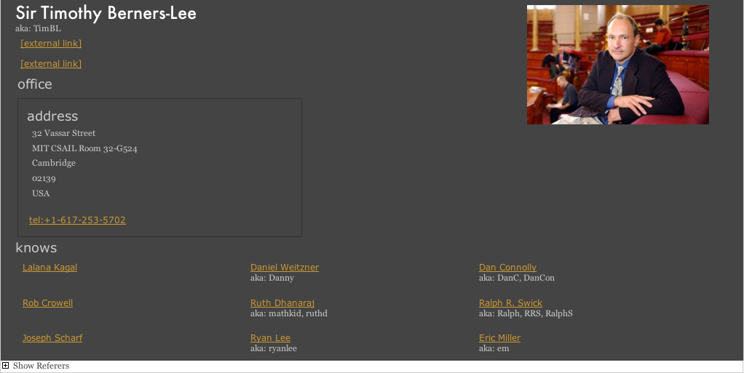
http://dig.csail.mit.edu/2006/Talks/0724-fresnel/#%2814%29
Domain-independent default for browser (Longwell)
With (handmade) Fresnel style

Slide 30
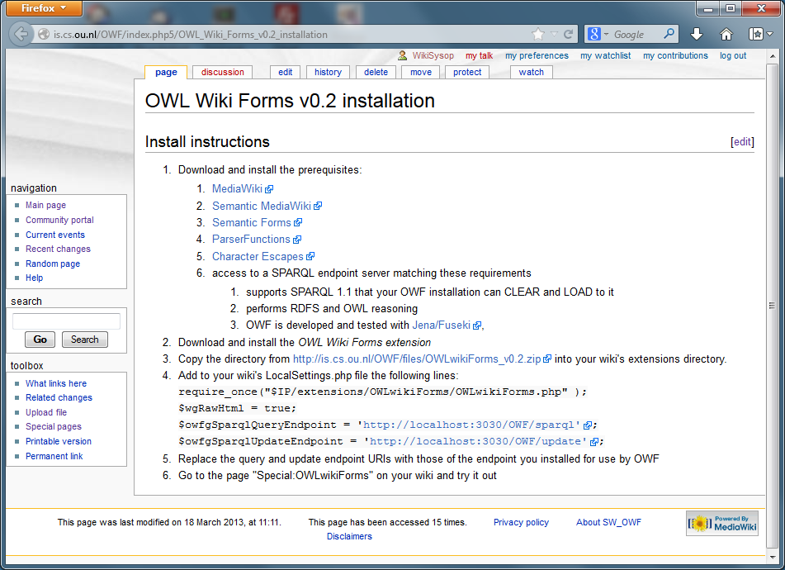

Slide 31
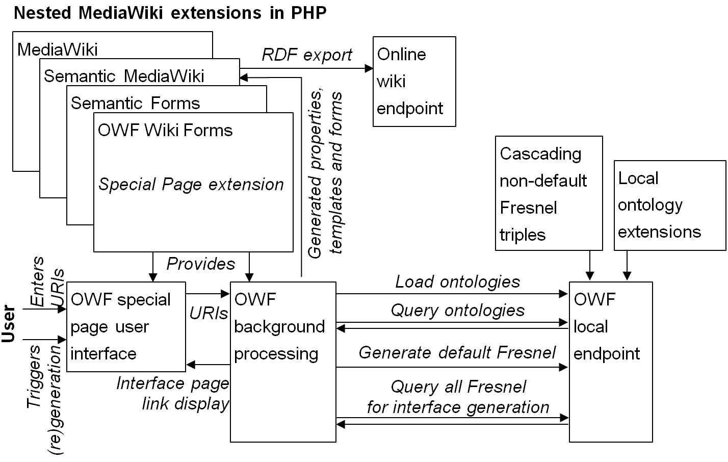
OWL Wiki Forms (OWF) architecture

Slide 32
Generated default Fresnel code
:defaultLenshttpxmlnscomfoaf01Person
rdf:type fresnel:Lens ;
fresnel:classLensDomain foaf:Person ;
fresnel:showProperties
foaf:currentProject , foaf:familyName , foaf:family_name , foaf:firstName , foaf:geekcode , foaf:img , foaf:knows , foaf:lastName , foaf:myersBriggs , foaf:pastProject , foaf:plan , foaf:publications , foaf:schoolHomepage , foaf:surname , foaf:workInfoHomepage , foaf:workplaceHomepage .

Slide 33
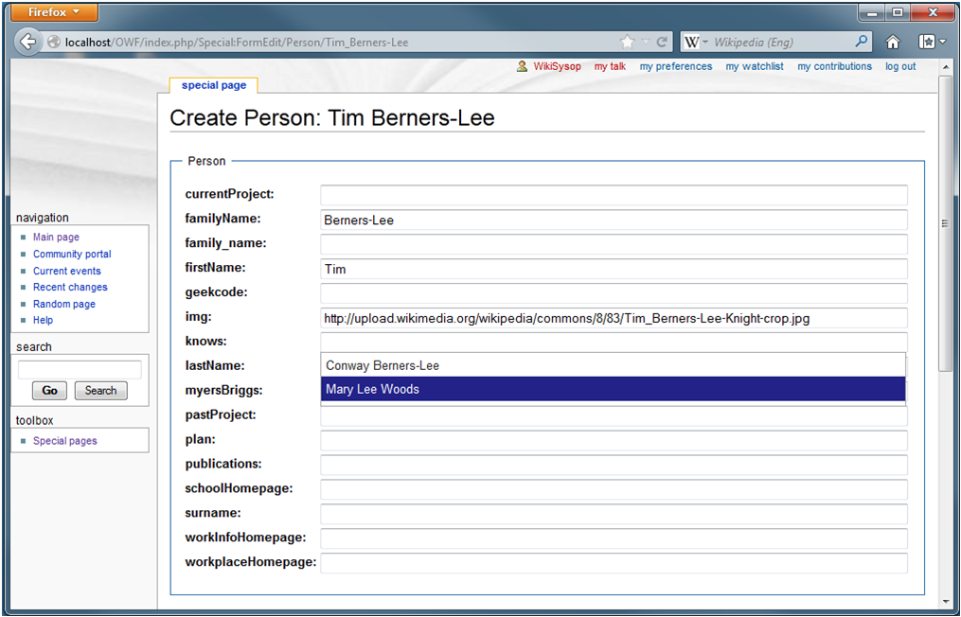
Range-based autocompletion

Slide 34
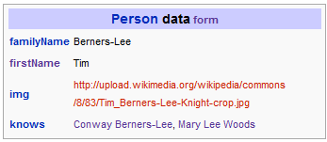
Default view
{{Informbox Person
|familyName=Berners-Lee
|firstName=Tim
|img=http://upload.wikimedia.org/wikipedia/commons/8/83/
Tim_Berners-Lee-Knight-crop.jpg
|knows=Conway Berners-Lee, Mary Lee Woods
}}

Slide 35
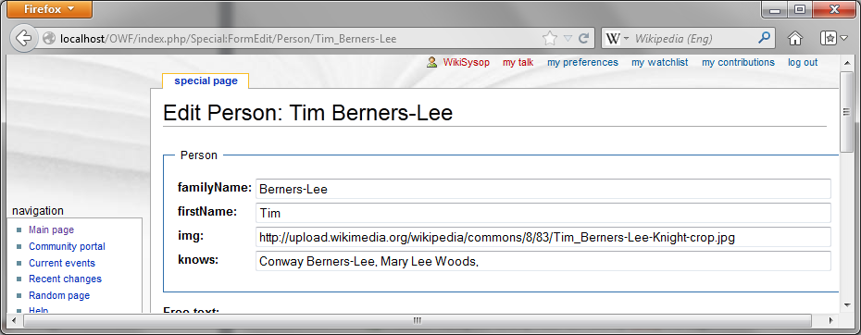
Cascade Fresnel to hide undesired properties
:defaultLenshttpxmlnscomfoaf01Person fresnel:hideProperties foaf:currentProject , foaf:family_name , foaf:geekcode , foaf:lastName , foaf:myersBriggs , foaf:pastProject , foaf:plan , foaf:publications , foaf:schoolHomepage , foaf:surname , foaf:workInfoHomepage , foaf:workplaceHomepage .

Slide 36
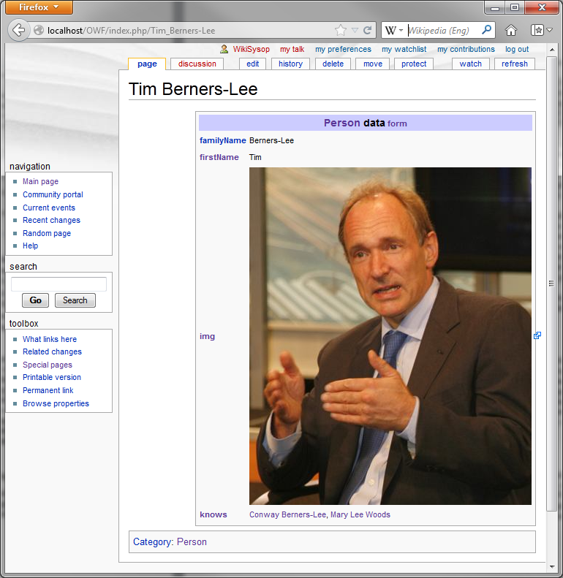
:imgFormat
rdf:type fresnel:Format ;
fresnel:value fresnel:image ;
fresnel:propertyFormatDomain
foaf:img .

Slide 37
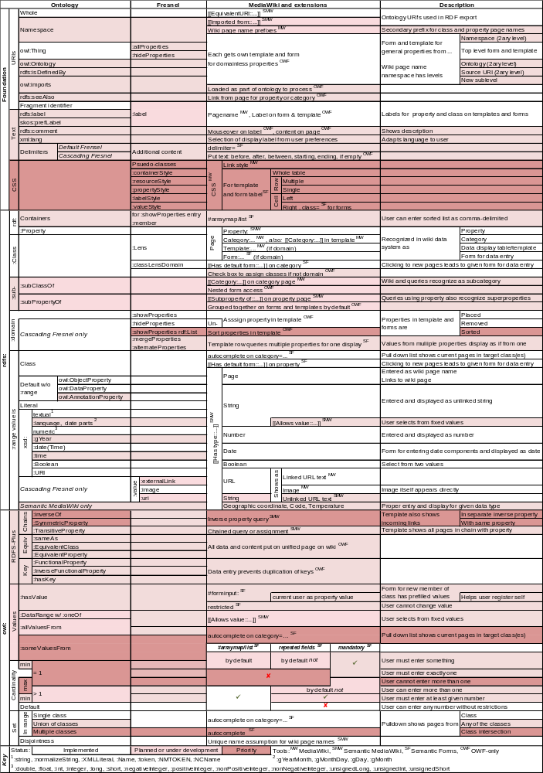
OWL Wiki Forms: Feature table

Slide 38
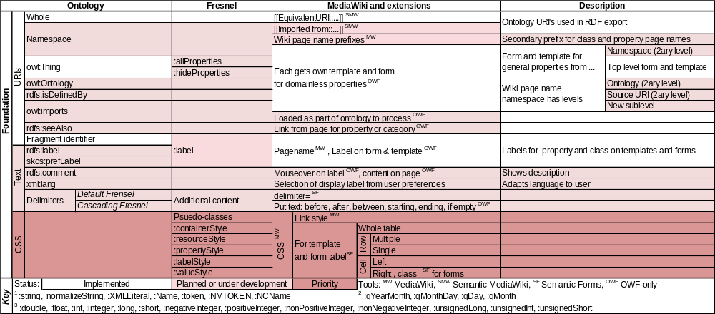
OWL Wiki Forms: Web foundation

Slide 39
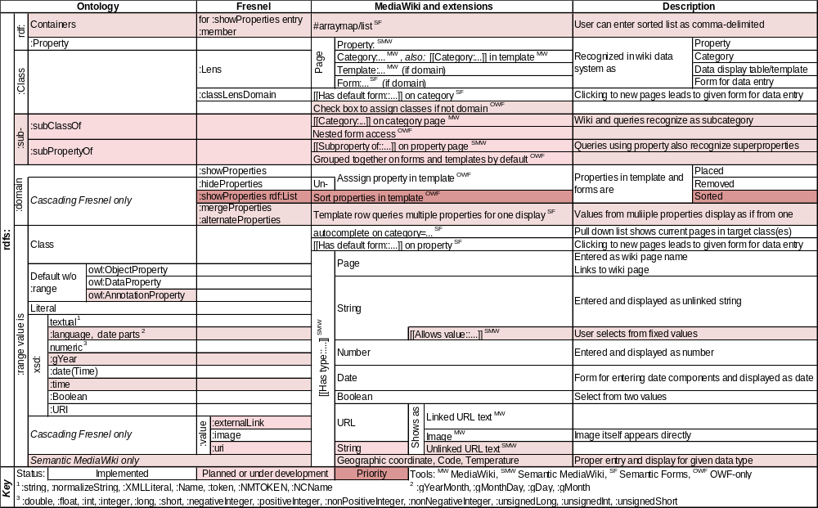
OWL Wiki Forms: RDF & RDFS

Slide 40
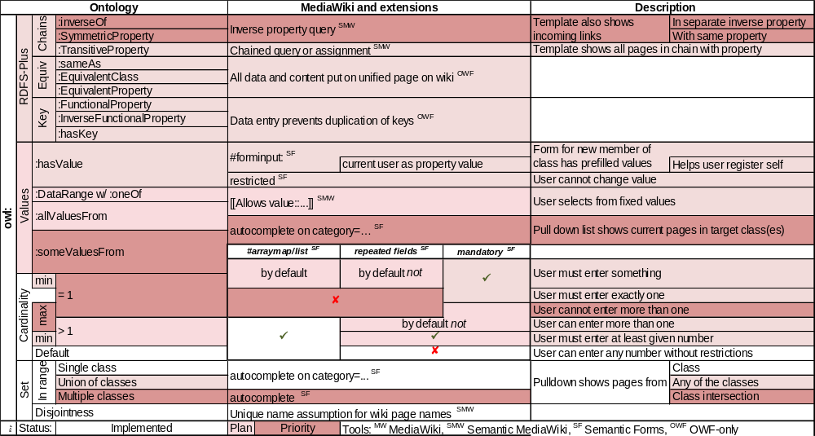
OWL Wiki Forms: OWL

Slide 41
Conclusion
Semantic MediaWiki
  Puts data processing in Wikipedia-like wiki
  Export to Semantic Web
  Mature, stable, very widely-used
Semantic Forms
  Semantic MediaWiki extension
  Assisted form-based data input
  Mature, stable, pretty widely-used
OWL Wiki Forms
  New research tool
  Explores tightening Semantic Forms link
  with underlying Semantic Web ontologies

