Slide 1
OpenSKOS
Hennie Brugman
Meertens Institute, Amsterdam
Hennie.brugman@meertens.knaw.nl
Semantic Registry Workshop, Utrecht, December 9 2013

Slide 2
OpenSKOS introduction and architecture
Screens and API
Status and availability
Positioning

Slide 3
OpenSKOS =
  SKOS format +
  Peer to peer architecture +
  RESTful API +
  Linked Data +
  Publication with upload and OAI-PMH +
  Management using Interactive Dashboard +
  Support for alignment +
  Promotion of open database licenses
  Vocabulary curation with built-in Editor

Slide 4
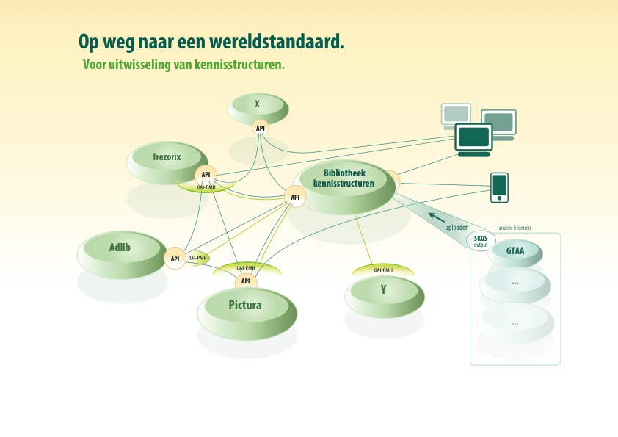
Each node implements:
Upload module
RESTful API (autocomplete, find, CRUD)
Linked Data access
OAI-PMH data provider and harvester
Editor for management and curation

Slide 5
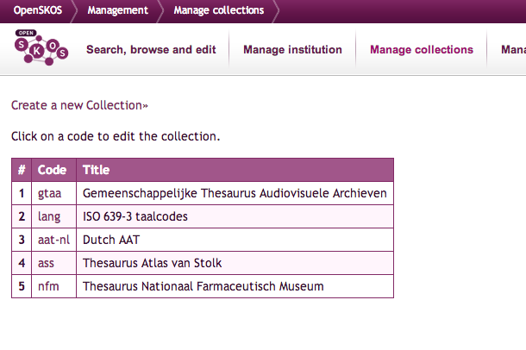
Suppose, I am looking for a thesaurus to describe windmills, or gestures, or linguistic categories, or …
Then I can go to OpenSKOS where thesauri are made available

Slide 6
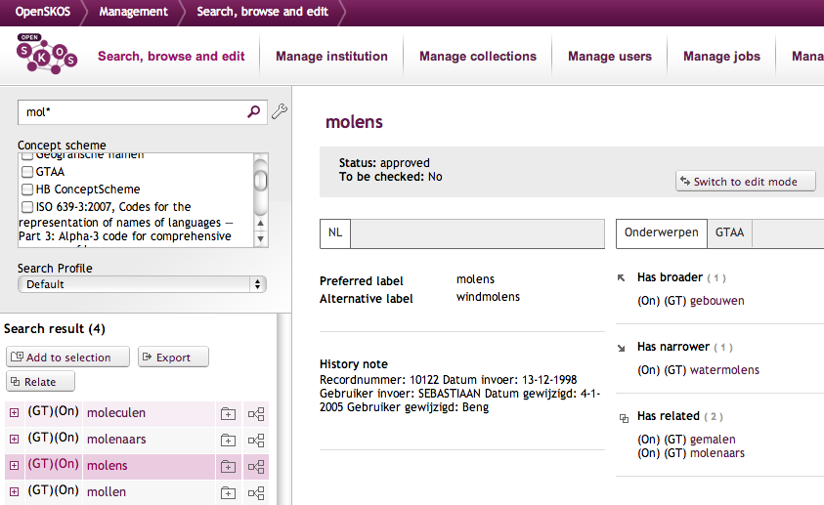
Then, I want to find information about the thesaurus and evaluate its contents online

Slide 7
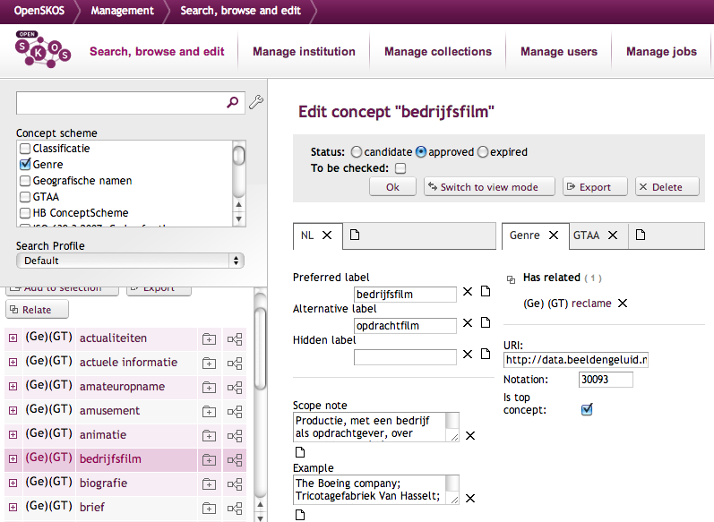

Suppose, I want to construct and maintain my thesaurus online, possibly together with others
Then I can use the Editor that is built into OpenSKOS (by Netherlands Institute for Sound and Vision)

Slide 8
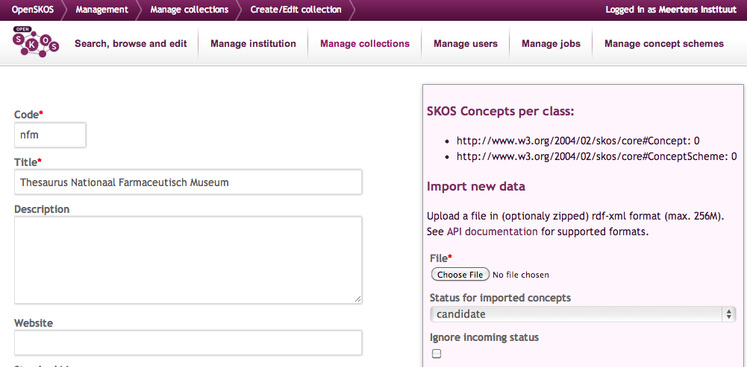
Suppose, I want to provide a thesaurus (update) to the world or to a partner institution who uses a commercial tool (e.g. Picturae’a Memorix) or a scientific one (CLARIN’s Arbil)
Then I can easily upload with the OpenSKOS upload functionality

Slide 9
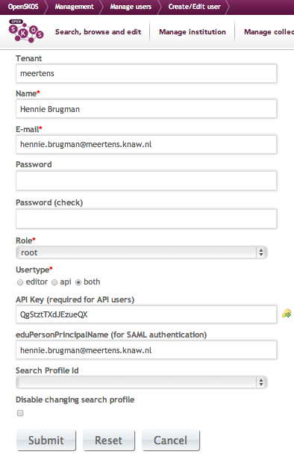

Suppose, I want to maintain an OpenSKOS node. Then I have interactive management functions available

Slide 10
RESTful API
Concept resolve API
Find API
Autocomplete
CRUD (create, retrieve, update, delete)
Institutions
Collections
Notes:
Naar aanleiding van uitgebreide, gezamenlijk geprioriteerde lijst van use cases
Lucene Query Parser Syntax
Sommige endpoints: GET, PUT, POST, DELETE: lezen en schrijven

Slide 11
API voorbeelden
{
"tenant": "meertens",
"collection": 4,
..
"uri": "http://openskos.meertens.knaw.nl/Organisations/3ffbdaf6-d07f-4f04-8ea9-aba0c2749670",
"uuid": "d921f9f9-f759-475a-cb9d-5f1dcfa00b49",
"class": "Concept",
..
"prefLabel@en": [
"UiL-OTS, Utrecht University"
],
..
"LexicalLabels@en": [
"UiL-OTS, Utrecht University",
"UiL-OTS, Utrecht University"
],
"altLabel@en": [
"UiL-OTS, Utrecht University"
],
..
"broader": [
"http://openskos.meertens.knaw.nl/Organisations/78d67e6a-0a2a-4ba3-8757-146eaf7fed7d"
],
"SemanticRelations": [
"http://openskos.meertens.knaw.nl/Organisations/78d67e6a-0a2a-4ba3-8757-146eaf7fed7d"
],
"inScheme": [
"http://openskos.meertens.knaw.nl/Organisations"
],
"xmlns": [
"rdf",
"skos"
],
"notation": [
"108950"
]
}
Concept resolve
  api/concept?id=http://openskos.meertens.knaw.nl/Organisations/78d67e6a-0a2a-4ba3-8757-146eaf7fed7d&format=html
  RDF, JSON or html
<rdf:RDF>
<rdf:Description rdf:about="http://openskos.meertens.knaw.nl/Organisations/3f..70">
<rdf:type rdf:resource="http://www.w3.org/2004/02/skos/core#Concept"/>
<skos:prefLabel xml:lang="en">UiL-OTS, Utrecht University</skos:prefLabel>
<skos:altLabel xml:lang="en">UiL-OTS, Utrecht University</skos:altLabel>
<skos:broader rdf:resource="http://openskos.meertens.knaw.nl/Organisations/78..7d"/
<skos:inScheme rdf:resource="http://openskos.meertens.knaw.nl/Organisations"/>
</rdf:Description>
</rdf:RDF>

Slide 12
{"response": {
  "numFound": 4,
  "start": 0,
  "docs": [
    …
    {
      "scopeNote": [
        "veldrijder"
      ],
      "prefLabel": [
        "Rutte, Marcel"
      ],
      "xmlns": [
        "rdf",
        "skos",
        "dcterms"
      ]
    },
    {
      "scopeNote": [
        "minister-president VVD, fractievoorzitter VVD Tweede Kamer, staatssecretaris OCW en Sociale Zaken, voorzitter JOVD"
      ],
      "prefLabel": [
        "Rutte, Mark"
      ],
      "xmlns": [
        "rdf",
        "skos",
        "dcterms"
      ]
    },
    …
  ]
}
}
Find API
  api/find-concepts?q=crisis&format=rdf
  api/find-concepts?q=crisis+collection:4&format=json
  api/find-concepts?q=crisis+tenant:rkd&format=json
  api/find-concepts?q=prefLabelText:rutte+collection:4+inScheme:http*Persoonsnamen&format=json&fl=prefLabel,scopeNote

Slide 13
Autocomplete API
  api/autocomplete/politi?returnLabel=prefLabel
  api/autocomplete/speelf?returnLabel=prefLabel

Slide 14
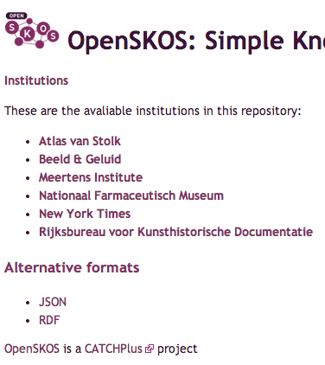
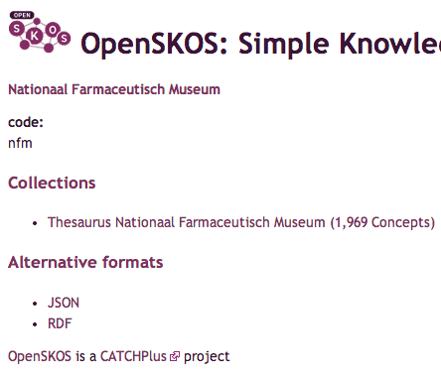
Institutions, Collections API
  in RDF: /api/institutions
  in HTML: /api/institutions?format=html
  /api/collections/beng:gtaa.html

Slide 15
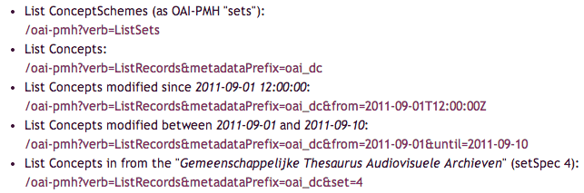
OAI-PMH examples

Slide 16
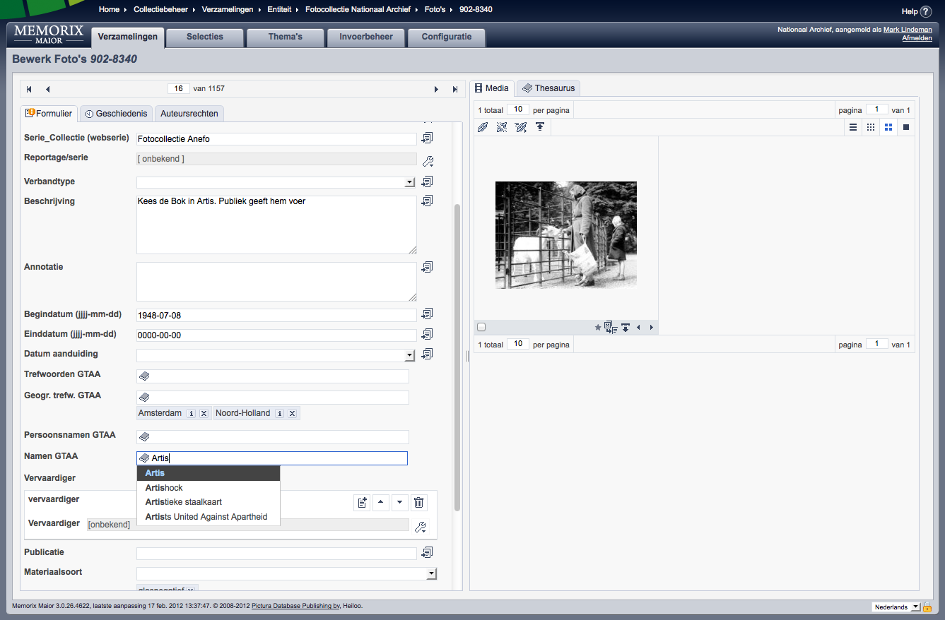
OpenSKOS instances
  Instance(s) for internal use, publication and curation of GTAA thesaurus of Sound and Vision
  Approx 8 instances for (international) customers of Picturae
  Meertens instance for CLARIN-NL CLAVAS project
  Experimental instance at Institute for Corpus Linguistics and Text Technology, Vienna
  Cologne Center for eHumanities (thesaurus construction)
  Test installation at Europeana (1914-1918 project)
Client tools: Memorix, Arbil (planned)

Slide 17
Availability
Source code available under Open Source licence (GitHub)
Open Database licences and Creative Commons recommended for content
Free use of services promoted
  Except for curation and management functions
  Everybody is free to run own OpenSKOS instance
CATCHPlus agreement: hosted for 10 years by Picturae

Slide 18
Positioning of OpenSKOS. Dimensions:
  Scope: what types of data?
  Semantic accuracy: how detailed?
  Data model:
    SKOS, by choice of design
    Extra: Collections and Institutions for data management purposes
  Loss of semantics versus interoperability

Slide 19
  Supported stakeholders and use cases
  Cultural Heritage and Digital Humanities
    Both scientific and commercial usage
  Primarily: tool support, vocabulary publication and exploitation, vocabulary creation and curation
  Not primarily: (authoritative) registry, standardization

Slide 20
  Openness of content
    Open data licences, free use of services, harvestable
  (inter)linking important and part of vocabularies
    Linked data, semantic context
    Concepts linked within and across concept schemes (vocabulary alignment)
    Generalization and specialization

Slide 21
  Access
  Low threshold for input and output
    “market place”
  Alternative protocols
    OAI-PMH
    REST
    Linked Data
    Interactive

Slide 23
Stakeholders: providers
Publish your vocabularies or updates yourself with a simple upload action (or via OAI data provider)
Use your own vocabularies in somebody elses tool (commercial or non-commercial) without intervention of the tool builder
Easy to align your own concepts with other vocabularies

Slide 24
Stakeholders: users
Simple to discover, evaluate and (re)use vocabularies
  Less need to construct them yourself
New browsing and searching possibilities
  In vocabularies, in metadata descriptions
Online vocabularies are always up to date

Slide 25
Stakeholders: tool builders
No customization per (version of a) vocabulary needed
Can benefit from work of other tool builders and vocabulary providers
Potential for a range of new use cases
Notes:
Like: (collaborative) management, openskos as topic map for collections

Slide 26
SKOS, an ultra short primer
Simple Knowledge Organization System
SKOS knowledge structures consist of Concepts grouped in ConceptSchemes
Concepts are identified by a URI
Concepts have labels in 1 or more languages
Concepts can be documented with ‘notes’
Concepts have mutual semantic relations
  broader, narrower, related
Concept in different ConceptSchemes can have matching relations

Slide 27
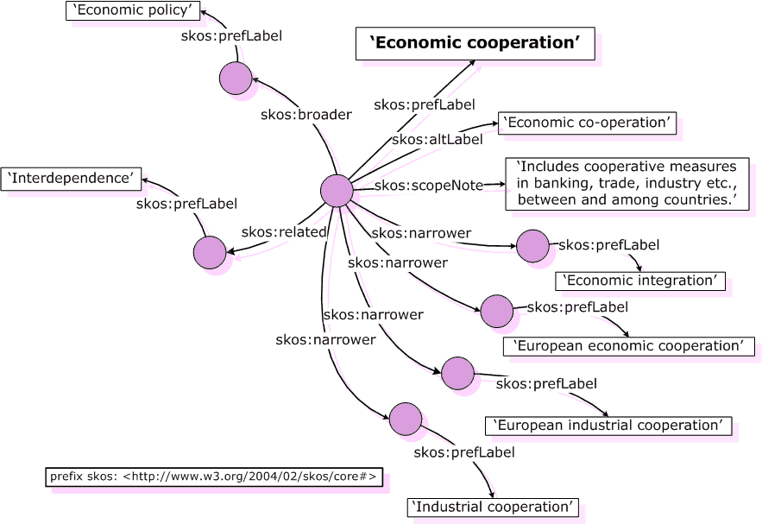
Notes:
Korte SKOS recapitulatie:
Links: termgebaseerd
Rechts: conceptgebaseerd (waarbij de termen labels zijn, gekoppeld aan concepten)
Term-> prefLabel
Used for -> altLabel
Broader, narrower term -> broader, narrower concept
etc

Slide 28
Vocabulaires
GTAA (Beeld en Geluid)
AAT-NED (RKD)
Library of Congress Subject Headings
CLAVAS
  ISO 639-3 language codes
  ISOcat metadata profile
  Organisatie-namen
Getest met enkele andere bestaande SKOS thesauri
Getest met versie van Thesaurus Nationaal Farmaceutisch Museum
??
Overkoepelende registry ontbreekt nog

Slide 29
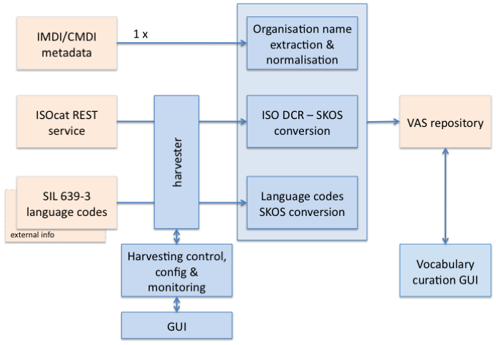
CLARIN-NL: CLAVAS
OpenSKOS

