Slide 1
ISO 12620 Data Category Registry
An introduction
Marc Kemps-Snijdersª, Sue Ellen Wright^{b}, Menzo Windhouwerª
ªMax Planck Institute for Psycholinguistics, ^{b}Kent State University
Marc.kemps-snijders@mpi.nl, sellenwright@gmail.com, menzo.windhouwer@mpi.nl
CLARIN-NL ISOcat workshop
Utrecht
2010-03-25

Slide 2
Data category
The result of the specification of a given data field
  A data category is an elementary descriptor in a linguistic structure or an annotation scheme.
Model consists of 3 main parts:
  Administrative part
    Administration and identification
  Descriptive part
    Documentation and working language
  Linguistic part
    Conceptual domain of object language

Slide 3
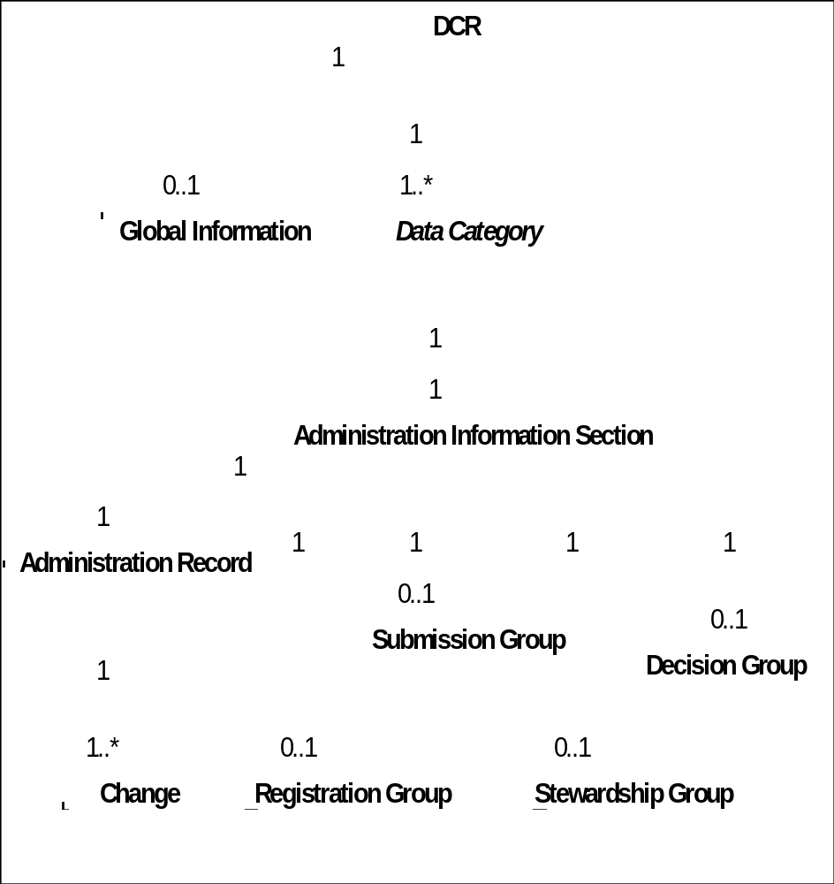
Data category
Administrative part
The DCR is a free service: anyone can access it or register as an expert and create/share his/her own data categories.
Data categories can be submitted to the standardization process, in which case they are assigned to a Thematic Domain Group which judges it.

Slide 4
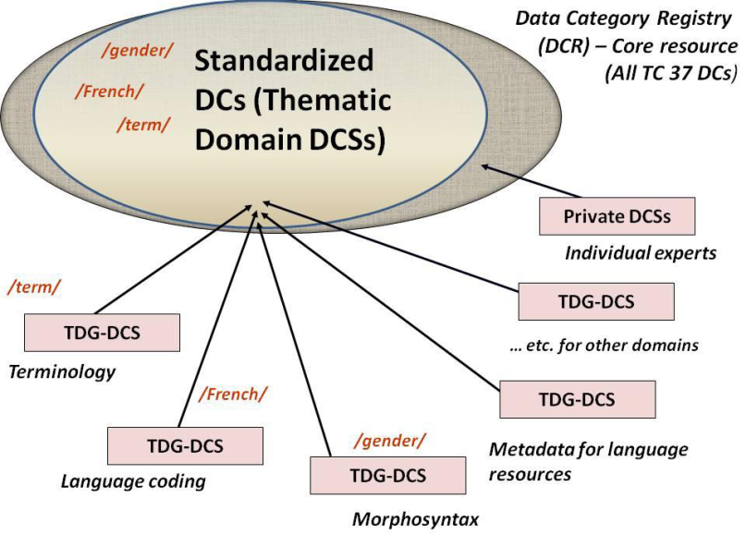
Data category
A short excursion into standardization
Data categories can be submitted to the standardization process, in which case they are assigned to a Thematic Domain Group which judges it.
DCR Board
At regular intervals, snapshots of
the standardized subset of the
DCR will be submitted to ISO.
TDG
terminology
TDG
morphosyntax
TDG
metadata
TDG
…..

Slide 5

Data category
A short excursion into standardization
Decision Group
Submission
group
Thematic Domain
Group
Data Category Registry
Board
Stewardship
group
Evaluation
Validation
rejected
rejected
Publication

Slide 6
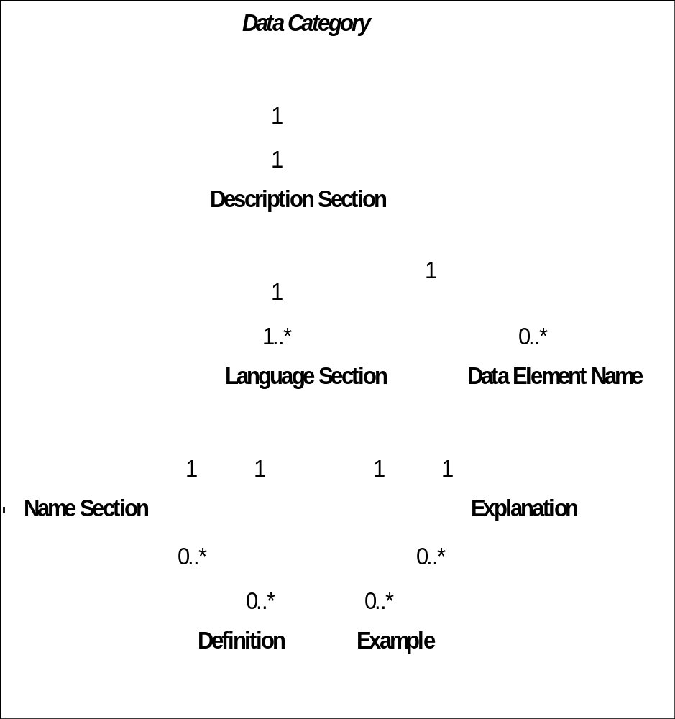
Data category
Descriptive part
Describes working language equivalents
Database, format or application specific data element names

Slide 7
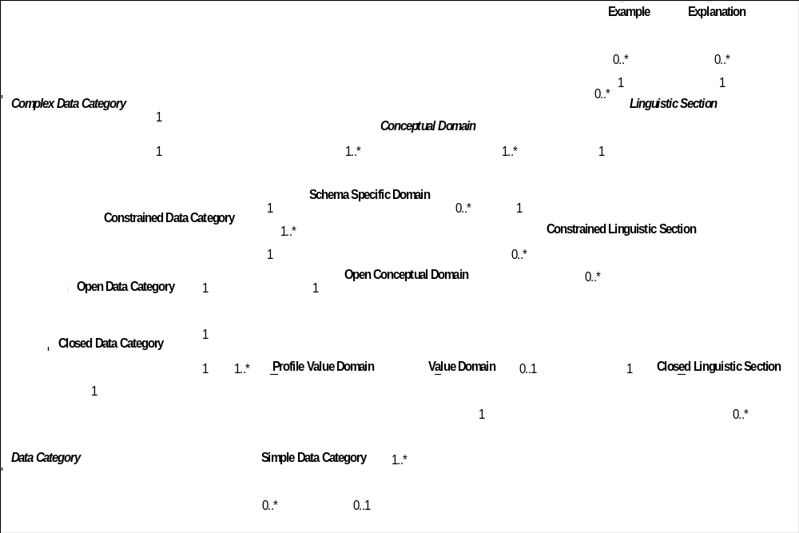
Data category
Linguistic part
Complex and simple data categories are explicitly modeled here
Constraints for a given object language

Slide 8
Data category
Linguistic part (example)
Data category: /Grammatical gender/
  Conceptual domain: /male/, /feminine/, /neuter/
    Lists all admissible values for all languages
  Linguistic Section
    Language: fr
    Value Domain: /male/, /feminine/
    Lists all admissible value for French

Slide 9
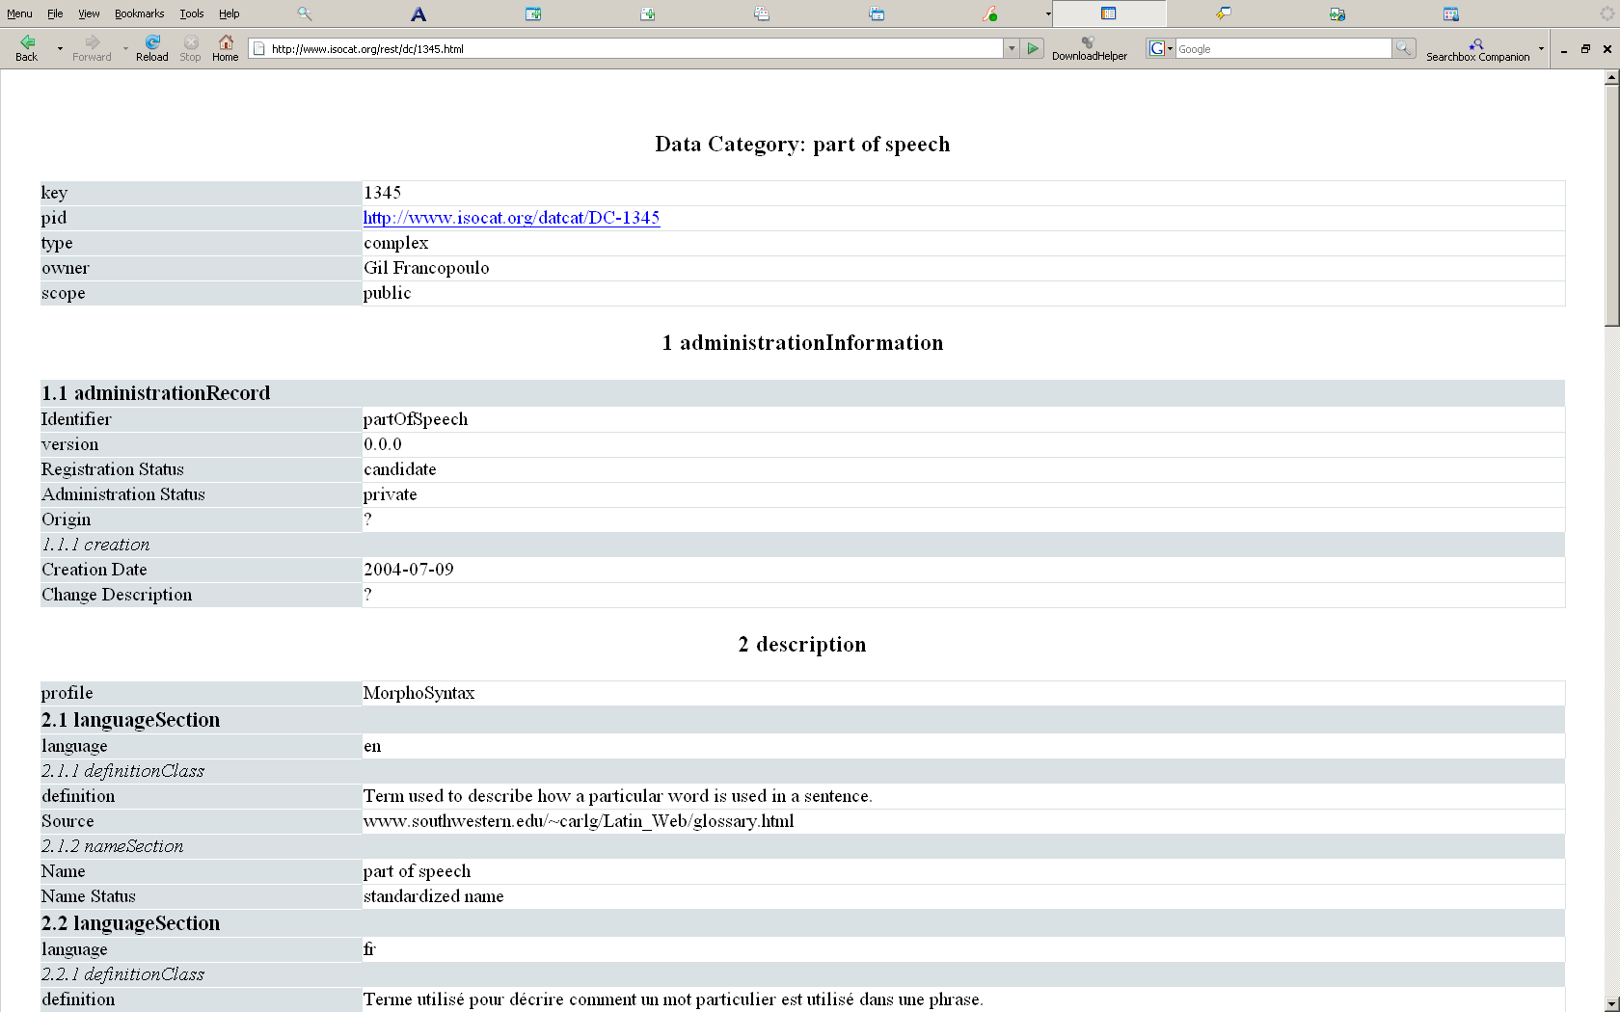
Referencing data categories
Globally unique and persistent identifier
  Cool URIs,
    ownership of www.isocat.org domain is in hands of ISO.
DCIF Example
<dcif:dataCategory pid="http://www.isocat.org/datcat/DC-1345" type="complex">
−
<dcif:administrationInformation>
−
<dcif:administrationRecord>
<dcif:identifier>partOfSpeech</dcif:identifier>
<dcif:version>0.0.0</dcif:version>
<dcif:registrationStatus>candidate</dcif:registrationStatus>
<dcif:origin>?</dcif:origin>
−
<dcif:creation>
<dcif:creationDate>2004-07-09</dcif:creationDate>
<dcif:changeDescription xml:lang="en">?</dcif:changeDescription>
</dcif:creation>
</dcif:administrationRecord>
</dcif:administrationInformation>
−
<dcif:descriptionSection>
<dcif:profile>MorphoSyntax</dcif:profile>
−
<dcif:languageSection>
<dcif:language>en</dcif:language>
−
<dcif:definitionClass>
−
<dcif:definition xml:lang="en">
Term used to describe how a particular word is used in a sentence.
….
…
</</dcif:dataCategory>
http://isocat.org/datcat/ISO-DC-1345
content type HTML
Default content type
303 redirect
DCIF
http://www.isocat.org/rest/dc/1345.html

Slide 10
Annotating linguistic resources
Schema language support for equivalence:
  E.g. ODD from TEI
Annotation using dcr:datcat attribute:
  E.g. RNG schema
<elementSpec ident="pos">
<equiv name="partOfSpeech" uri="http://isocat.org/datcat/ISO-DC-369"/> … </elementSpec>
<rng:element name="partOfSpeech" dcr:datcat="http://isocat.org/datcat/ISO-DC-369" >
<rng:choice>
<rng:value dcr:datcat="http://isocat.org/datcat/ISO-DC-370">
verb
</rng:value>
<rng:value dcr:datcat="http://isocat.org/datcat/ISO-DC-371">
noun
</rng:value>
……
……
</rng:choice>
</rng:element>

Slide 11
Data categories as RDF resources
:headword
dcr:datcat <http://isocat.org/datcat/DC-258> ;
rdfs:label "head word"@en ;
rdfs:comment "A lemma heading a dictionary entry."@en ;
rdfs:label "lemma"@nl ;
rdfs:comment "Het eerste woord van een artikel in een woordenboek."@nl .
:partOfSpeech
dcr:datcat <http://isocat.org/datcat/DC-396> ;
rdfs:label "part of speech"@en ;
rdfs:comment "A category assigned to a word based on its grammatical and semantic properties."@en .
A domain modeling approach:
:headword a rdfs:Class .
:partOfSpeech a rdf:Property ;
rdfs:domain :headword .
Alternative approach:
:headword a rdfs:Class .
:partOfSpeech a rdf:Class.
:hasPartOfSpeech a rdf:Property ;
rdfs:domain :headword
rdfs:range:partOfSpeech.
:noun a partOfSpeech.

Slide 12
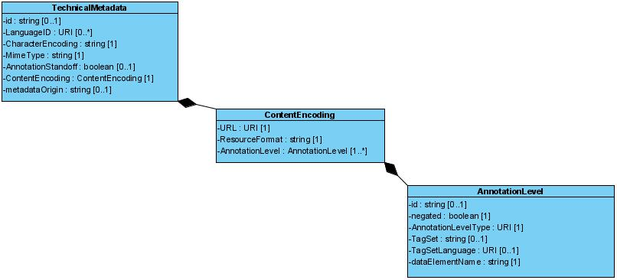
Metadata profiles
Profile
(Resource)
Profile
(Service)
Operation
Parameter
Notes:
30042 has been issued as a standard.

Slide 13
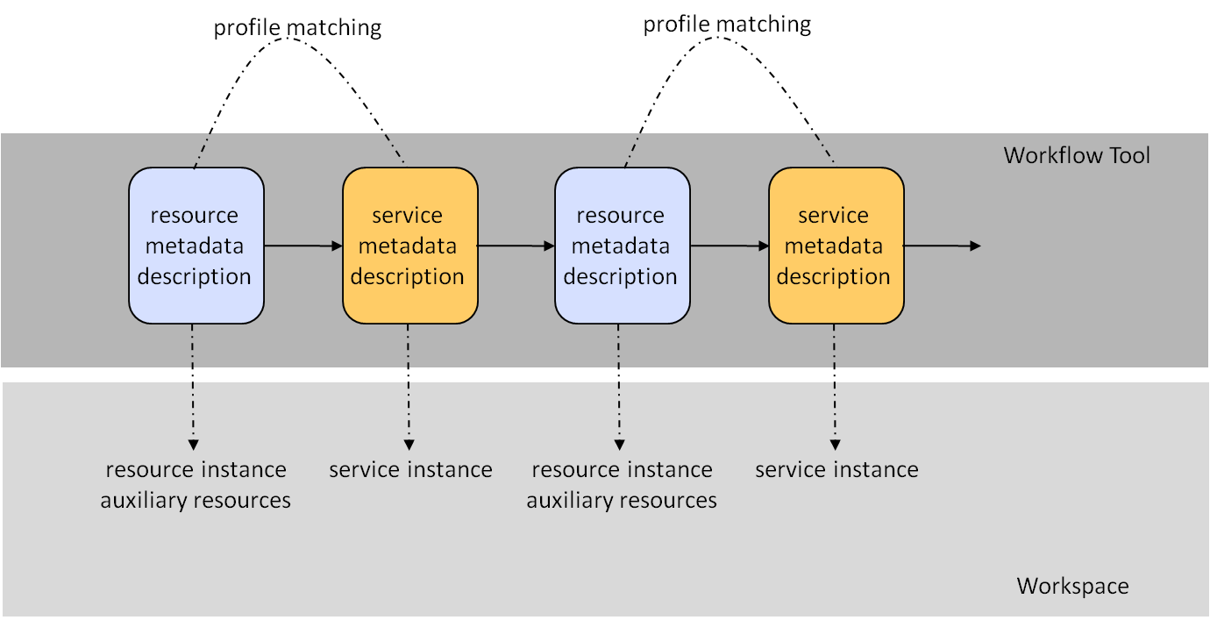
Profile matching
metadata of resources and services are used to identify compliance
if not they should suggest converters, etc.
metadata specifications for web services are used for profile matching
Notes:
30042 has been issued as a standard.

Slide 14



A network of registries
Relation registries
Data Category registries
resource registries

Slide 15
Projects using ISOcat
ISOcat is at the center of CLARIN-EU
  Metadata TDG is currently very active here
In the first project round for CLARIN-NL resources will be annotated using data categories from ISOcat
D-Spin (CLARIN Germany) project is entering STTS tagset
GOLD community is involved to populate ISOcat with data categories derived from GOLD
Notes:
30042 has been issued as a standard.

Slide 16
Thank you for your attention

