Slide 1
ISOcat tutorial
Annotation of various resource types

Slide 2
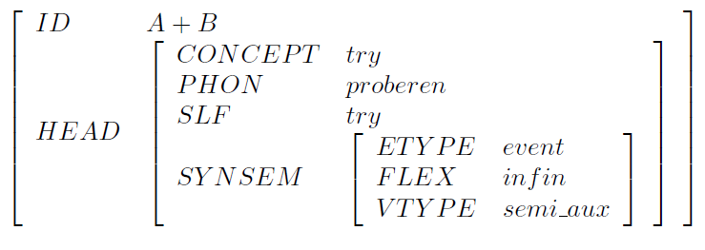
Feature structure
|ID:A+B
|HEAD:|CONCEPT:try
| |PHON:proberen
| |SLF:try
| |SYNSEM:|ETYPE:event
| | |FLEX:infin
| | |VTYPE:semi_aux

Slide 3
TEI feature structure XML vocabulary
ISO 24610-1, http://www.tei-c.org/release/doc/tei-p5-doc/en/html/FS.html
<fs type=“main”>
<f name=“ID”>
<string>A+B</string></f>
<f name=“HEAD”>
<fs type=“head”>
<f name=“CONCEPT”>
<symbol value=“try”/></f>
<f name=“PHON”>
<string>proberen</string></f>
<f name=“SLF”>
<string>try</string></f>
<f name=“SYNSEM”>
<fs type=“synsem”>
<f name=“ETYPE”>
<symbol value=“event”/></f>
<f name=“FLEX”>
<symbol value=“infin”/></f>
<f name=“VTYPE”>
<symbol value=“semi_aux”/></f>
</fs></f>
</fs></f>
</fs>

Slide 4
Feature system declaration
<fsDecl type=“main”>
<fDecl name=“ID” dcr:datcat=“http://www.isocat.org/datcat/DC-1”>
<vRange>
<vNot>
<string/>
</vNot>
</vRange>
</fDecl>
<fDecl name=“HEAD” dcr:datcat=“http://www.isocat.org/datcat/DC-2”>
<vRange>
<fDecl type=“head”/>
</vRange>
</fDecl>
</fsDecl>
<fsDecl type=“head”>
<fDecl name=“CONCEPT” dcr:datcat=“http://www.isocat.org/datcat/DC-3”>
<vRange>
<vAlt>
<symbol value=“try”
dcr:datcat=“http://www.isocat.org/datcat/DC-4”/>
…

