Slide 1
ISOcat tutorial
DCR data model and guidelines

Slide 2
Simple and complex DCs
Data Category
Description Section
Simple Data Category
Complex Data Category
Conceptual Domain

Slide 3
Administrative Information Section
The mandatory identifier
  is a mnemonic string used to refer to the data category
  should be based on a meaningful English word or series of words presented as an alphanumeric character string; for multiword strings, begin with lowercase and express the identifier as one continuous string in camel case with no white space (for instance, /term/, /normativeAuthorization/, /preferredTerm/)
  maybe used in XML vocabularies and thus must be a valid local part of a qualified name:
    Cannot start with a number, shouldn’t contain any whitespace, …
ISOcat warns you when the identifier is invalid and will refuse to save the data category
Notes:
Show a example of multiple XML vocabularies using the same identifier
Where to introduce the PID?

Slide 4
Administrative Information Section
The mandatory version
  used to refine identifier to indicate the version of the data category
  managed by the system
  based on branching not on major and minor revisions
1:0
1:1
2:0
3:0
1:2
2:1
3:1
2:1:1
2:1:2

Slide 5
Administrative Information Section
The mandatory data category type
  complex/open
    conceptual domain is not restricted to an enumerated set of values
  complex/constrained
    conceptual domain is non-enumerated, but is restricted to a constraint specified in a schema-specific language or languages
  complex/closed
    conceptual domain is restricted to a set of enumerated simple data categories making up its value domain
  simple

Slide 6
Data category types
complex:
open
closed
constrained
writtenForm
grammaticalGender
email
string
string
string
Constraint: .+@.+
neuter
feminine
masculine
simple:

Slide 7
Administrative Information Section
The justification
  a short description justifying why the data category should be included in the registry
  mandatory for data categories to be standardized; desirable in general
  even data categories that are common in a given thematic domain may be unfamiliar or ambiguous to users unfamiliar with that domain

Slide 8
Administrative Information Section
The origin
  (document, project, discipline or model) for the data category specification

Slide 9
Administrative Information Section
The mandatory administration status
  a designation of the status in the administration process for handling registration requests under the stewardship of the DCR Board
  managed by the system
  values:
    private
    submission
    pre-evaluation, evaluation, rejected-TDG, accepted-TDG
    pre-validation, validation, rejected-DCR Board
    accepted

Slide 10
Standardization process
Submission
group
Thematic Domain
Group
Data Category Registry
Board
Stewardship
group
Evaluation
Validation
Publication
ISO

Slide 11
Administrative Information Section
The mandatory registration status
  a designation of the status in the registration life-cycle of an administered item
  managed by the system
  values:
    private
    candidate
    standard
    superseded
    deprecated
1:0
1:1
2:0
3:0
1:2
2:1
3:1
2:1:1
2:1:2
Notes:
Replace the version tree by a tree showing how a DC gets standardized

Slide 12
Administrative Information Section
The effective date
  the date a data category specification has/will become available to DCR users
The until date
  the date a data category specification is no longer effective in the registry; this information is set when the registration status of the data category specification changes to deprecated or superseded
ISOcat isn’t acting on these dates (yet)

Slide 13
Administrative Information Section
The explanatory comments
  descriptive comments about the data category specification
The unresolved issues
  a problem that remains unresolved regarding proper documentation of the data category specification

Slide 14
Description Section
The mandatory profile
  attribute used to relate the current data category specification to one or several thematic domains treated by ISO/TC 37 (for example, morphosyntax, syntax, metadata, language description, etc.)
  the value of profile defaults to Private
  submission for standardization requires the selection of at least one thematic domain profile because it is the relevant TDG that is responsible for maintenance of standardized data category specifications
  if multiple profiles from multiple TDGs are selected one TDG will still be responsible, but the other TDGs will be involved in the harmonization process
  if a user desires to create a new profile, consult the DCR Board

Slide 15
Profiles and TDGs
Each Thematic Domain Group (TDG) manages at least one profile
The following TDGs are active:
  Metadata
  Morphosyntax
  Terminology
The Language codes profile will be maintained separately and hooked up to ISOcat
Other TDGs and their profiles are still asleep
ISOcat will host a forum in the near future, which also includes the functionality to send users, i.e., an owner of a DC or the chair of a TDG, an email

Slide 16
Data Element Name Sections
used to record names for the data category as used in a given database, format or application
language independent
attributes:
  the mandatory data element name
    one identifier (word, multi-word unit or (alpha)numeric representation
  the mandatory source
    the database, format or application in which the data element name is used
ISOcat will future have better support for keeping sources in sync

Slide 17
Working and object languages
Working language:
  language used to describe objects
Object language:
  language being described
You can describe properties of the object language French in the working language Dutch:
In de Franse taal worden vrouwelijke en mannelijk zelfstandige naamwoorden onderscheiden.

Slide 18
Working and object languages
Simple Data Category
Data Category
Complex Data Category
Description Section
Conceptual Domain
*
*
Language Section
Linguistic Section
working language
object language
Notes:
Indicate which parts deal with working language, and which parts deal with object language

Slide 19
Language Section
The English language section is mandatory and has to contain at least one name and one definition
Additional language sections can be added as needed, and should translate at least the definition of the English language section
  if a user needs an additional language, contact the DCR system administration

Slide 20
Language Section
The Name Section
  records a possible name for the data category in a specific language
  status:
    standardized name
    preferred name
    admitted name
    deprecated name
    superseded name

Slide 21
Language Section
The Definition Section
  definition of the data category concept associated with the data category, written in the language of the language section
  attributes:
    definition:
      definitive formulation that should be general enough to apply to all thematic domains and implementations of the data category
    source:
      from which the definition has been borrowed or adapted
    note:
      any additional information about the definition

Slide 22
ISO 704 Terminology work — principles and methods
Intensional definitions:
  They should consist of a single sentence fragment;
  They should begin with a meaningful broader concept, either immediately above or at a higher level of the data category concept being defined;
  They should list critical and delimiting characteristic(s) that distinguish the concept from other related concepts.
Actual concept systems, such as are implied here by the reference to broader and related concepts, should be modeled in Relation Registries outside the DCR. Furthermore, different domains and communities of practice may differ in their choice of the immediate broader concept, depending upon any given ontological perspective. Harmonized definitions for shared DCs should attempt to choose generic references insofar as possible.

Slide 23
Language Section
The examples
  a sample instance reflecting the data category
  should be limited to those that illustrate the data category in general, excluding language specific usage, which should be documented in a Linguistic Section
  may be accompanied by the source of the example
The explanations
  any additional information about the data category that would not be relevant for a definition (for example, more precise linguistic background concerning the use of the data category)
  may be accompanied by the source from which the explanation has been borrowed or adapted
The notes
  any additional information associated with the data category, excluding technical information that would normally be described in an explanation

Slide 24
Conceptual domains
Complex Data Category
Linguistic Section
Conceptual Domain
+
*
*
Constrained Data Category
Constrained Linguistic Section
Schema Specific Domain
+
*
*
Open Data Category
Closed Linguistic Section
Open Conceptual Domain
+
*
*
Closed Data Category
Value Domain
+
Simple Data Category
+

Slide 25
Conceptual domains
The mandatory data type
  the data type, as defined for W3C XML Schema, of this complex data category
  the default data type is string
Just the data type is enough for an open data category
Notes:
List the other data types or show the W3C XML Schema type hierarchy

Slide 26
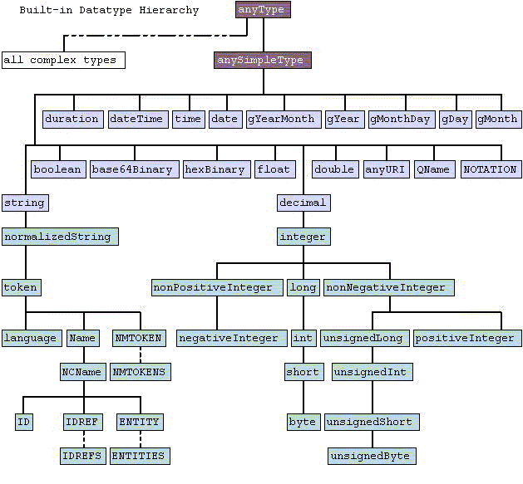
W3X XML Schema data types

Slide 27
Constrained Conceptual Domain
The mandatory constraint:
  allows users to express constraints on the possible values of a conceptual domain associated with a given data type in a rule language suitable for the schema in question
  rule languages currently ‘supported’:
    Schematron
    Object Constraint Language
    Semantic Web Rule Language
    Relax NG
  the DCR doesn’t do any interpretation of the rules, this has to be done by the user/TDG/DCR Board
ISOcat does check if its valid XML (when applicable)
ISOcat’s DCIF export is somewhat incomplete in this area: constraints expressed in XML are outputted as one text block instead of being an integrated part of the DCIF document

Slide 28
Profile value domains
Closed Data Category
+
Profile Value Domain
Value Domain
+
Simple Data Category

Slide 29
Profile Value Domain
set of permissible values for a specific profile
each value is represented by a simple data category
the simple data category needs to be a member of the profile
ISOcat makes an exception for the Private profile value domain which can contain any simple data category
Standardized data categories can’t have a Private profile value domain
ISOcat tries to simplify the creation of the value domain by automating the assignment to profile value domains. However, at the moment this is too simplistic and a more advanced editor is needed to fully manage profile value domains.

Slide 30
Example
Data category | Morposyntax | Terminology
/partOfSpeech/ | X | X
/adjective/ | X | X
/ordinalAdjective/ | X
/participleAdjective/ | X
/qualifierAdjective/ | X
/adposition/ | X | X
/circumposition/ | X
/preposition/ | X
/postposition/ | X
Notes:
An example of profile value domains: finer granularity for PoS for Morphosyntax, coarser for Terminology

Slide 31
Linguistic Sections
used to specify the behaviour of a complex data category in a specific object language
Language specific examples, explanations and notes
Refinement of the conceptual domain:
  (additional) constraints for open and constrained complex data categories
  subset value domains for closed complex data categories

Slide 32
Example
/grammaticalGender/ has as (profile specific) value domain:
  /masculine/
  /feminine/
  /neuter/
The French linguistic section limits it to:
  /masculine/
  /feminine/
Notes:
The grammatical gender example

Slide 33
Hierarchical Simple Data Categories
Simple data categories can be put in a subsumption (is-a) hierarchy
  allows different levels of granularity in a value domain
  make large value domains manageable
  a simple data category can be only a member of one hierarchy, i.e., it can have only one parent

Slide 34
Changes
Each time you save a data category you’re asked to enter a description of what you’ve changed
These descriptions are available in the history log of each data category
The DCIF contains the first (upon time of creation) and the last change description

Slide 35
Checker
Not all mandatory parts of the specification has to be filled at once
The check will tell you what is still missing
Some errors or warnings can only be fixed by issues change requests to a standardized data category
  Membership of another profile

