Slide 1
Content of the Data Category Registry

Slide 2
Data Category Registry (DCR)
Set of Data Categories (DCs) describing, for example, linguistic annotation schemes, metadata, at several levels/thematic domains
  Morphosyntax
  Syntax
  Terminology
  …
ISOcat as a whole is a DCR

Slide 3
Thematic Domains (TD) and Groups
TDs Contain Data Category Selections (DCS)
  Data Categories within a specific domain (like everything for terminology),
Apart from TDs as reflected by ‘Thematic Views’ in browser pane: ‘groups’
  A subset of DCs, like all DCs for a specific project
The latter strategy will be followed in CLARIN-NL , making the definitions used in existing corpora etc available
first “private/SHARED”, later “public”

Slide 4
Groups
Group: morphosyntax
  Entries for:
    CGN (Corpus of Spoken Dutch)
    SoNaR (reference Corpus for Dutch)
    Finnish project XYZ
    Austrian …
  ALL concept used are to be included, those needed in the definitions themselves included!!

Slide 5
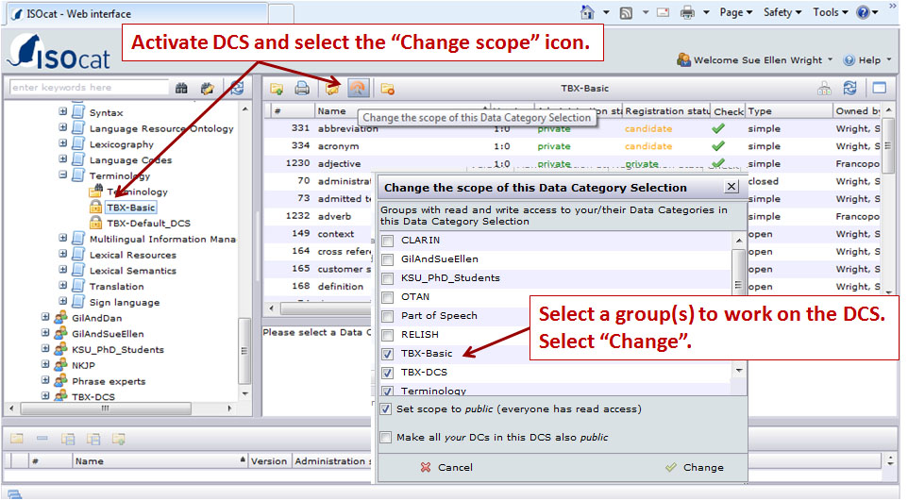
Groups

Slide 6
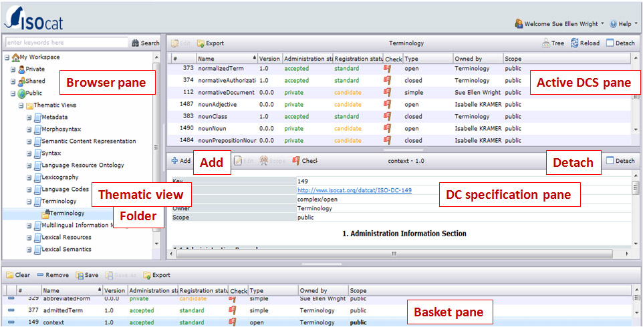
ISOcat panes

Slide 7
CLARIN-NL/VL project level
Make DCs for all concepts, for example for ‘particple adjective’
Note:
  in running text: /participle adjective/
  in identifier: participleAdjective
    Make use of camelCase !
  in Data Element Name: participle adjective
For CLARIN-NL (and VL)
  Make use of Shared CLARIN-NL group !

Slide 8
Language to be used in DC
identifier, etc
  Standard in English
    ALSO when your tagset is defined in another language!
  Your tagset “eigennaam” (Dutch)
  => /proper noun/, properNoun, proper noun
  But: names in other languages can be added elsewhere.
Data Element Name is the literal as used in an application/domain

Slide 9
Definition to be used
The ideal case:
  There is already a good, standardized definition available which you can reuse
  Note: this definition should express what is expressed in your application as well!
  Een galopperend paard (a galloping horse)
  participle adjective (key 1595) i.e. an adjective
  WW(od,prenom,zonder), i.e. a verb

Slide 10
Definition to be used (2)
No perfect/good definition available?
  In case this should/could be fixed
    We are to negotiate with the owner and try to have it adapted
    CLARIN-NL/VL: contact the ISOcat coordinator (Ineke)
  In case of a more fundamental mismatch, come up with a definition yourself
    (like verb vs adjective)

Slide 11
New definition
New definition?
Guidelines:
English
One (1) sentence fragment
  “Element which is used …”
  “STTS tag for attributive adjective”
  “A noun or adjective denoting…”
Do not mention the concept to be defined
zuInclusion =/= inclusion of zu
adjective =/= Adjective
[cont.]

Slide 12
New definition (2)
Guidelines (cont.):
Provide a generic definition whenever possible
  Especially when a definition was still lacking, not ‘wrong’
Mention relevant characteristics
Start with reference to superordinate concept
  “ Pronoun referring to person” for pers.pronoun
Be as “language neutral” as possible
  No exotic languages in definition, unless …

Slide 13
Other aspects of new entries
Come up with an (mnemonic) identifier
  Not necessarily unique (unlike key)
Justify the new entry: why is it important
  (not: why is existing entry bad !)
Origin: BNC, Chomsky, ISO, …
Provide set of valid values (if applicable) in Conceptual Domain
  Gender: masculine, feminine, neutral, other

Slide 14
Other aspects of new entries (2)
Optional:
Note section
1424 verb
note: A verb in a lot of languages expresses morphological features …
Explanatory section
2794 ADIA
explanation General rule: The ADJA class contains …

Slide 15
Profile
Profile:
  Indicates which Thematic Domain is involved, this can be more than one:
    /Part of Speech/ (key 1345):
      Terminology, morphosyntax
  In such a case: try to come up with one DC instead of several ones by adding several profiles to one and the same concept
Failing profile makes it difficult to find a concept
  /participant age range/

Slide 16
Language/linguistic sections
Do not confuse these !!
English/Dutch/Finnish Language Section
  The English section presents the definition (etc.)
  In the other languages a translation is provided,
  Also for the ‘concept’ itself
  proper noun => eigennaam
  The definition remains in se the same!

Slide 17
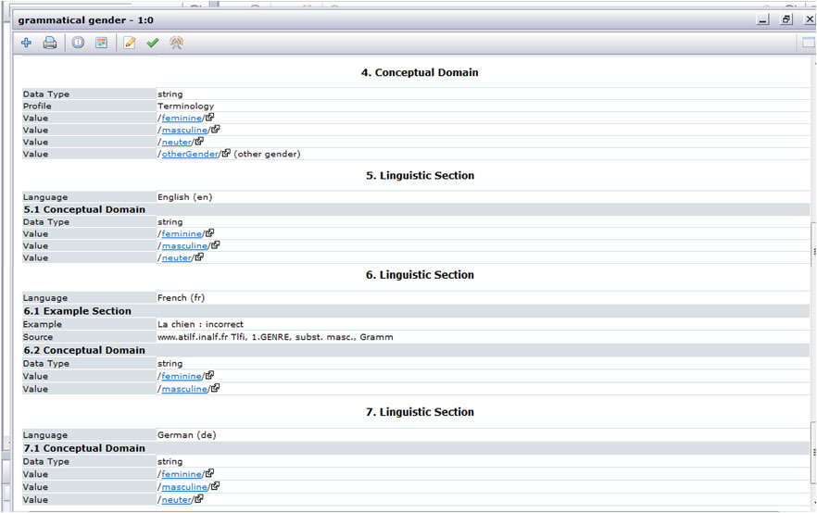
Linguistic Section

Slide 18
Linguistic Section (2)
Not always available
Here relevant values for a specific language can be added
Also possibility to provide language specific examples
Notes:
Menzo: ik zou deze verwachten bij veel/alle closed, maar lijkt niet zo te zijn !

Slide 19
General
Start in ‘Private’
  CLARIN NL: share your info with the other projects in order to avoid all kinds of problems!
Public
  At a later moment the data can be made public.
  In the end (part of the) DCs may be submitted for standardization (others may be too specific)

